Slide 1
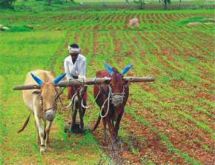
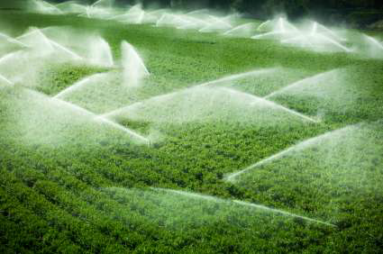
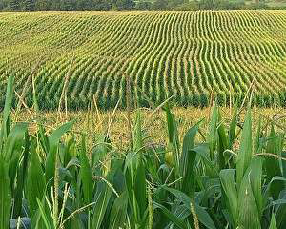
Farming Based Livelihood Systems
Topic: Livelihood: definition, principles, indicators, assets
B.Sc. (Hons.) Ag.
Year: First Semester: First
Credit hrs: 2+1
Course instructor: Dr. P. K. Tyagi

Slide 2
Farming Based Livelihood Systems
Livelihood: definition & concept
What is a livelihood
(आजीविका)?
“Making a living”, “supporting a family”, or “my job” all describe a livelihood.
Livelihood is defined as a set of activities necessary for daily life.
A livelihood comprises the capabilities, assets (including both material and social resources) and activities required for a means of living.
A livelihood is sustainable when it can cope with and recover from stress and shocks and maintain or enhance its capabilities and assets both now and in the future, while not undermining the natural resource base.

Slide 3
Farming Based Livelihood Systems
Livelihood: definition & concept
What is a livelihood
(आजीविका)?
An activity people engage in for a living.
Way to earn money for food, cloth, place and basic needs is known as livelihood.
It depends upon the capability of an individual person, efforts, and hard work.
Livelihood should be sustainable if people enhance their well-being and proper use of natural resource.

Slide 4
Farming Based Livelihood Systems
Livelihood: definition & concept
Principle of livelihood
The principle of livelihood should aim at the provision of nutrition for all the people.
Moreover, it should also provide cheap clothing, shelter and means of travel for the people.
Principle of sustainable livelihood
Sustainable livelihoods provide meaningful work that fulfills the social, economic, cultural and spiritual needs of all members of a community.

Slide 5
Farming Based Livelihood Systems
Livelihood: definition & concept
Need of livelihood systems
Livelihood systems are important because they can help people and communities in many ways, including:
Economic growth
Livelihood programs can create jobs,
encourage entrepreneurship & support
local economies.
Poverty reduction
Livelihood programs can help people break
the cycle of poverty and improve their
living conditions.

Slide 6
Farming Based Livelihood Systems
Livelihood: definition & concept
Need of livelihood systems
Community development
Livelihood programs can strengthen
communities, foster social cohesion, and help
people participate in decision-making.
Environmental sustainability
Livelihood programs can promote sustainable
agriculture, renewable energy, and
responsible use of natural resources.
Social empowerment
Livelihood programs can help people gain the
resources, knowledge, and skills they need to
improve their lives.

Slide 7
Farming Based Livelihood Systems
Livelihood: definition & concept
Need of livelihood systems
Building resilience
Livelihood programs can help people
develop the tools and resources they
need to deal with crises and shocks.
Thus Livelihoods are an important part of
human existence, and they are needed to
sustain and support households.
Shocks like natural disasters and disease
outbreaks can affect livelihoods, and people
need the resources to deal with these shocks.

Slide 8
Farming Based Livelihood Systems
Livelihood: definition & concept
Livelihood Assets
(आजीविका परिसंपत्तियां)
Livelihood assets (LA) are the Capabilities, Assets & Activities needed for living.
Assets may be tangible (physical), such as food stores and cash savings, as well as trees, land, livestock, tools, and other resources.
Assets may also be intangible (social) such as claim one can make for food, work, and assistance as well as access to materials, information, education, health services and employment opportunities.

Slide 9
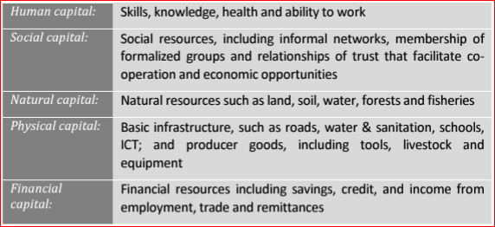
Farming Based Livelihood Systems
Livelihood: definition & concept
These assets (components) are interlinked and affected by external policies, institutions & processes.
These assets help people cope with adversity and hedge against risk.

Slide 10
Farming Based Livelihood Systems
Livelihood: definition & concept
Indicators to study livelihood systems
Livelihood capital
A farmer's choice of livelihood strategies is
influenced by their livelihood capital status
and how they use it
Human assets
Assets can help protect people's livelihoods
from shocks, but shocks can also cause
people to lose their assets.

Slide 11
Farming Based Livelihood Systems
Livelihood: definition & concept
Indicators to study livelihood systems
Human capital
The sustainable livelihood approach to poverty reduction focuses on the factors that determine or constrain people's access to resources and assets.
Sustainable livelihood index (SLI)
A composite measure that can give an idea of
the extent of livelihood sustainability.
Economic efficiency index
The economic efficiency of a state is
important because it contributes to the
state's GDP.

Slide 12
Farming Based Livelihood Systems
Livelihood: definition & concept
Indicators to study livelihood systems
Livelihood diversification
A key indicator of livelihood strategies,
diversification can help spread risk and
reduce vulnerability
Annual change in household income
This is a key indicator of the stability of
livelihood.

Slide 13

Farming Based Livelihood Systems
Duck –Fish Farming System

