Slide 1
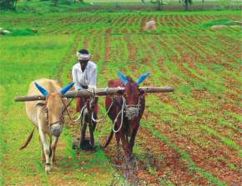
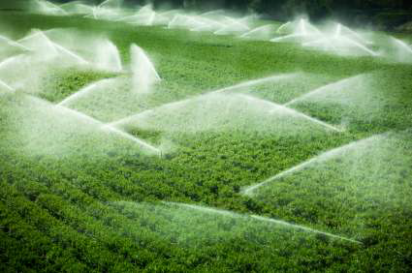
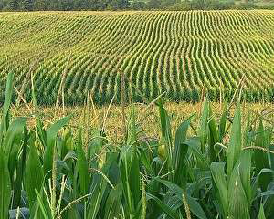
Farming Based Livelihood Systems
Topic: Agricultural Livelihood Systems (ALS): Meaning, Approach & Framework
B.Sc. (Hons.) Ag.
Year: First Semester: First
Credit hrs: 2+1
Course instructor: Dr. P. K. Tyagi

Slide 2
Farming Based Livelihood Systems
Agricultural Livelihood Systems (ALS)
Agricultural Livelihood Systems (ALS)
ALS is a livelihood system mainly based on
agricultural activities such as crop and livestock
ALS refers to the integrated & holistic approach to
managing agricultural activities that contribute
to the economic & social well-being of
individual & communities.
This system is vital in rural areas where agriculture is a primary source of income, food security and cultural identity.

Slide 3
Farming Based Livelihood Systems
Agricultural Livelihood Systems (ALS)
Agricultural Livelihood Systems (ALS)
ALS encompass the various agricultural-based activities and strategies employed by households and communities to shape the living conditions of individuals who depend on agriculture for their sustenance. It includes:
Farming activities
Income diversification strategies
Access to markets, inputs
Support services

Slide 4
Farming Based Livelihood Systems
Agricultural Livelihood Systems (ALS)
Types of ALS
Poor-income, landless & subsistence-based farms
2. Medium-income farms
3. Better-off income farms
Factors affecting ALS
Weather : Weather abnormalities can affect
the livelihood of small and marginal
farmers, who make up more than
80% of all farmers.

Slide 5
Farming Based Livelihood Systems
Agricultural Livelihood Systems (ALS)
Factors affecting ALS
Farm resource : Farmers may not know
recycling how to recycle organic wastes
from farms, industries, and
municipalities, which can be
used to improve soil health.
Crop diversification: Factors that can drive crop
diversification include
household heads‘ agricultural
experience, education levels,
income sources, and
proximity to markets.

Slide 6
Farming Based Livelihood Systems
Agricultural Livelihood Systems (ALS)
Core Components of ALS
Natural Resources
Human Resources
Financial Resources
Social & Institutional Support
Physical Infrastructure
Market and Trades

Slide 7
Farming Based Livelihood Systems
Agricultural Livelihood Systems (ALS)
Approaches to ALS
Farming systems : Focuses on the farm as a holistic
approach system, considering interactions
between crops, livestock, soil,
water & socio-economic factors.
It aims at optimizing resource use for sustainable productivity.

Slide 8
Farming Based Livelihood Systems
Agricultural Livelihood Systems (ALS)
Approaches to ALS
Sustainable : SLA views livelihood in a broader
Livelihood socio-economic context, focusing
Approach on how people use assets
(natural, financial, human, social,
physical) to develop livelihood
strategies & reduce vulnerabilities.
Agro-ecological : It integrates ecological principles
Approach into agricultural systems.
It promotes biodiversity, organic inputs and traditional knowledge to enhance the resilience and productivity of agricultural ecosystems.

Slide 9
Farming Based Livelihood Systems
Agricultural Livelihood Systems (ALS)
Approaches to ALS
Value : It seeks to improve the entire
Chain agricultural value chain from
Approach production to marketing by linking
smallholder farmers to markets,
improving access to inputs and
increasing value addition.
Integrated : It combines agricultural
Rural development with other rural
Development sectors (health, education,
Approach infrastructure) to create synergies
that improve the overall well-being
of rural communities.
.

Slide 10
Farming Based Livelihood Systems
Agricultural Livelihood Systems (ALS)
Approaches to ALS
Climate-smart : CSA aims to increase agricultural
Agriculture productivity and incomes,
(CSA) build resilience to climate change
and reduce greenhouse gas
emissions through the promotion
of climate adaptive practices.

Slide 11
Farming Based Livelihood Systems
Agricultural Livelihood Systems (ALS)
Framework of ALS
Assets : Households rely on five types of capital:
natural, physical, financial, social and
human.
These assets are used to formulate strategies to improve livelihood.
Vulnerability : Factors such as climate variability
context economic instability, policy change
and market fluctuations that
influence livelihoods and shape the
environment in which households
operate.

Slide 12
Farming Based Livelihood Systems
Agricultural Livelihood Systems (ALS)
Framework of ALS
Transforming Structures and Processes
These include government institutions, private sector, non-governmental organizations (NGO’s) and international agencies that provide resources, implement policies and other services that influence ALS outcomes.
Livelihood strategies
These are the various activities and choices people make to achieve livelihood goals, including crop production, livestock rearing, wage labour, and income diversification through non-agricultural activities.

Slide 13
Farming Based Livelihood Systems
Agricultural Livelihood Systems (ALS)
Framework of ALS
Transforming Structures and Processes
These include government institutions, private sector, non-governmental organizations (NGO’s) and international agencies that provide resources, implement policies and other services that influence ALS outcomes.
Livelihood strategies:
These are the various activities and choices people make to achieve livelihood goals, including crop production, livestock rearing, wage labour, and income diversification through non-agricultural activities.

Slide 14
Farming Based Livelihood Systems
Agricultural Livelihood Systems (ALS)
Framework of ALS
Livelihood outcomes:
The outcomes of ALS strategies are measured in terms of
increased income,
food security,
reduced vulnerability,
sustainable resource management and
improve well-being.

Slide 15
Farming Based Livelihood Systems
Agricultural Livelihood Systems (ALS)
Conclusion
ALS is a complex and multi-dimensional concept that integrates agricultural production, socio-economic factors and sustainability considerations.
Through various approaches and framework, ALS seeks to enhance the livelihoods of rural communities, ensuring resilience, environmental stewardship, and equitable development.
ALS is dynamic, adapting to changing environmental, economic and social conditions to provide a sustainable path for agricultural-dependent populations.

Slide 16

Farming Based Livelihood Systems
Agricultural Livelihood Systems (ALS)

