Slide 1
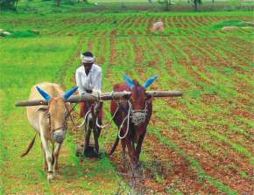
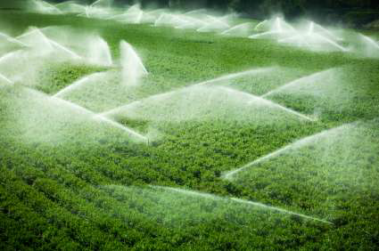
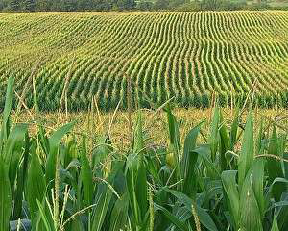
Farming Based Livelihood Systems
Topic: Duck – Fish Farming System
B.Sc. (Hons.) Ag.
Year: First Semester: First
Credit hrs: 2+1
Course instructor: Dr. P. K. Tyagi

Slide 2
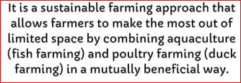
Farming Based Livelihood Systems
Duck –Fish Farming System
What is Duck-cum Fish System?
The duck-fish farming system is a type of integrated farming practice where ducks and fish are raised together in the same ecosystem.
Or
The rearing of duck is combined with fish culture by constructing duck housing units on the pond embankment or over the pond in such a way that the wastes are directly drained into the pond.
This system is often referred to as “aquaculture-agriculture integration” or “duck-fish pond farming.”

Slide 3
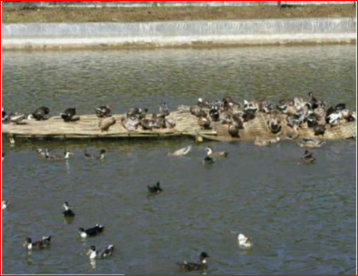
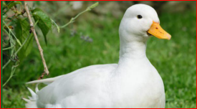
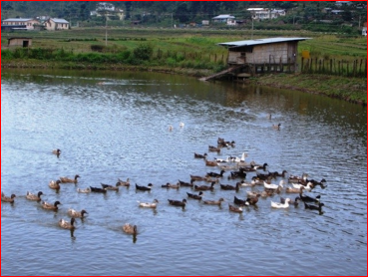

Farming Based Livelihood Systems
Duck –Fish Farming System

Slide 4
Farming Based Livelihood Systems
Duck –Fish Farming System
Advantages of duck-cum-fish farming
• Ducks are highly compatible with fishes.
• Fish utilizes the feed spilled by ducks and eat their droppings directly by some fishes.
• Ducks called as manuring machine as they fertilize the ponds by their droppings saving the expenditure involved in labour in applying manure in the pond.
• Ducks keep water plants in check.
• Save fertilizer cost.
• Save supplementary feed cost (account 60%).
• Duck get its required quantity of water from the fish pond.

Slide 5
Farming Based Livelihood Systems
Duck –Fish Farming System
• Aerate the water while swimming hence called Biological aerator.
• Ducks increases the pond productivity by releasing the nutrients from the pond bottom soil through dabbling the pond bottom mud.
• From the same places at the same time duck meat & eggs and also the fish can be produced.
• Duck get 50- 75% of their total feed requirement from the pond itself in the form of aquatic weeds, insects, mollusks, etc. which do not form the food of the fish.

Slide 6
Farming Based Livelihood Systems
Duck –Fish Farming System
Integrated farming of fish and duck can be divided into 2 groups:
◻ Fish culture practice
◻ Duckery farming practice
Fish culture practice
Fish, such as Tilapia, catfish, carp or shrimpa are raised in ponds or water bodies, where they are provided with food and clean water.
The fish are typically farmed in controlled environment, often in earthen ponds or tanks, depending on the available resources.

Slide 7
Farming Based Livelihood Systems
Duck –Fish Farming System
Duckery farming practice
Ducks are allowed to roam over or near the fish pond. Ducks can be kept in pens or free-range, depending on the system’s design and the desired management style.
Ducks have access to the water where they can search for insects, small aquatic organisms, and plant, which provides additional feed for them.

Slide 8
Farming Based Livelihood Systems
Duck –Fish Farming System
Stocking Density and Pond size
Fish stocking density
Depending upon the pond size and the species of fish, a typical stocking density might range from 1 to 3 fish/m².
Pond size
The size of pond should be adequate to support both fish and ducks without overcrowding.
Generally, 1-2 ducks/100 m² of pond area are recommended.

Slide 9
Farming Based Livelihood Systems
Duck –Fish Farming System
Shelter
Ducks need a dry place to rest and shelter at night.
This can be a floating raft, a land-based structure, or a pen adjacent to the pond.
The shelter should be secure from predators and weather elements.

Slide 10
Farming Based Livelihood Systems
Duck –Fish Farming System
Water Quality Management
The pond needs to have proper aeration, especially if the water gets turbid or the fish are stocked densely.
Aeration can help improve oxygen levels for the fish and maintain healthy pond conditions.

Slide 11
Farming Based Livelihood Systems
Duck –Fish Farming System
_{Feeding Strategy}
Ducks
Ducks are primarily fed grains (corn, rice or wheat) and supplements, but they also forage for aquatic plants, insects and small fish.
They are generally free to forage in the pond, adding diversity to their diet.

Slide 12
Farming Based Livelihood Systems
Duck –Fish Farming System
_{Feeding Strategy}
Fish
Fish are fed commercial feed or natural foods available in the pond (plankton, algae).
Farmers can supplement fish feed with duck-manure-drived nutrients that enrich the pond water, improving natural food sources.

Slide 13
Farming Based Livelihood Systems
Duck –Fish Farming System
Health and disease Management
Disease control
The close proximity of ducks and fish means that farmers need to be cautious about disease transmission.
Good water management, maintaining appropriate stocking densities, and preventing overfeeding are essential to minimize the risk of disease outbreaks..

Slide 14
Farming Based Livelihood Systems
Duck –Fish Farming System
Health and disease Management
Parasites control
Ducks may introduce external parasites into the pond, so monitoring both ducks and fish for parasitic infections is important.
A regular cleaning and water change schedule can help to reduce parasite loads in the pond.

Slide 15
Farming Based Livelihood Systems
Duck –Fish Farming System
Harvesting
Ducks
Ducks can be harvested for meat, eggs or feathers. Depending upon the breed and farming system, they my be sold at market as either live birds or processed.
Fish
Fish are typically harvested when they reach market size.
Harvesting is done carefully to minimize stress on the fish and ducks.

Slide 16

Farming Based Livelihood Systems
Duck –Fish Farming System

