Slide 1
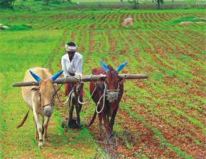
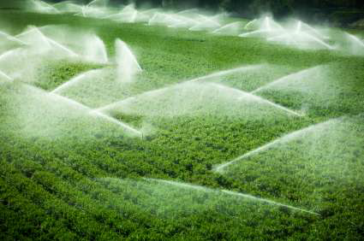
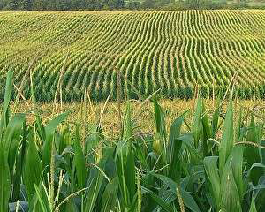
Farming Based Livelihood Systems
Topic: Status of agriculture in India & different states, income of farmers and rural people in India
B.Sc. (Hons.) Ag.
Year: First Semester: First
Credit hrs: 2+1
Course instructor: Dr. P. K. Tyagi

Slide 2
Farming Based Livelihood Systems
Status of agriculture in India & different states
Land use pattern in India (mha)
Total geographical area | : | 328.73*
*Land use statistics available | : | 306.0 (93%)
Net sown/cultivated area | : | 141.0 (46%)
Total forest area | : | 72.0 (24%)
Non-agricultural Land | : | 28.0 (9%)
Fallow land | : | 25.0 (8.0%)
Barren & uncultivated Land | : | 17.0 (5.5%)
Culturable Waste Land | : | 12.0 (4.0%)
Permanent pasture & grazing land | : | 10.0 (3.0%)
Misc. tree crops & groves | : | 3.0 (1.0%)

Slide 3
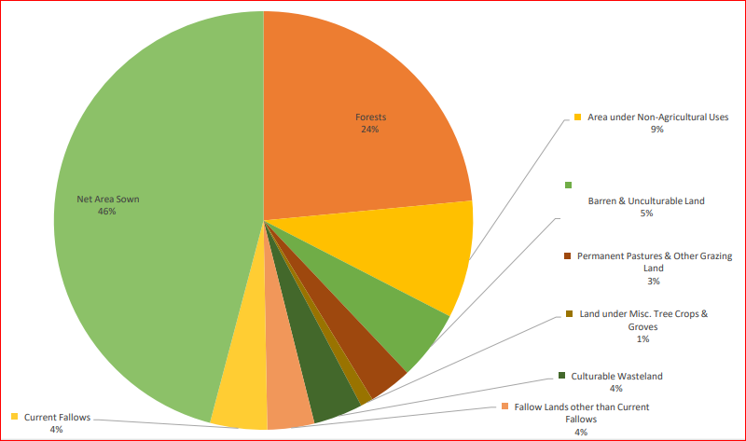
Farming Based Livelihood Systems
Status of agriculture in India & different states
Classification of Land Utilization (%) in the Country, 2022-23

Slide 4
Farming Based Livelihood Systems
Status of agriculture in India & different states
Land use pattern in India (mha)
Net sown/cultivated area | : | 141.0
Irrigated sown area | : | 73.0 (52%)
Rainfed area | : | 68.0 (48%)
Food grains contribution by RFA | : | 44.0% of total
Support to population by RFA | : | 40.0%
Productivity of RFA | : | 10.0 q ha⁻¹
Productivity of irrigated AG | : | 30.0 q ha⁻¹

Slide 5
Farming Based Livelihood Systems
Status of agriculture in India & different states
Status of agriculture in India
Agriculture is the primary source of livelihood for nearly 58% of India’s population & about 70% of the rural households depend on agriculture only.
The agriculture industry plays a significant part in the Indian economy, accounting for around 20% of Gross Domestic product (GDP).
At present, 95% of area under coarse cereals, 91% under pulses, 80% under oilseeds, 65% under cotton and 53% under rice is rainfed.

Slide 6
Farming Based Livelihood Systems
Status of agriculture in India & different states
Status of agriculture in India
As per a report around 70% of all agricultural households have a land holding size of less than 1 hectare and around 88% have a land holding size of less than 2 hectares.
Crop productivity of irrigated AG : 3 tha⁻¹
Crop productivity of rainfed AG : 1 tha⁻¹
Cropping intensity : >155.0%
(% of total cropped area over
net sown area)

Slide 7
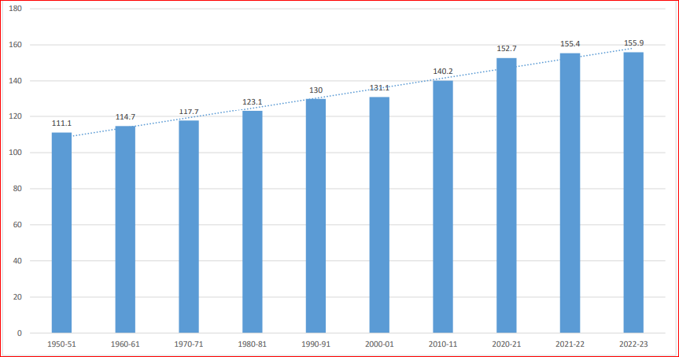
Farming Based Livelihood Systems
Status of agriculture in India & different states
Cropping Intensity (%) - All India

Slide 8
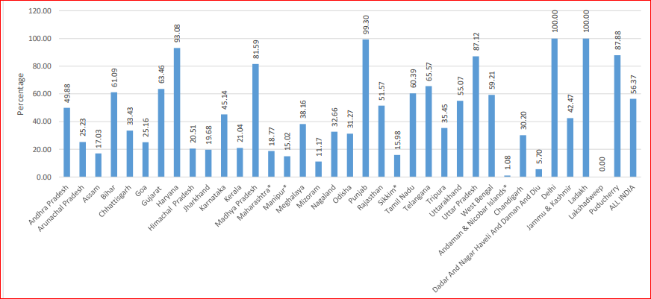
Farming Based Livelihood Systems
Status of agriculture in India & different states
State wise percentage share of Net irrigated area to Net sown area -2022-23

Slide 9
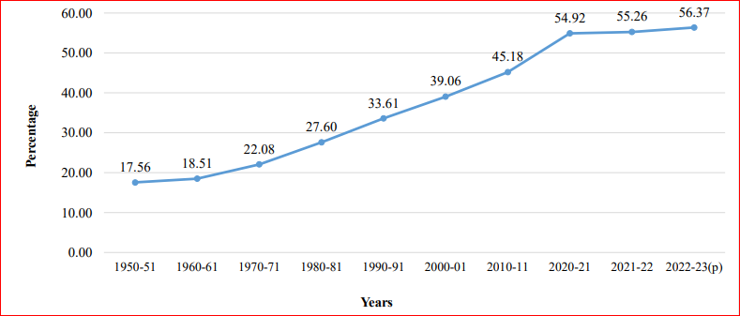
Farming Based Livelihood Systems
Status of agriculture in India & different states
Percentage Share of Net irrigated Area to Net Sown Area for different years

Slide 10
Farming Based Livelihood Systems
Status of agriculture in India & different states
Major crops and agricultural regions
Rice: The main staple crop grown in states like
West Bengal, Punjab, U.P., A.P. and T.N.
Wheat: Predominantly grown in Punjab,
Haryana, U.P. and M.P..
Pulses: Maharashtra, M.P., Rajasthan & U.P.
Sugarcane: Cultivated in U.P., Maharashtra,
Karnataka and T.N.
Fruits & Vegetable: Leading states in production of various fruits and vegetables are Maharashtra, A.P., T.N., Gujarat & W.B.

Slide 11
Farming Based Livelihood Systems
Status of agriculture in India & different states
Major challenges in Agriculture
Fragmented Land Holdings: Over 86% of
Indian farmers have less than 2 ha. of land,
leading to uneconomical farm sizes.
Water Scarcity: Dependence on monsoon rains
makes agriculture highly vulnerable to
fluctuations in rainfall.
Low productivity: Despite the large
workforce, agricultural productivity in India
remains low compared to global standards.

Slide 12
Farming Based Livelihood Systems
Status of agriculture in India
Major challenges in Agriculture
Limited Access to Technology: Modern farming
techniques and advanced machinery are not
accessible to many small and marginal farmers.
Climate Change: Increased incidence of
droughts, floods and unseasonal rainfall are
impacting crop yields and famers income.

Slide 13
Farming Based Livelihood Systems
Status of agriculture in India & different states
Agriculture in different states
Punjab: “Known as Granary of India”
“Food basket of India”
Lead producer of Wheat and Rice
Agriculture is highly mechanized & farmers
benefit from assured irrigation, primarily
through canals.
Over reliance on water-intensive crops like
paddy has led to groundwater depletion.
Challenges: Depleting water table, declining soil
health, stagnating crop yields and over
dependence on wheat-paddy crop cycle.

Slide 14
Farming Based Livelihood Systems
Status of agriculture in India & different states
Agriculture in different states
Uttar Pradesh
Major producer of food grains including wheat, rice and sugarcane.
The state also leads in milk production, contributing significantly to India’s dairy sector.
Challenges: Fragmented land holdings, low
mechanization and insufficient access
to modern farming technologies.

Slide 15
Farming Based Livelihood Systems
Status of agriculture in India & different states
Agriculture in different states
Maharashtra
Lead producer of cotton, sugarcane, pulses
and horticultural crops (grapes,
pomegranates and oranges).
The state has made significant progress in
agricultural export, especially in fruits.
Challenges: Drought prone regions (like
Marathwada & Vidarbha) face severe
water shortage affecting crop yields.

Slide 16
Farming Based Livelihood Systems
Status of agriculture in India & different states
Agriculture in different states
Madhya Pradesh : “Known as Soybean State”
Largest soybean producing state in India
with over 50% of the Nation’s production.
Known for being the largest producer of
pulses and oilseeds in India.
The state’s agricultural economy has been
increased by the cultivation of wheat,
pulses, soybean and chickpea.
Challenges: Despite good rainfall, irrigation
coverage is limited and farmers rely
on monsoon for water.

Slide 17
Farming Based Livelihood Systems
Status of agriculture in India & different states
Agriculture in different states
Tamil Nadu:
A leading producer of rice and horticultural
crops.
Agriculture in T.N. has been affected by
water scarcity and irregular rainfall pattern.
Challenges: Water scarcity, monsoon
dependency and urbanization are
impacting rural and farm areas.

Slide 18
Farming Based Livelihood Systems
Status of agriculture in India & different states
Agriculture in different states
West Bengal:
Top producer of Rice, Jute and Fish.
The state has rich soil & ample water
resources from the Ganges and its
tributaries, but floods often affect crop
yields.
Challenges: Floods, outdated farming methods
and rural poverty continue to
challenge agricultural productivity.

Slide 19
Farming Based Livelihood Systems
Status of agriculture in India & different states
Income of rural people & farmers in India
Average income of farmers:
Monthly av. income of Indian farmers was
around RS. 10,218 (As per a 2018 National Sample Survey Office report).
Regional variations:
Punjab: Highest av. income i.e., >Rs. 18,000
Bihar, JK, WB: Lowest av. Income i.e., around
Rs. 7,000 to Rs. 9,000.
This income includes income from wages, cultivation, livestock and non-farm business activities.

Slide 20
Farming Based Livelihood Systems
Status of agriculture in India & different states
Rural employment & income distribution
Around 70% of India’s rural population is dependent on agriculture for their livelihood.
Rural income comes from multiple sources:
Agriculture: cultivation and livestock,
Rural Labour Market: non-agricultural activities like construction, transportation,
Public sector employment: Govt. schemes like MGNREGA (Mahatma Gandhi National Rural Employment Guarantee Act), provides at least 100 days of guaranteed employment to rural farmers to improve rural income stability.

Slide 21

Farming Based Livelihood Systems
Status of agriculture in India & different states

