Slide 1
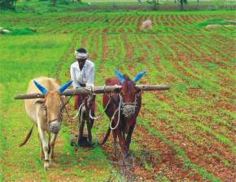
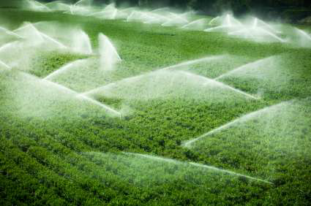
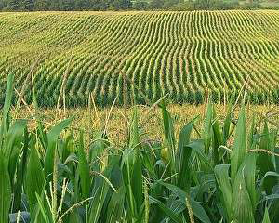
Farming Based Livelihood Systems
Topic: Types of Traditional & Modern Farming Systems
B.Sc. (Hons.) Ag.
Year: First Semester: First
Credit hrs: 2+1
Course instructor: Dr. P. K. Tyagi

Slide 2
Farming Based Livelihood Systems
Traditional & Modern Farming Systems
Traditional Farming Systems (TFS)
TFS is primitive (ancient) type food production and farming that use natural resources, traditional tools and indigenous knowledge to cultivate crops & rise livestock.
TFS are known for being sustainable & harmonious with the environment, but they are less efficient than modern farming systems.

Slide 3
Farming Based Livelihood Systems
Traditional & Modern Farming Systems
Shifting cultivation (Slash & burn Agriculture)
It is an agricultural practice that involves clearing a patch of forest, burn vegetation & grow crops on the nutrient- rich ash. In northeast region, it is also known as ‘Jhum Kheti’
After a few years of cultivation, the soil fertility declines, and the field is abandoned (vacant).
The process is then repeated on a new patch of land.

Slide 4
Farming Based Livelihood Systems
Traditional & Modern Farming Systems
Shifting cultivation (Slash & burn Agriculture)
Advantages
It allows soil recovery over time, conserves biodiversity in forested areas, and requires fewer inputs like fertilizers or pesticides.
Disadvantages
Deforestation, loss of biodiversity, and unsustainable with increasing
population pressure.

Slide 5
Farming Based Livelihood Systems
Traditional & Modern Farming Systems
Subsistence Farming/Agriculture
A traditional farming practice where farmers grow crops & raise livestock to meet the needs of their families & communities rather than sale in market.
It is labor-intensive, often reliant on family labor, and uses traditional tools like hoes and plows.
The goal is to produce enough food & other goods for survival with little or no surplus for trade or sale.

Slide 6
Farming Based Livelihood Systems
Traditional & Modern Farming Systems
Subsistence Farming/Agriculture
Advantages
Low input costs and minimal environmental degradation.
Disadvantages
Low yields, limited surplus for trade, and high vulnerability to climate
variations.

Slide 7
Farming Based Livelihood Systems
Traditional & Modern Farming Systems
Pastoralism (चरवाहापन) Agriculture
A type of agriculture or system where livestock (cattle, sheep, goats) are moved seasonally in search of grazing areas.
It is the extensive livestock production system that involves the tracking and use of grazing and water across a given landscape (normally a “rangeland”). Normally practiced in dryland areas, mobility is the key to this system.

Slide 8
Farming Based Livelihood Systems
Traditional & Modern Farming Systems
Pastoralists are of two types
Nomadic pastoralists (खानाबदोश चरवाहे) are constantly on the move to search fresh pastures for their livestock & their livelihood is purely based on livestock.
Semi-nomadic (अर्ध खानाबदोश चरवाहे)
people have a permanent home but additionally, they also build a semi-permanent home for several months or years. In this type of animal herds are moved from one place to another to ensure fodder and water.

Slide 9
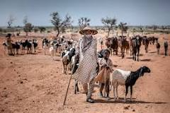
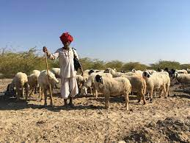
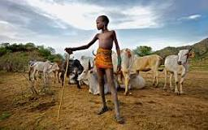
Farming Based Livelihood Systems
Traditional & Modern Farming Systems
Pastoralism

Slide 10
Farming Based Livelihood Systems
Traditional & Modern Farming Systems
Pastoralism (चरवाहापन) Agriculture
Advantages
Utilizes marginal lands that are unsuitable for crop production and allows flexible use of resources.
Disadvantages
Overgrazing, land degradation, and conflict over grazing rights.

Slide 11
Farming Based Livelihood Systems
Traditional & Modern Farming Systems
Mixed Farming (मिश्रित खेती)
A system of farming in which crop cultivation is combined with livestock. Farmers grow crops to feed animals & sell animal products viz., milk, meat, & eggs.
Advantages: Diversifies income, improves soil fertility through animal manure, & reduces risk through multiple income streams.
Disadvantages: Requires more labor, expertise in both animal husbandry & crop production & may need more land.

Slide 12
Farming Based Livelihood Systems
Traditional & Modern Farming Systems
Terrace Farming (सीढ़ीनुमा खेती)
Farming on sloped land by constructing terraces (step-like structures) to prevent soil erosion and conserve water.
Terrace farming is a method of agriculture that involves cultivating crops on the sides of steep hills and mountains by constructing terraces or steps on the slopes.

Slide 13
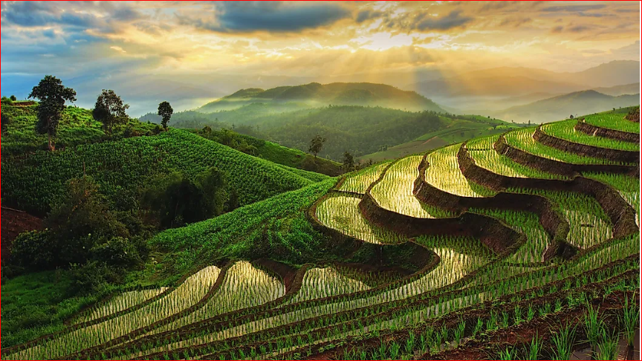
Farming Based Livelihood Systems
Traditional & Modern Farming Systems
Terrace Farming (सीढ़ीनुमा खेती)

Slide 14
Farming Based Livelihood Systems
Traditional & Modern Farming Systems
Terrace Farming (सीढ़ीनुमा खेती)
Advantages: Makes use of hilly terrain, conserves water, reduces erosion, and supports food production in mountainous areas.
Disadvantages: Labor-intensive to construct and maintain terraces.

Slide 15
Farming Based Livelihood Systems
Traditional & Modern Farming Systems
Rainfed Agriculture (वर्षा आधारित कृषि )
Rainfed agriculture or rainfed farming is a method of farming that depends entirely on rain water, with little to no irrigation .
It occupies a large portion of the world's cropland and plays a vital role in producing food and livelihoods in rural areas.

Slide 16
Farming Based Livelihood Systems
Traditional & Modern Farming Systems
Rainfed Agriculture (वर्षा आधारित कृषि )
Advantages: Minimal cost for irrigation infrastructure, promotes local crop varieties suited to rainfall patterns.
Disadvantages: Highly vulnerable to weather changes, droughts, and inconsistent rainfall.

Slide 17
Farming Based Livelihood Systems
Traditional & Modern Farming Systems
Modern Farming (आधुनिक खेती)
The highly mechanized & technology-driven approach to agriculture is referred as Modern Farming (MF).
To maximize yield, it emphasizes on large-scale monoculture, utilizing genetically modified crops, synthetic fertilizers, and pesticides.

Slide 18
Farming Based Livelihood Systems
Traditional & Modern Farming Systems
Types of Modern Farming (आधुनिक खेती)
Monoculture (एकलकृषि/एक ही फसल की खेती)
The practice of growing a single crop on a large scale over a vast area.
Monoculture crops are sometimes rotated year to year & this continuous monoculture, in which the same crop is grown year after year, has become one of the dominant example in modern industrial agriculture.
However, “Monoculture has been widely criticized for its negative impact on biodiversity and susceptibility to diseases

Slide 19
Farming Based Livelihood Systems
Traditional & Modern Farming Systems
Monoculture (एकलकृषि/एक ही फसल की खेती)
Advantages
Simplifies management,
Efficient use of machinery, and
Maximizes output for high-demand crops
Disadvantages
Depletes soil nutrients,
Increases vulnerability to pests & diseases, and
Leads to biodiversity loss.

Slide 20
Farming Based Livelihood Systems
Traditional & Modern Farming Systems
Types of Modern Farming
Commercial Farming (व्यावसायिक खेती)
It is also known as agribusiness.
A method of farming that involves producing crops and raising livestock with the intention of selling the products in the market.
The main goal of commercial farming is to generate profit by maximizing yields and using resources efficiently.

Slide 21
Farming Based Livelihood Systems
Traditional & Modern Farming Systems
Types of Modern Farming
Characteristics of Commercial Farming
Large-scale operations
CF typically involves large farms that use modern technology, machinery, irrigation methods, HYV of seeds, fertilizers, insecticides & pesticides.
High-demand crops
Commercial farms mainly produce crops that are in high demand, such as those that need to be exported or used as raw materials in industry.

Slide 22
Farming Based Livelihood Systems
Traditional & Modern Farming Systems
Types of Modern Farming
Characteristics of Commercial Farming
Capital investment
CF requires a large amount of capital investment to get the farm up & running.
More labor
Large-scale production also requires more labor.
CF has replaced subsistence farming as the dominant mode of agricultural production after green revolution.

Slide 23
Farming Based Livelihood Systems
Traditional & Modern Farming Systems
Commercial Farming (व्यावसायिक खेती)
Advantages
High yields,
Increased efficiency through mechanization and
Contribution to food security and export economies
Disadvantages
High input costs,
Environmental damage from overuse of fertilizers & pesticides, and
Social inequalities in land ownership.

Slide 24
Farming Based Livelihood Systems
Traditional & Modern Farming Systems
Types of Modern Farming
How to do Commercial Farming?
By the use of
High-yielding varieties (HYVs) of seeds,
Chemical fertilizers,
Pesticides,
Insecticides, and
Many other things viz., livestock, poultry, plantation, aquaculture, commercial floriculture, grain farming, dairy, etc.

Slide 25
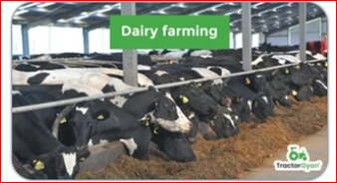
Farming Based Livelihood Systems
Traditional & Modern Farming Systems
Types of Modern Farming
Types of Commercial Farming?
Dairy Farming
It is a type of CF & as the name suggests, it is mainly involved in the production of milk & milk products.
In this, the primary purpose is to rear cattle, which gives out milk & other dairy products plus organic manure also in return.

Slide 26
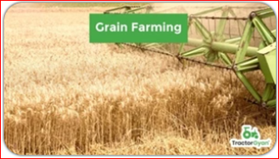
Farming Based Livelihood Systems
Traditional & Modern Farming Systems
Types of Modern Farming
Types of Commercial Farming?
2. Grain Farming
It is a type of industrial farming in which grain, including corn, barley & wheat are cultivated for human consumption & export.
Commercial grain farming is highly mechanized & necessitates enough land, equipment, farmers and more.

Slide 27
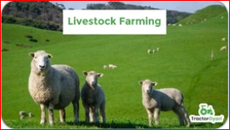
Farming Based Livelihood Systems
Traditional & Modern Farming Systems
Types of Modern Farming
Types of Commercial Farming?
3. Livestock Farming
It is a type of farming wherein animals are reared to obtain meat.
Cattles & sheep are the most frequent species raised in livestock farming, although on same farms, you may also find pigs & poultry raised in huge numbers.

Slide 28
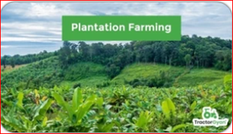
Farming Based Livelihood Systems
Traditional & Modern Farming Systems
Types of Modern Farming
Types of Commercial Farming?
4. Plantation Farming
In this C.farming, a large piece of land is used to cultivate cash crop like tea, coffee, bananas, coconut, etc. which are then sold in the global market to receive excessive revenues.

Slide 29
Farming Based Livelihood Systems
Traditional & Modern Farming Systems
Types of Modern Farming
Types of Commercial Farming?
5. Monoculture Farming
This type of CF involves the cultivation of a single crop over large expenses of land.
The most common CF examples seen in India & it focuses on maximizing the yield & efficiency of a particular crop and creating a surplus.
Commercial crops like wheat, corn, soybean & rice are mostly cultivated as these are the staple grains in India & are important for feeding the huge population of our nation.

Slide 30
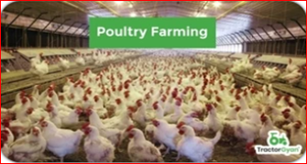
Farming Based Livelihood Systems
Traditional & Modern Farming Systems
Types of Modern Farming
Types of Commercial Farming?
6. Poultry Farming
This type of commercial farming is very common in India.
Poultry Farming involves raising chickens, ducks, turkeys and other birds for meat and eggs production.
Poultry farming has become highly mechanized and intensive to meet the growing demand for poultry products.

Slide 31
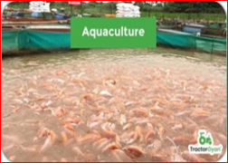
Farming Based Livelihood Systems
Traditional & Modern Farming Systems
Types of Modern Farming
Types of Commercial Farming?
7. Aquaculture or Fish farming
This involves the breeding & rearing of fish & aquatic plants in controlled environments such as ponds, tanks and ocean enclosures.
This type of farming caters to the demand for seafood and help to conserve wild fish populations.

Slide 32

Farming Based Livelihood Systems
Traditional & Modern Farming Systems
Types of Modern Farming
Types of Commercial Farming?
8. Commercial Floriculture
Comm. floriculture involves the large scale cultivation of flowers & ornamental plants for the floral industry.
Flowers are grown for various purpose, including floral arrangement, bouquets and decorations.

Slide 33
Farming Based Livelihood Systems
Traditional & Modern Farming Systems
Types of Modern Farming
Advantages of Commercial Farming
Comm. Farming is more than just a farming practice in India because it take cares of people’s daily eating needs & allow a nation to become economically strong through exports.
Comm. Farming boosts the power supply to areas in the suburbs of farmed land since it uses machinery & electricity.

Slide 34
Farming Based Livelihood Systems
Traditional & Modern Farming Systems
Types of Modern Farming
Advantages of Commercial Farming
It contributes to the improvement of local infrastructure. Roads are paved to facilitate the transit of goods and equipment quickly and comfortably.
Comm. Farming is an easy way to boost a nation’s employment ratio. It creates multiple work opportunity for people in the surrounding region. To put it another way, commercial farming can help boost the local economy.

Slide 35
Farming Based Livelihood Systems
Traditional & Modern Farming Systems
Types of Modern Farming
Advantages of Commercial Farming
As comm. Farming is mainly practiced for profit earning, it helps in foreign exchange polices.
Cocoa, coffee, and other non-traditional agricultural export commodities generate foreign exchange for their countries.

Slide 36
Farming Based Livelihood Systems
Traditional & Modern Farming Systems
Types of Modern Farming
Challenges to Comm. Farming in India
In India, Comm. Farming is essential for increasing food availability &, hence, supporting the nation’s economy. However, it addresses some significant obstacles restricting output & expansion.
Small plots dominate India’s landmass. Hence, comm. farmers need help to apply contemporary (modern) technologies, farming techniques or extensive operations.

Slide 37
Farming Based Livelihood Systems
Traditional & Modern Farming Systems
Types of Modern Farming
Challenges to Comm. Farming in India
Irrigation remains a significant issue and unpredictable monsoon influence crop yields. Excessive GW extraction and inadequate water management strategies exacerbate (intensify) the issue.
The cost of tools & inputs may surpass (exceed) the revenues of small-scale commercial farmers. As they have to worry about money, they find it more difficult to try new activities.

Slide 38
Farming Based Livelihood Systems
Traditional & Modern Farming Systems
Types of Modern Farming
Challenges to Comm. Farming in India
Supply chain management is challenging when problem arise with storage space, transportation networks and access to the newest technologies.
Soil deterioration, biodiversity loss & climate change are undermining the reliability of industrial agriculture.
Thus, establishing new regulations, employing sustainable practices & enhancing technology is imperative to ensure the future sustainability of commercial farming in India.

Slide 39
Farming Based Livelihood Systems
Traditional & Modern Farming Systems
Traditional Farming | Modern Farming
Small-scale farming | Industrial or conventional farming
Low rate of prod. | Higher rate of prod.
Minimum damage to the environment | Less environment-friendly
More farm labour and use of cattle | Less farm labour and use of tractors
Use of compost & manure | Use chemical-based fertilizers & pesticides
Produces quality products | Produces lower quality products

Slide 40
Farming Based Livelihood Systems
Traditional & Modern Farming Systems
Subsistence Farming | Commercial Farming
Objective is to produce enough for family consumption | Objective is to produce for sale in the market for profit
Practiced on Small-scale | Practiced on Large-scale
Production technology relies on traditional methods | Production technology Uses modern machinery & technologies
Selection of crops is diverse i.e., staple foods & vegetables/fruits) | Focuses on high-value cash crops or livestock

Slide 41
Farming Based Livelihood Systems
Traditional & Modern Farming Systems
Subsistence Farming | Commercial Farming
Income source is mainly from off-farm work or small-scale local trade | Main source of income from selling agricultural products in the market
Higher risk due to environmental factors | May implement risk management strategies
Less dependency on external markets | Highly dependent on market conditions
Thus, both SF & CF play vital roles in global food production & each has its unique advantages & challenges. Some regions practice a mix of both types of farming, depending on factors such as local, traditional, land availability and economic conditions.

Slide 42
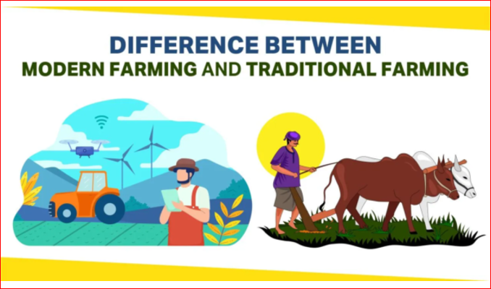
Farming Based Livelihood Systems
Traditional & Modern Farming Systems

Slide 43
Farming Based Livelihood Systems
Traditional & Modern Farming Systems
Types of Modern Farming
Agroforestry (कृषि वानिकी)
Agroforestry also known as agro-sylviculture or forest farming.
It is a land use management system that integrate trees & shrubs with crops or pasture and livestock.
It combines agricultural & forestry technologies to improve land use and diversify production with environmental health, economic and social benefits.

Slide 44
Farming Based Livelihood Systems
Traditional & Modern Farming Systems
Types of Modern Farming
Examples of Agroforestry (कृषि वानिकी)
Silvo-pastoral system (Silvopasture)
Combines trees with pastures or animals. Trees provide shade and shelter for livestock, while also improving forage production & carbon sequestration.
Alley cropping
Trees planted in multiple rows combined with crops cultivated in the alleyways between the tree rows.

Slide 45
Farming Based Livelihood Systems
Traditional & Modern Farming Systems
Types of Modern Farming
Examples of Agroforestry (कृषि वानिकी)
Agro-silviculture
Integration of trees with crop production. For example, growing fruit or
timber trees alongside cash crops or staples.
Agri-Horti-Forestry
A system combining agriculture, horticulture, and forestry to enhance
productivity and reduce risks.

Slide 46
Farming Based Livelihood Systems
Traditional & Modern Farming Systems
Types of Modern Farming
Examples of Agroforestry (कृषि वानिकी)
Riparian forest buffers
Natural or re-established areas along rivers and streams that are made up of trees, shrubs, and grasses. These buffers help filter farm runoff and stabilize the banks of streams, rivers, lakes, & ponds.
Windbreaks
Trees or shrubs planted to reduce wind speed & protect crops, animals, buildings, & soil from wind, snow, dust.

Slide 47
Farming Based Livelihood Systems
Traditional & Modern Farming Systems
Agroforestry (कृषि वानिकी)
Advantages: Increases biodiversity, improves soil fertility and provides multiple products (timber, fruits, fuel wood).
Disadvantages: Complex management system and longer time to see economic returns from tree crops.

Slide 48
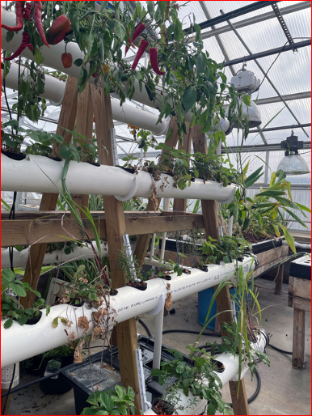
Farming Based Livelihood Systems
Traditional & Modern Farming Systems
Types of Modern Farming
Hydroponics
Soilless farming systems where plants are grown in nutrient rich water solutions.
A space-efficient hydroponic:
A- Frame using PVC tubes & a Vertical Frame
Hydroponics is used by small farmers, hobbyists & commercial enterprises

Slide 49
Farming Based Livelihood Systems
Traditional & Modern Farming Systems
Types of Modern Farming
Crops Choice in Hydroponics
Although almost anything can be grown hydroponically, short-season crops or crops that do not produce fruit such as herbs and leafy greens are great choices for indoor production in the winter.
In the summer, strawberries, tomatoes, cucumbers and peppers are all great choices.

Slide 50
Farming Based Livelihood Systems
Traditional & Modern Farming Systems
Types of Modern Farming
Aquaponics
Aquaponics is a food production system that couples aquaculture (raising aquatic animals such as fish, crayfish, snails or prawns in tanks) with hydroponics (cultivating plants in water) whereby the nutrient-rich aquaculture water is fed to hydroponically grown plants.
In aquaponics, the amount of water required is 90-99% less than that of agriculture.

Slide 51
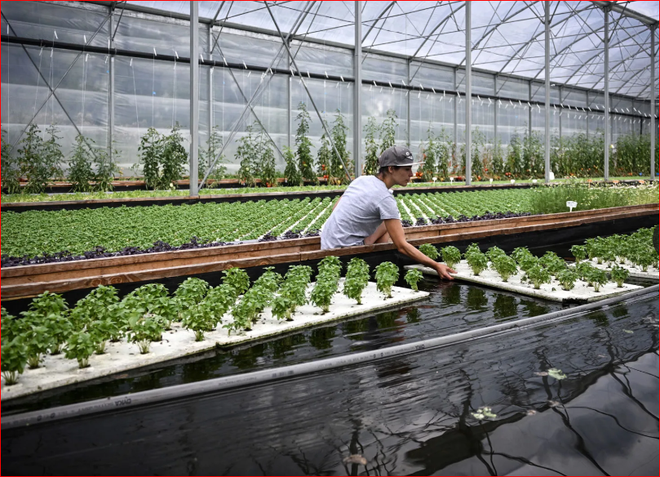
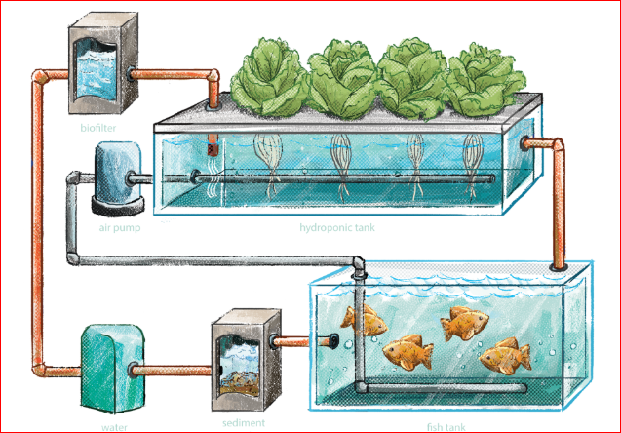
Farming Based Livelihood Systems
Traditional & Modern Farming Systems
Types of Modern Farming
Aquaponics
In aquaponics, animals provide nutrients in the form of broken down excretions, which allow the plants to grow.

Slide 52
Farming Based Livelihood Systems
Traditional & Modern Farming Systems
Hydroponics & Aquaponics
Advantages:
Uses less water,
no soil degradation,
no weed problem,
high efficiency in small spaces,
reduced use of pesticides,
faster growth and higher yields,
Crops can grow all year long.
Disadvantages: High setup costs, need for technical expertise and dependence on external inputs.

Slide 53
Farming Based Livelihood Systems
Traditional & Modern Farming Systems
Types of Modern Farming
Precision Farming/ Precision Agriculture
A technology-driven approach that uses GPS, sensors, and data analytics to
Optimize farm inputs (fertilizers, water, seeds),
Monitor crop conditions/ health in real-time and
Increased productivity of crops and soil
It can help farmers make better decisions about planting, managing, and harvesting crops, and can also help reduce costs and environmental impact.

Slide 54
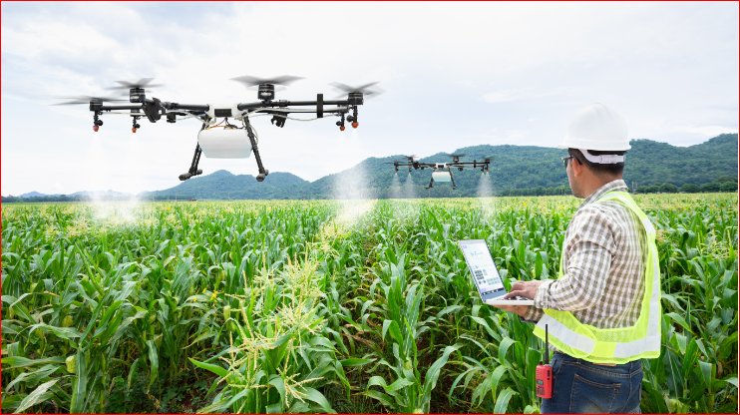
Farming Based Livelihood Systems
Traditional & Modern Farming Systems
Types of Modern Farming
Precision Farming
PA means application of precise & correct amount of inputs like water, fertilizer, pesticides etc. at the correct time to the crop for increasing its productivity and maximizing its yields

Slide 55
Farming Based Livelihood Systems
Traditional & Modern Farming Systems
Precision Farming
Advantages:
Increases resource use efficiency,
Reduce costs, which can increase overall profitability,
Reduce the amount of labor required,
Help to improve the quality of produce,
Reduces waste, and
Enhances the productivity by fine-tuning inputs to specific field conditions.
Disadvantages: High initial investment, dependence on technology & skill gap and training requirements.

Slide 56
Farming Based Livelihood Systems
Traditional & Modern Farming Systems
Types of Modern Farming
Vertical Farming
Growing crops in vertically stacked layers or vertically inclined surfaces, rather than in horizontal rows, often in controlled environments (indoors or greenhouses), to increase crop yield and reduce land use is referred as VF.
Crops like vegetables, ornamentals & herbs are mostly grown in VF.
Artificial light & nutrient solutions, without much sunshine & soil is exploited in VF.

Slide 57
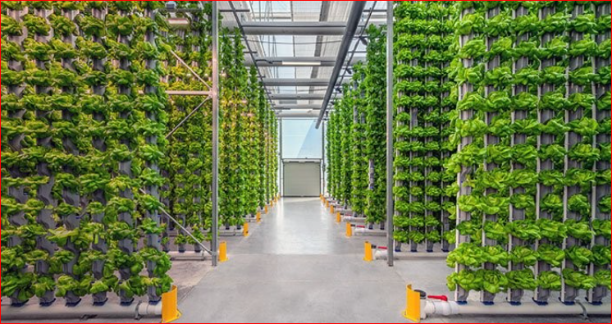
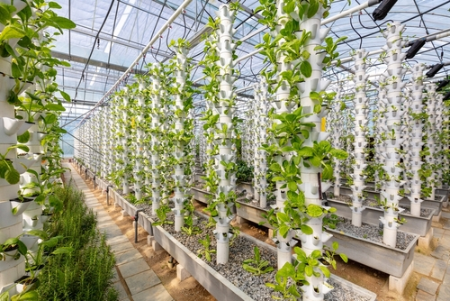
Farming Based Livelihood Systems
Traditional & Modern Farming Systems
Types of Modern Farming
Vertical Farming
Crops that are well suited to VF include tomatoes, cow pea, beans, cucumber, bottle gourd, sponge gourd, ridge gourd, snake gourd, and bitter gourd

Slide 58
Farming Based Livelihood Systems
Traditional & Modern Farming Systems
Vertical Farming
Advantages: Efficient use of space, controlled environment allows year-round production, reduces need for pesticides.
Disadvantages: High energy costs for artificial lighting and climate control,
expensive setup, and limited crop variety.

Slide 59
Farming Based Livelihood Systems
Traditional & Modern Farming Systems
Types of Modern Farming
Genetically modified (GM) Farming
A type of farming that utilizes genetically modified crops that are engineered for traits like pest resistance, herbicide tolerance, and improved nutritional content.
The goal is to meet the increasing demand for food while providing a balanced diet for everyone.
Examples of GM crops: Soybean, corn, potato, papaya, sugarbeet, Alfalfa, etc.

Slide 60
Farming Based Livelihood Systems
Traditional & Modern Farming Systems
Genetically modified (GM) Farming
Advantages:
More nutritious food with extending shelf life,
Higher yields,
Resistant to diseases & drought
Reduced use of pesticides & water,
Resistance to environmental stresses,
Faster growth of plants.
Disadvantages: Ethical concerns, potential environmental risks, and market resistance to GM products.

Slide 61

Farming Based Livelihood Systems
Traditional & Modern Farming Systems

