Slide 1
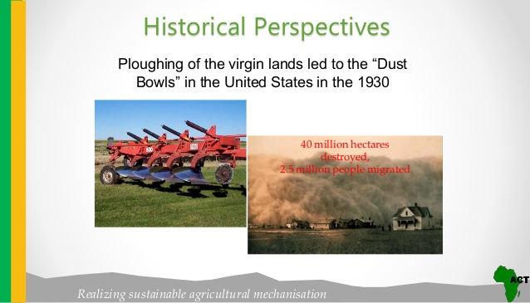

Slide 2
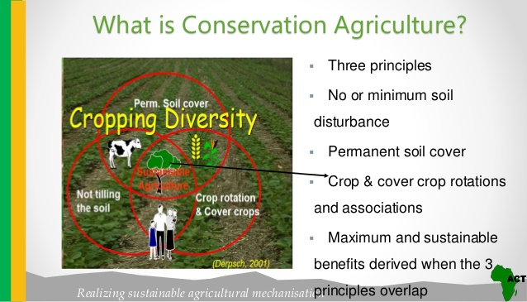

Slide 3
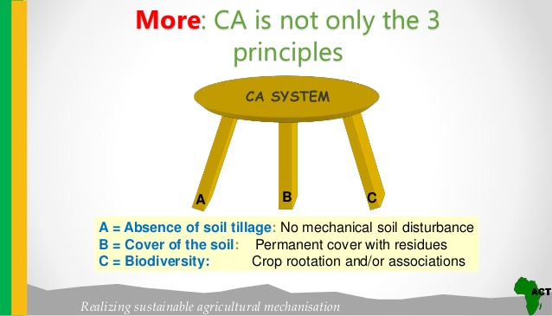

Slide 4
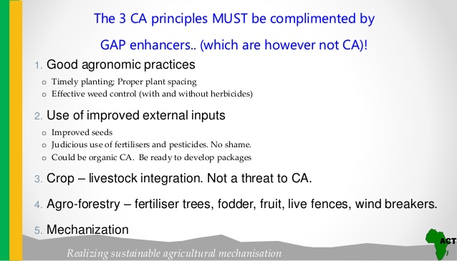

Slide 5
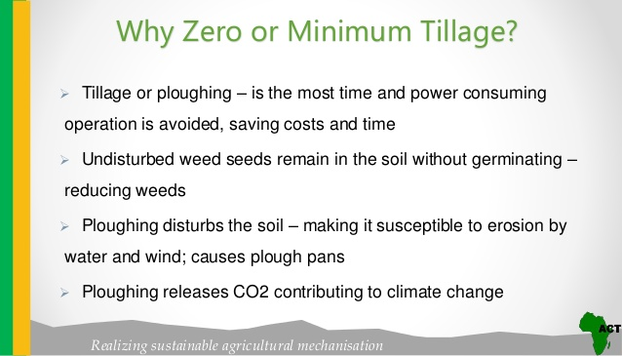

Slide 6
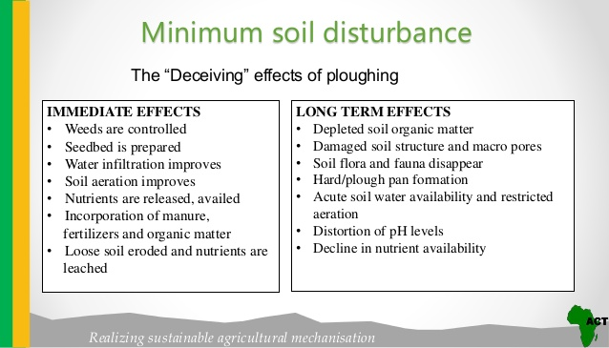

Slide 7
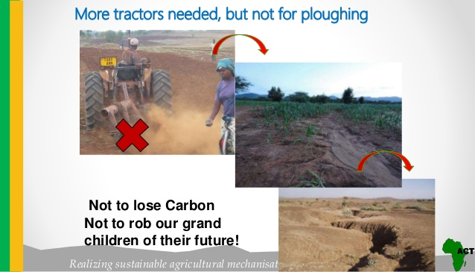

Slide 8
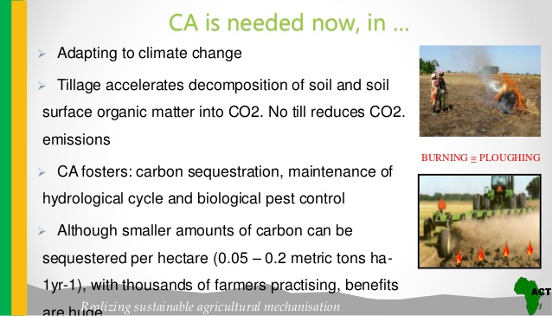

Slide 9
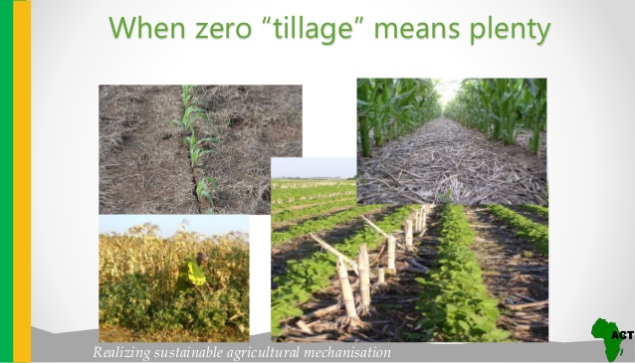

Slide 10
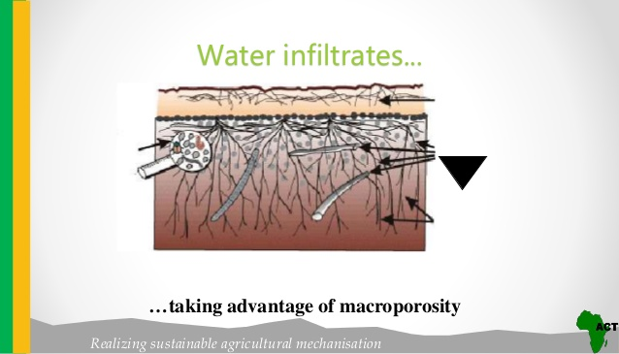

Slide 11
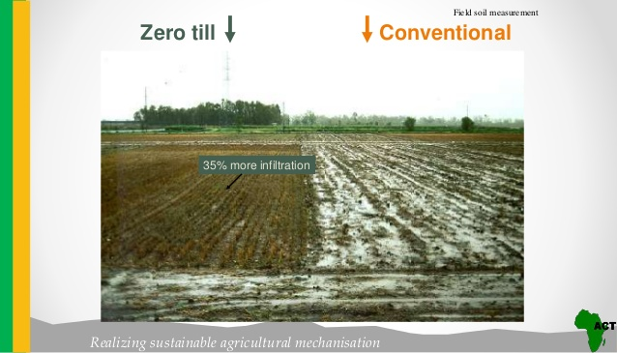

Slide 12
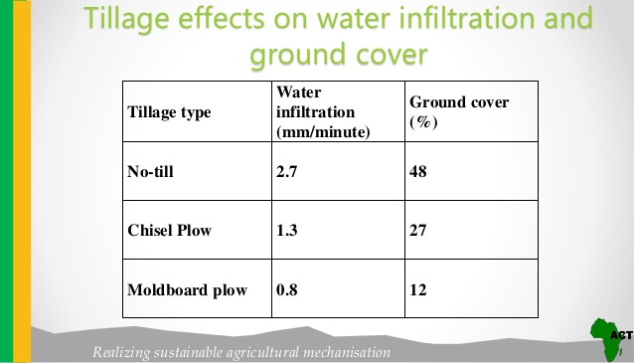

Slide 13
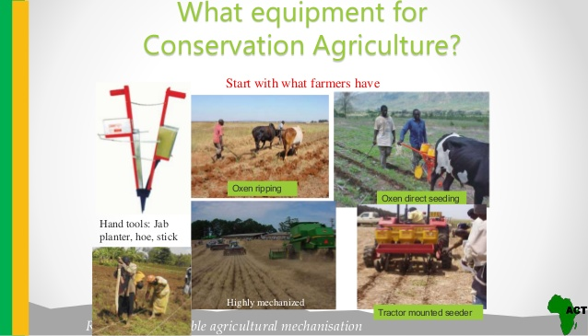

Slide 14
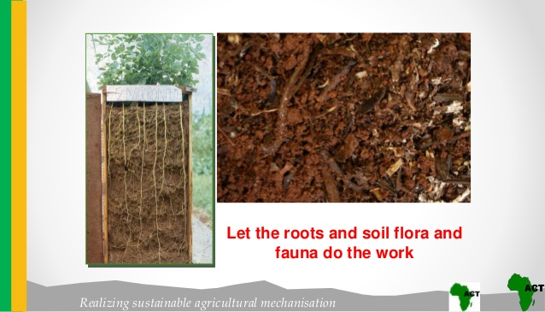

Slide 15
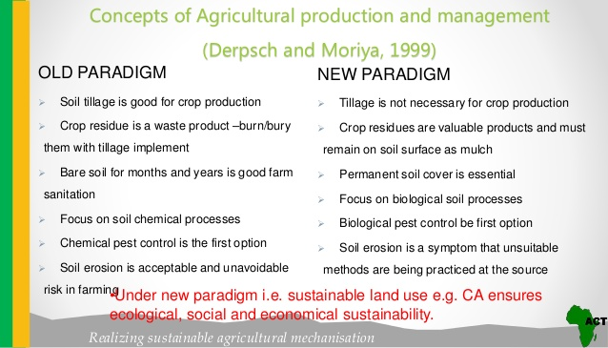

Slide 16
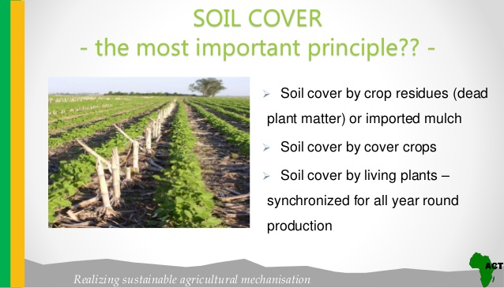

Slide 17
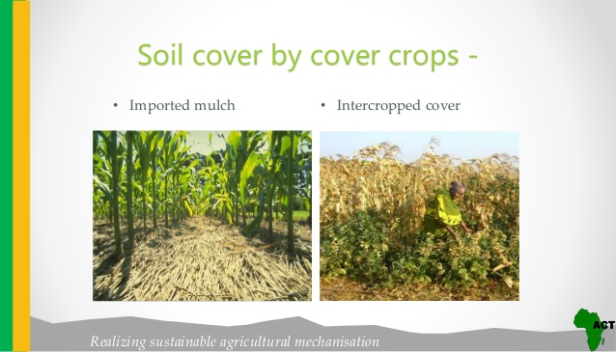

Slide 18
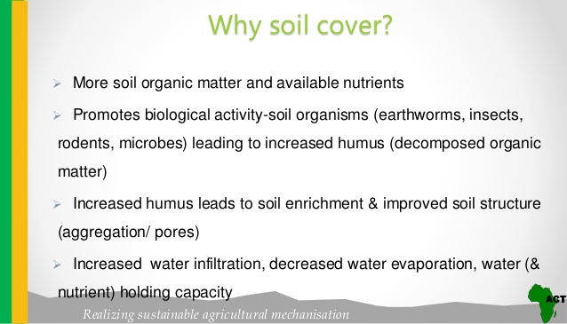

Slide 19
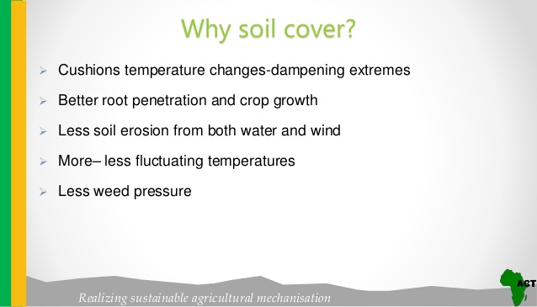

Slide 20
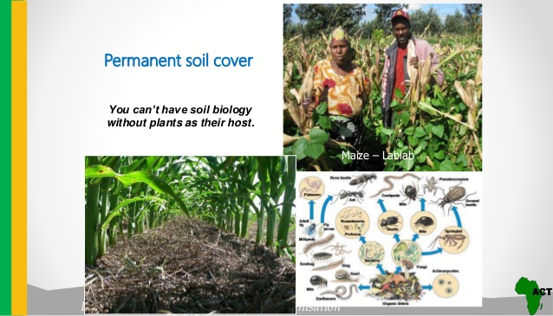

Slide 21
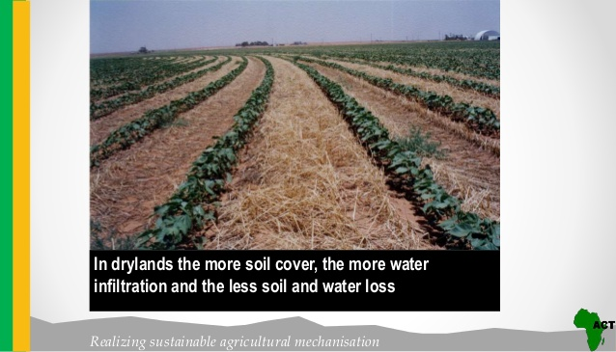

Slide 22
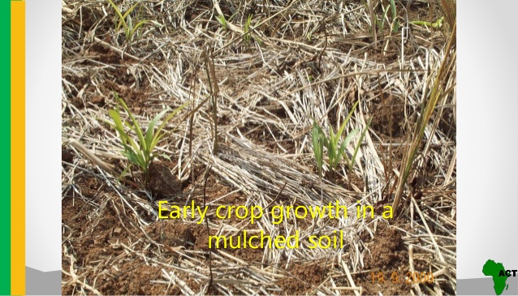

Slide 23
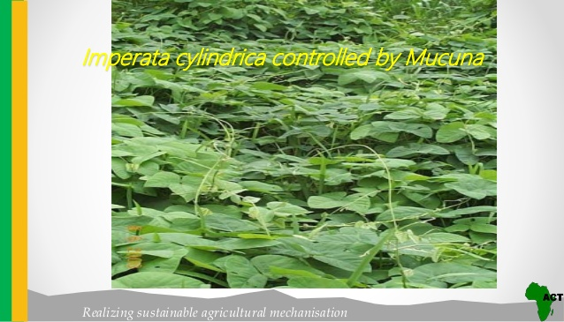

Slide 24
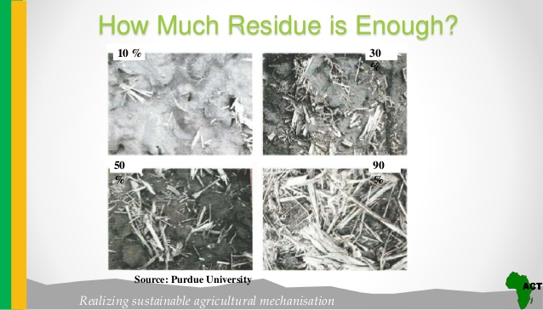

Slide 25
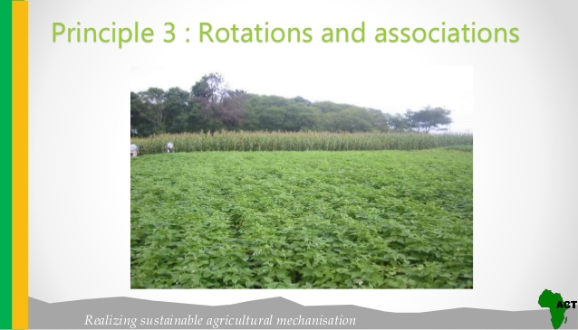

Slide 26
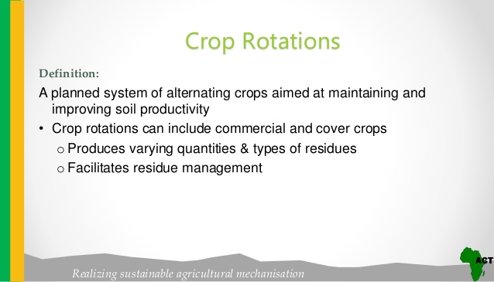

Slide 27
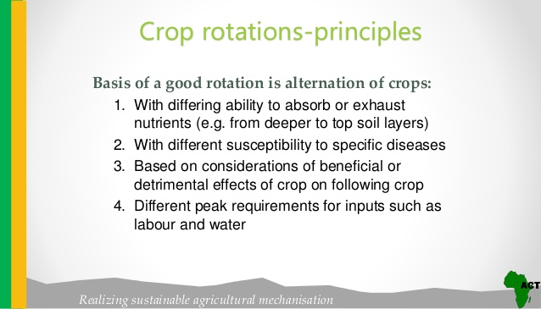

Slide 28
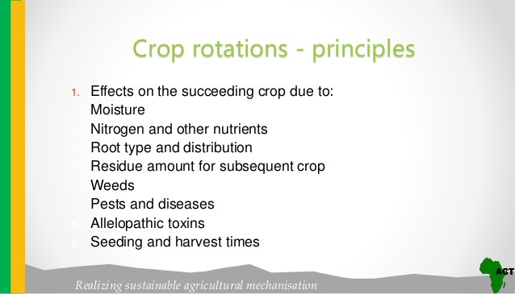

Slide 29
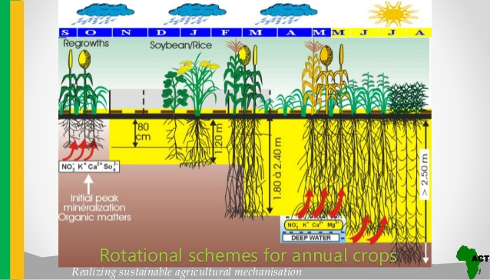

Slide 30
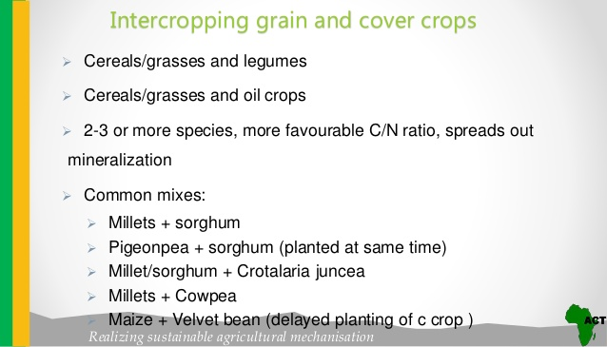

Slide 31
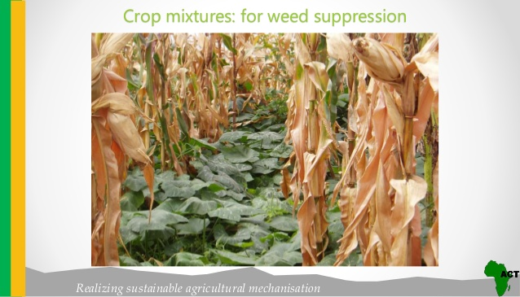

Slide 32
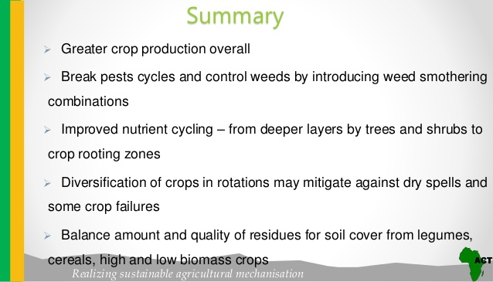

Slide 33
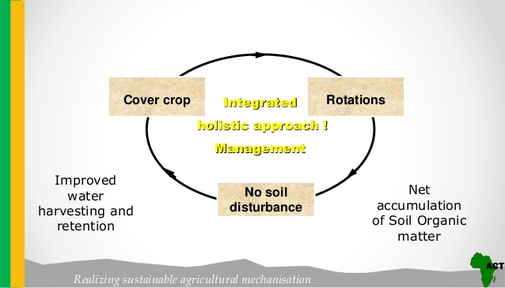

Slide 34
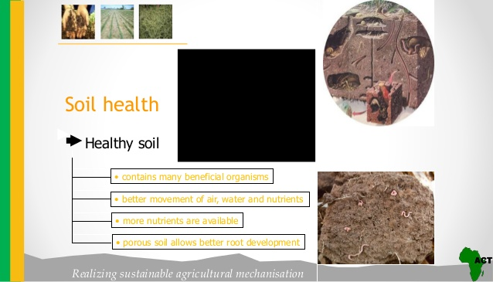

Slide 35
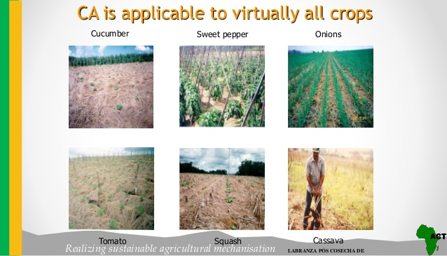

Slide 36
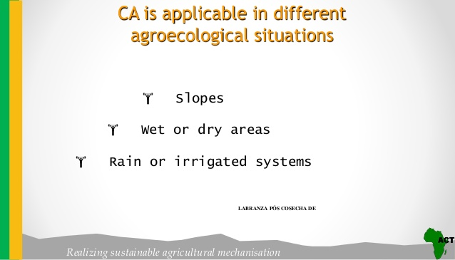

Slide 37
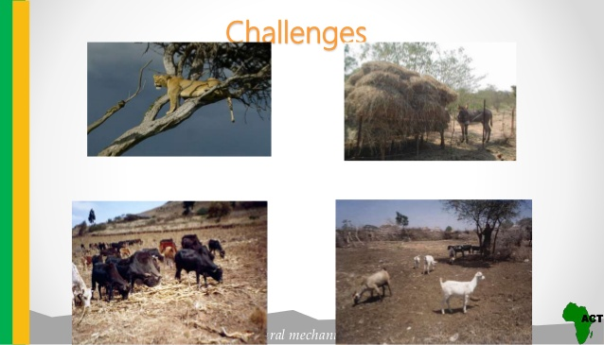

Slide 38
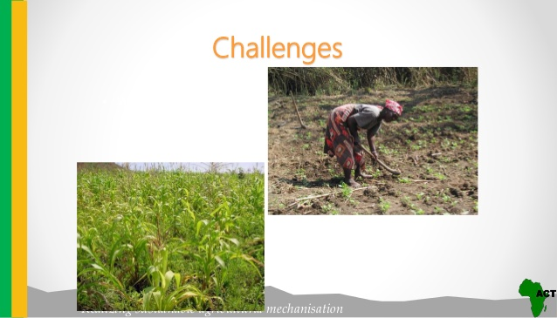

Slide 39
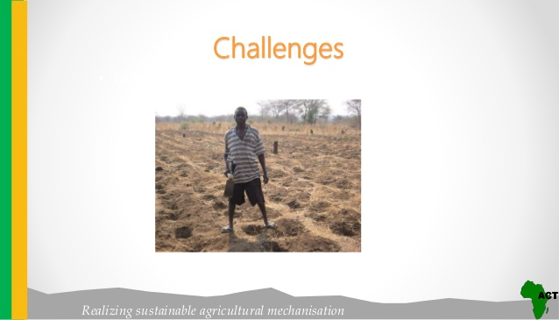

Slide 40
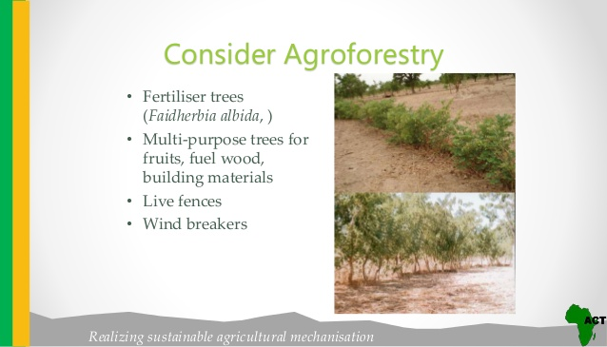

Slide 41
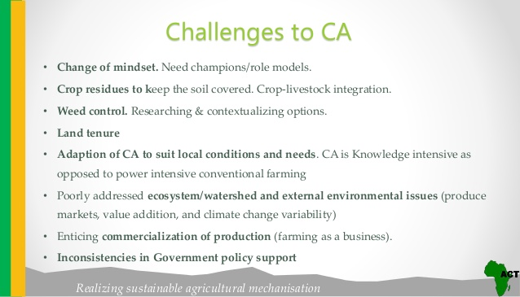

Slide 42
TABLE 2. EXTENT OF AREA UNDER ZERO-TILLAGE IN DIFFERENT COUNTRIES
Country Area under no-tillage (ha)
U.S.A 26,500,000
Brazil 25,500,000
Argentina 19,700,000
Canada 12,522,000
Australia 9,000,000
Paraguay 1,700,000
Indo-Gangetic Plains 2,500,000
Bolivia 550,000
South Africa 377,000
Spain 300,000
Venezuela 300,000
Uruguay 263,000
New Zealand 200,000
France 150,000
Chile 120,000
Colombia 102,000
China 100,000
Other (estimates) 1000,000
Total 105,863,000
Source: Derpsch, 2008.

Slide 43
BENEFITS OF CONSERVATION AGRICULTURE
The benefits of the conservation agriculture can be seen at farm, regional and national level. The benefits can be classified into three broad categories:
(i) Agronomic benefits that improve soil productivity;
(ii) Economic benefits that improve the production efficiency and profitability; and
(iii) Environmental and social benefits that protect the soil and make agriculture more sustainable.

Slide 44
Some of the benefits of conservation agriculture are listed below:
Improve the sustainability of different production systems.
Provides soil as sink for carbon dioxide, thereby improves soil organic carbon content and contribute in reducing global warming. Conservation agriculture is now receiving global focus for its carbon sequestration potential.
Improves water infiltration and thereby reduces run-off of surface and ground water and enhance ground water recharge.
Improves habitation of organisms, from larger insects down to soil borne fungi and bacteria, which improve soil biological, physical and chemical properties, thereby contribute in increasing crop productivity.
Reduce cost of production (15-16 per cent) by saving energy, labor and water, thereby increase farm income.
Enhance biodiversity and improves the value of environmental services.
Reduction in poverty and enhance food and nutritional security due to higher, more stable yields and lower food prices.
Greater rural incomes, which are leading to check in rural-urban migration.

