Slide 1
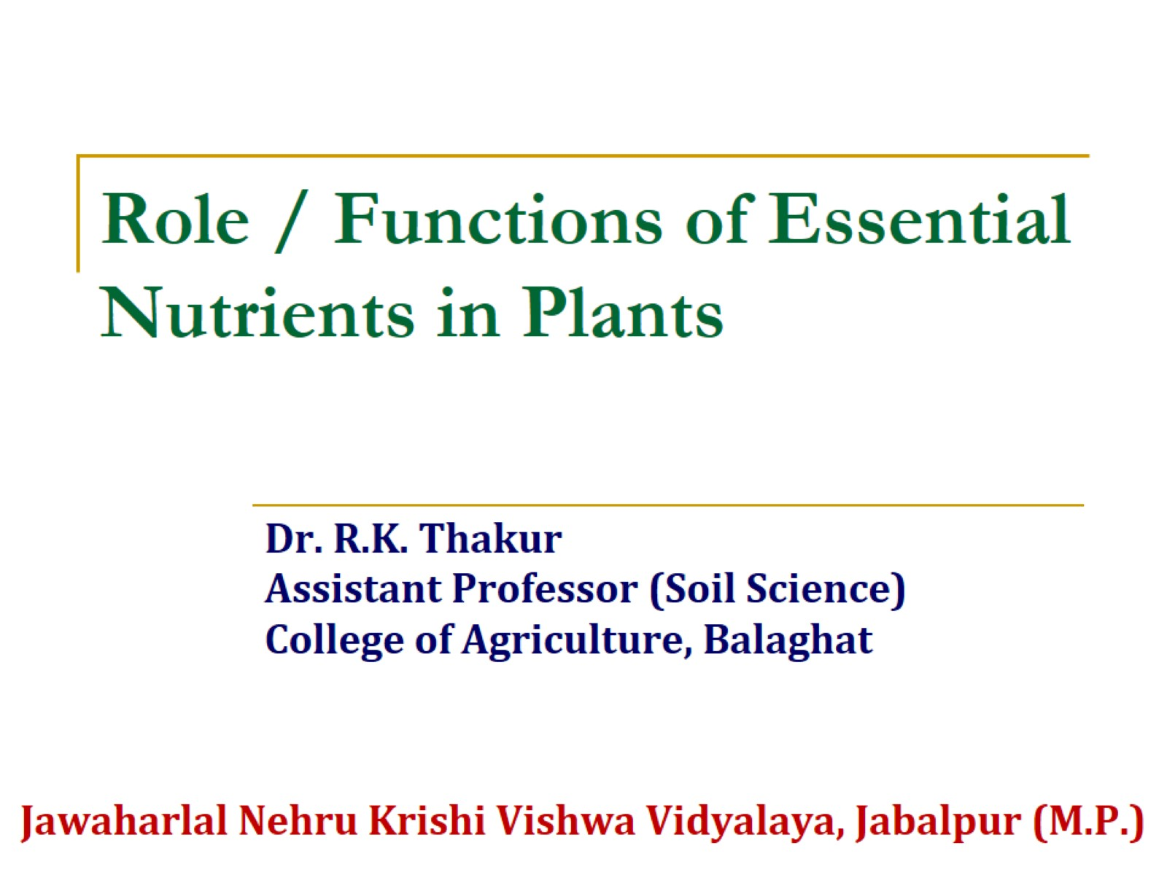
Role / Functions of Essential Nutrients in Plants

Slide 2
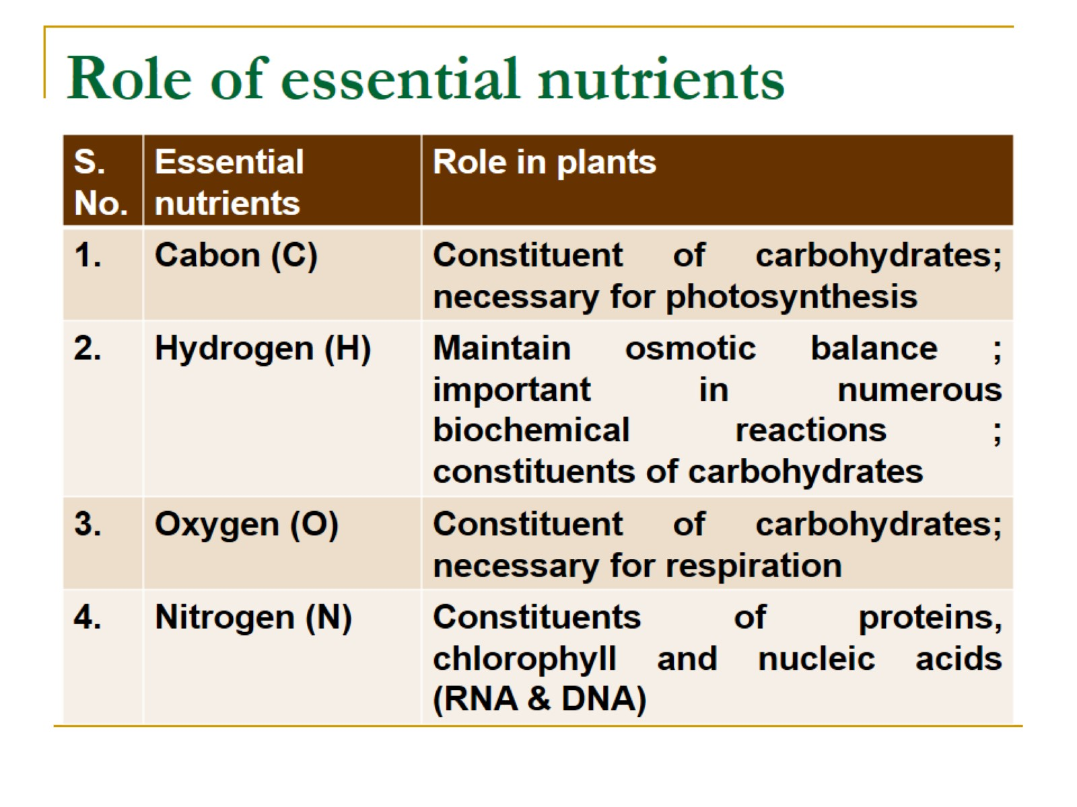
Role of essential nutrients

Slide 3
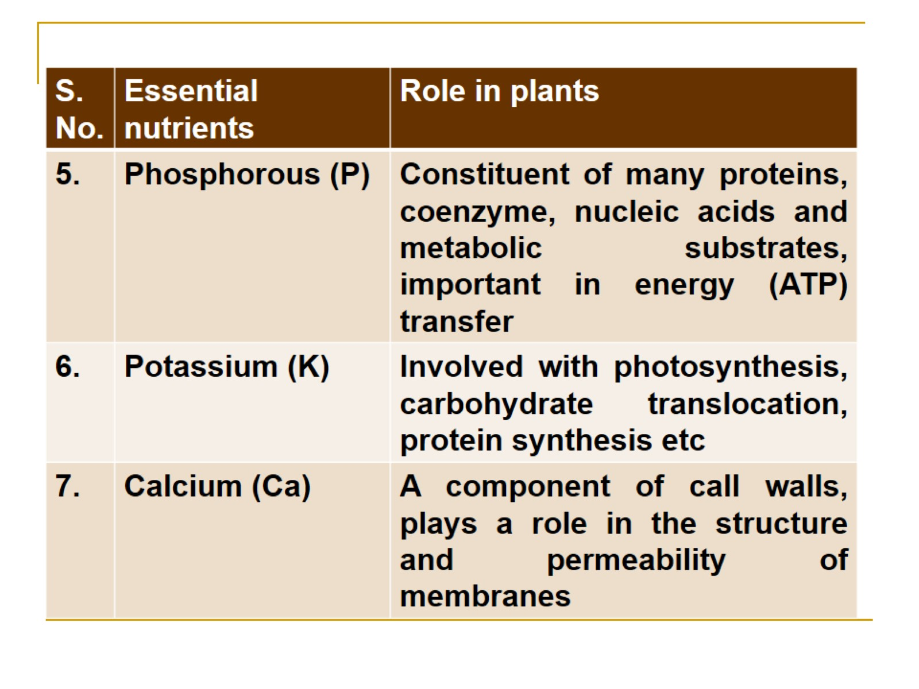

Slide 4
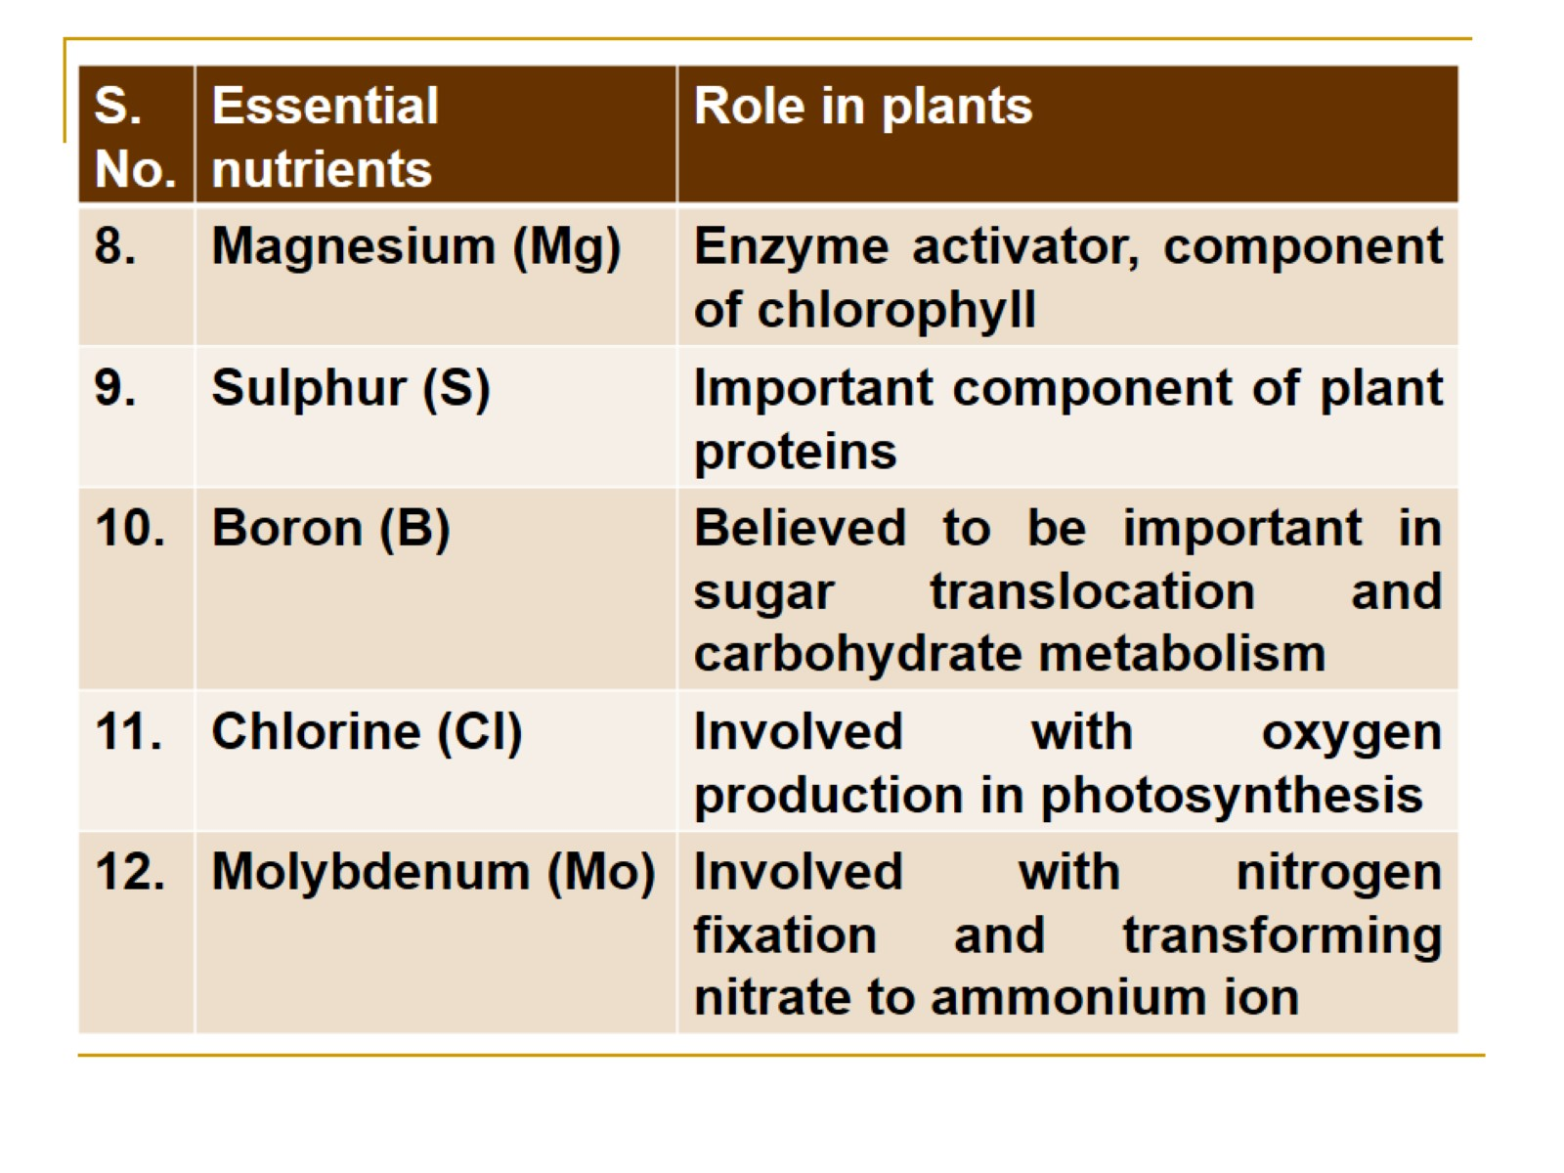

Slide 5
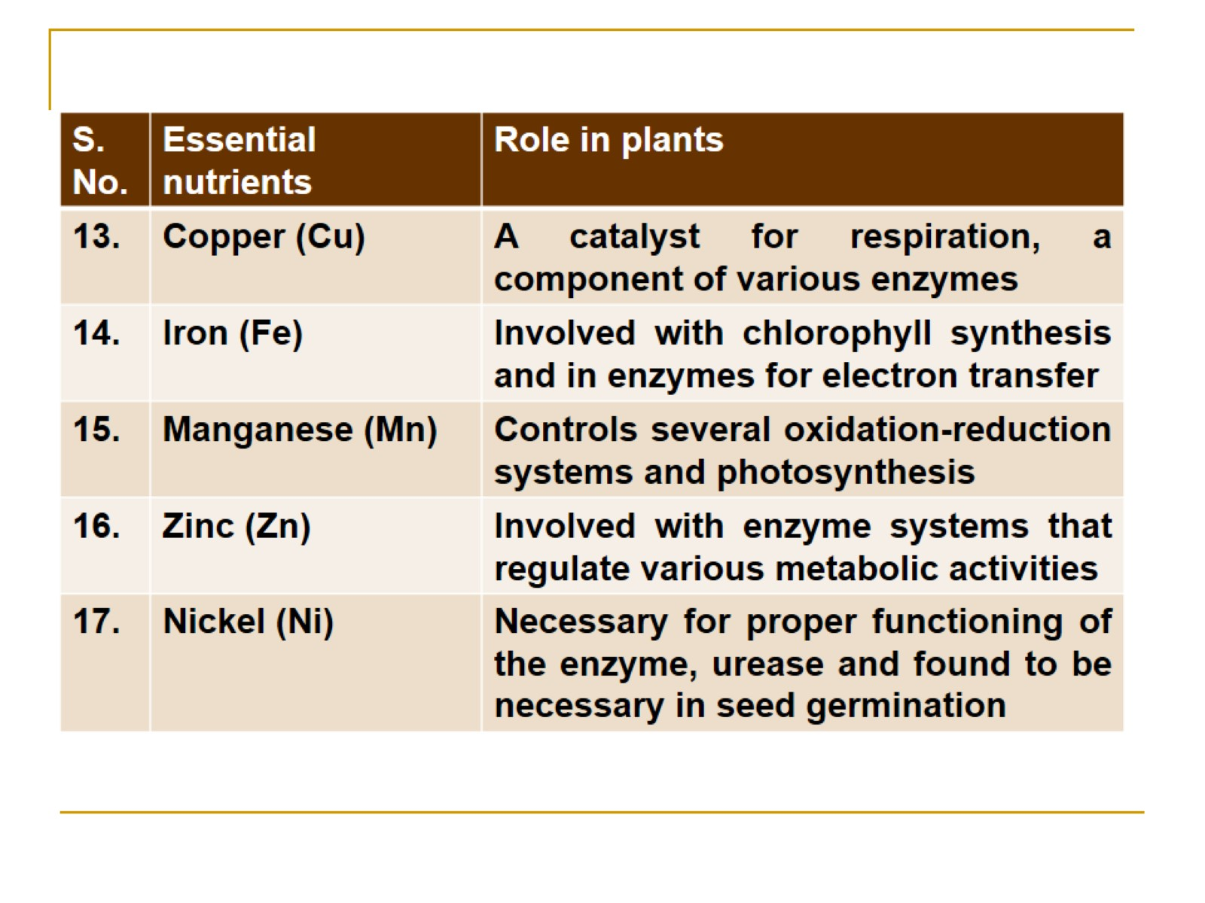

Slide 6
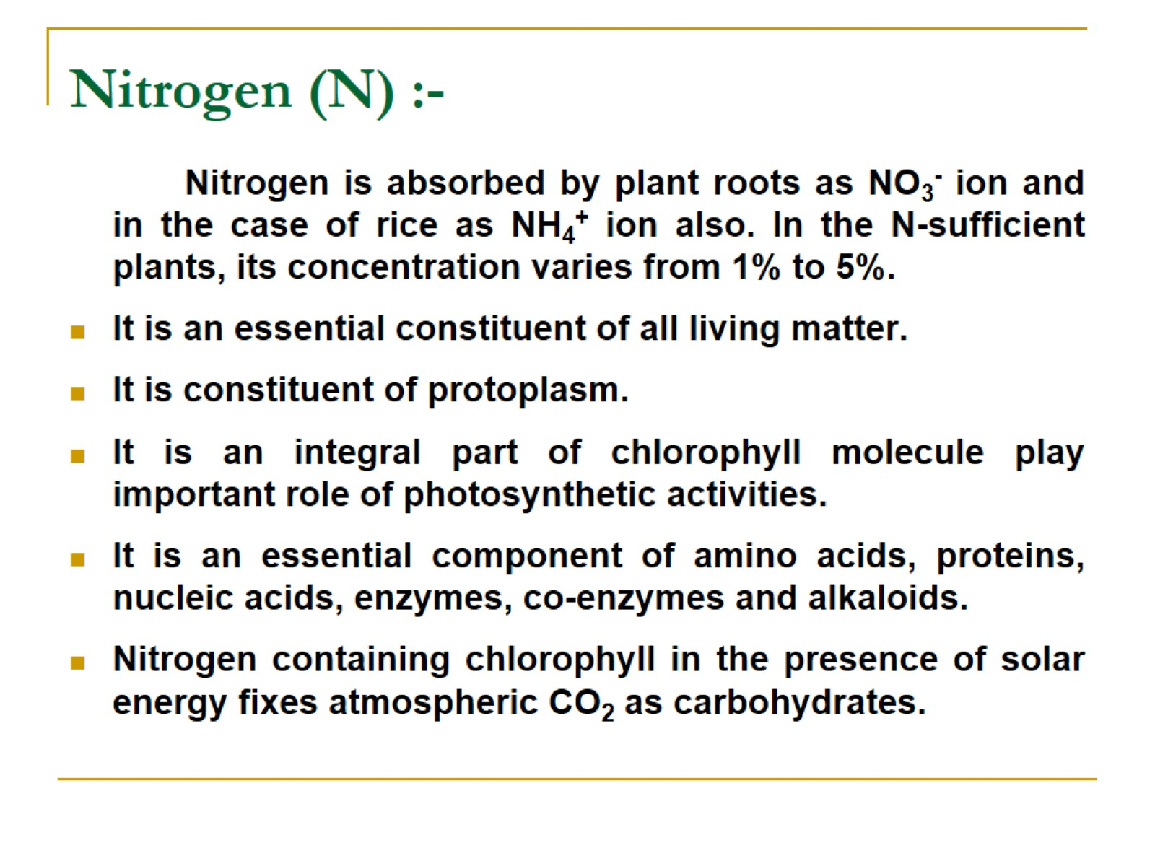
Nitrogen (N) :-

Slide 7
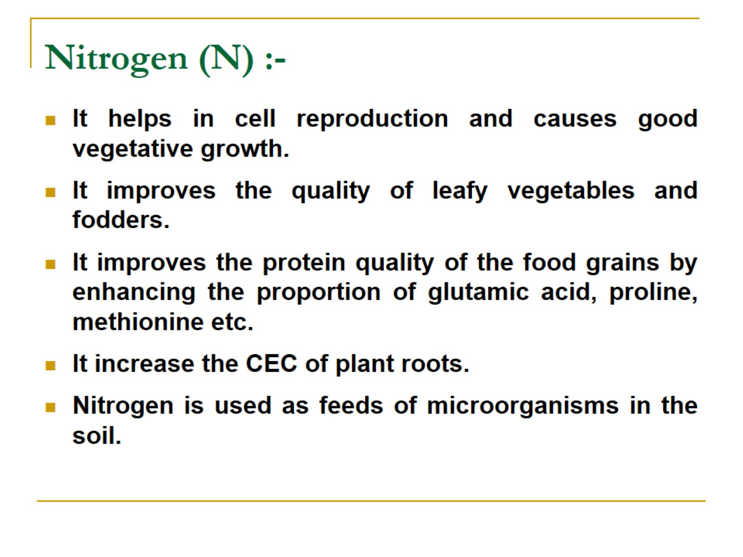
Nitrogen (N) :-

Slide 8
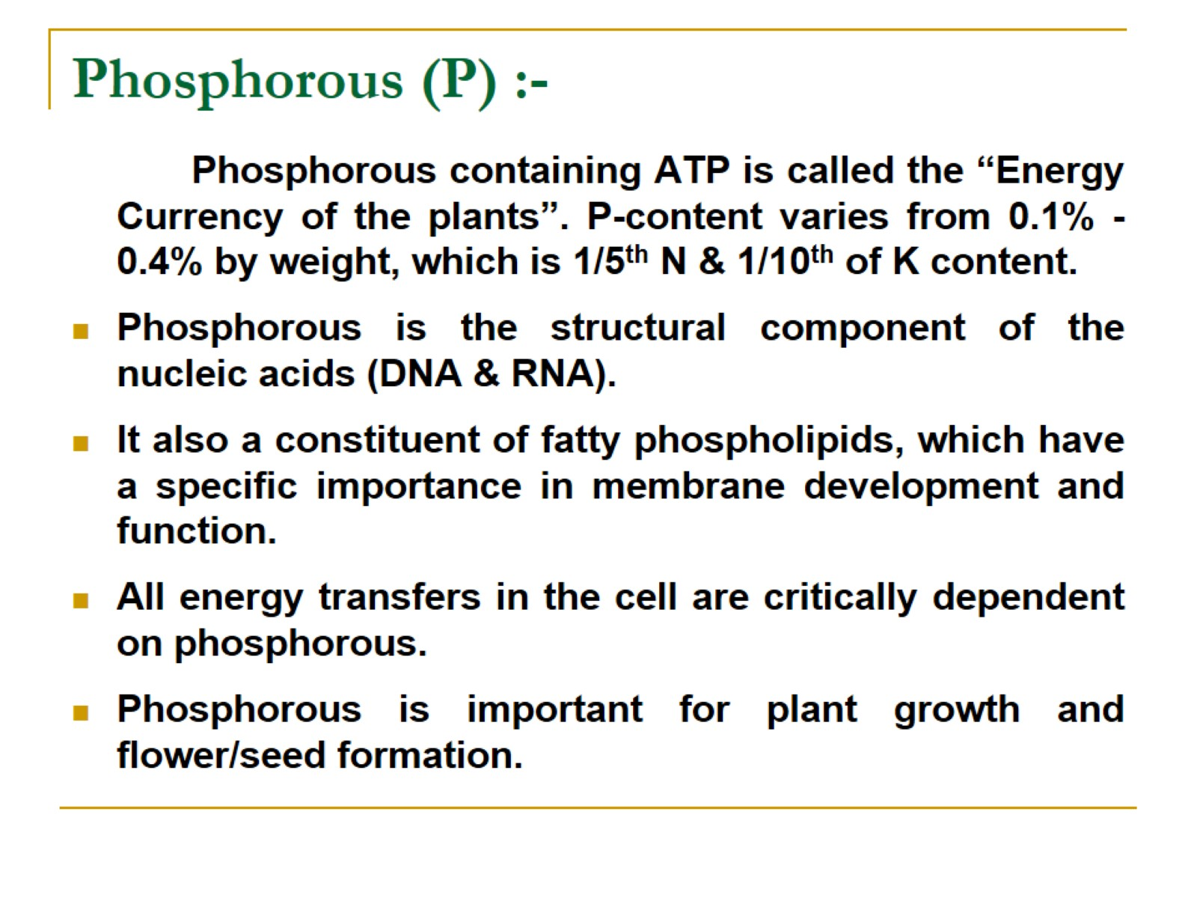
Phosphorous (P) :-

Slide 9
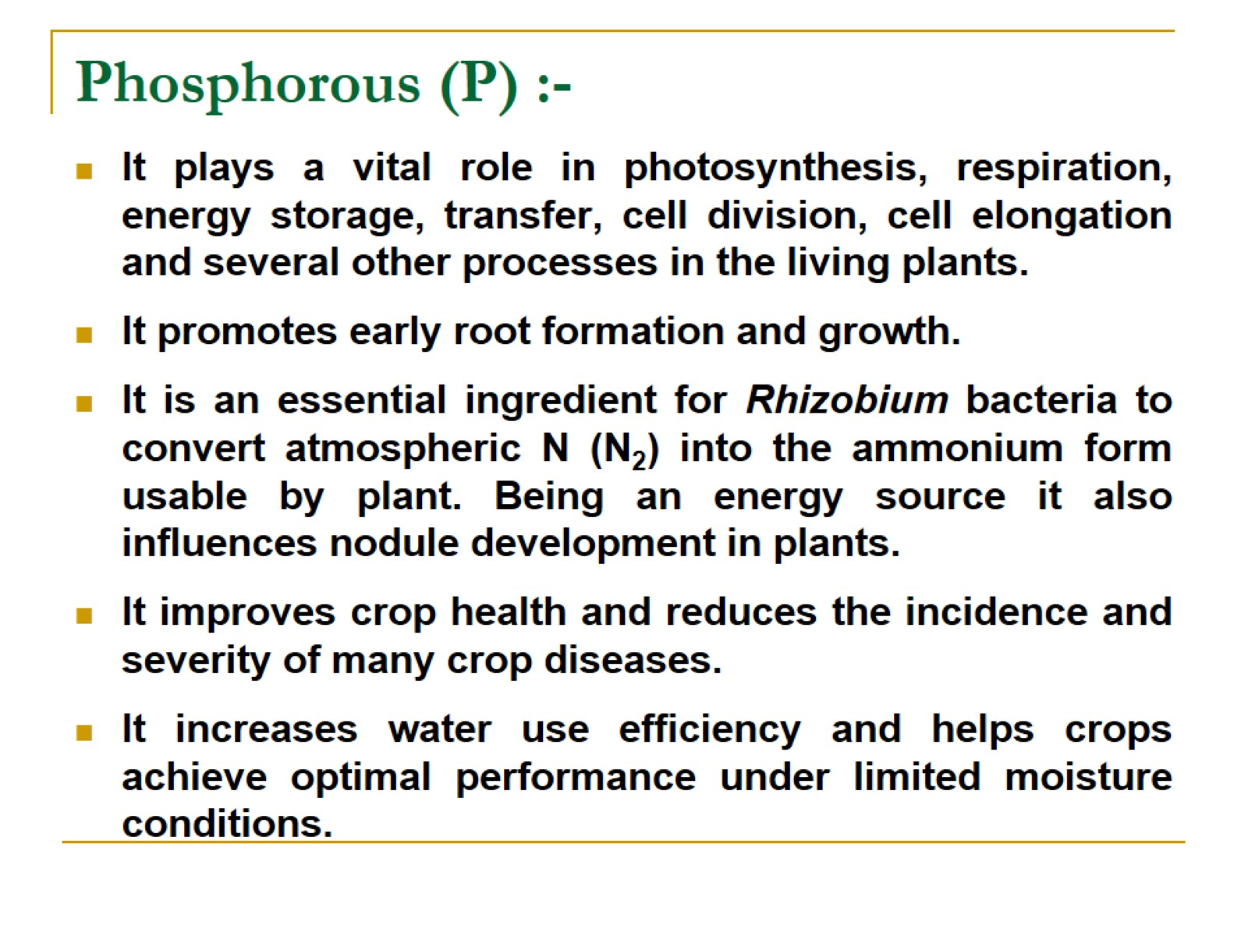
Phosphorous (P) :-

Slide 10
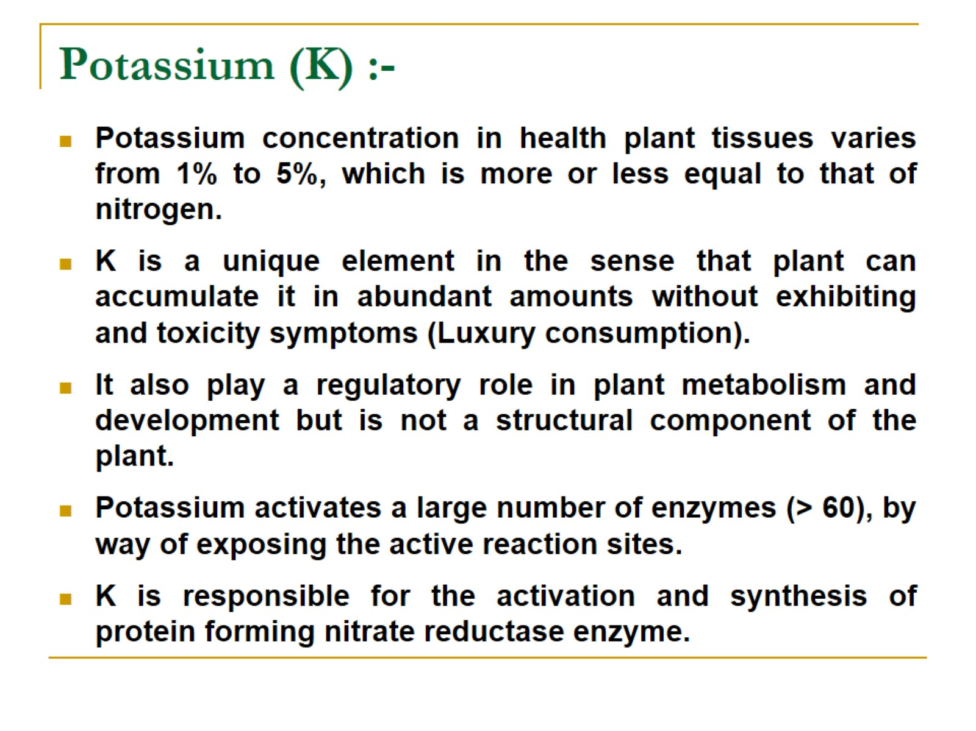
Potassium (K) :-

Slide 11
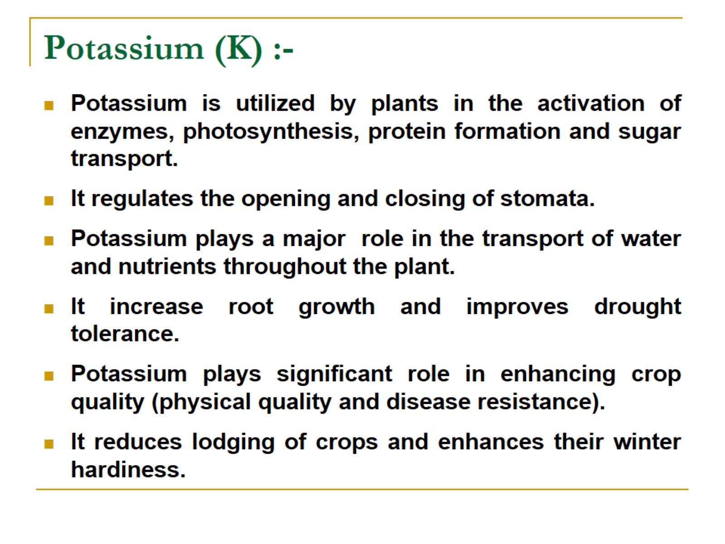
Potassium (K) :-

Slide 12
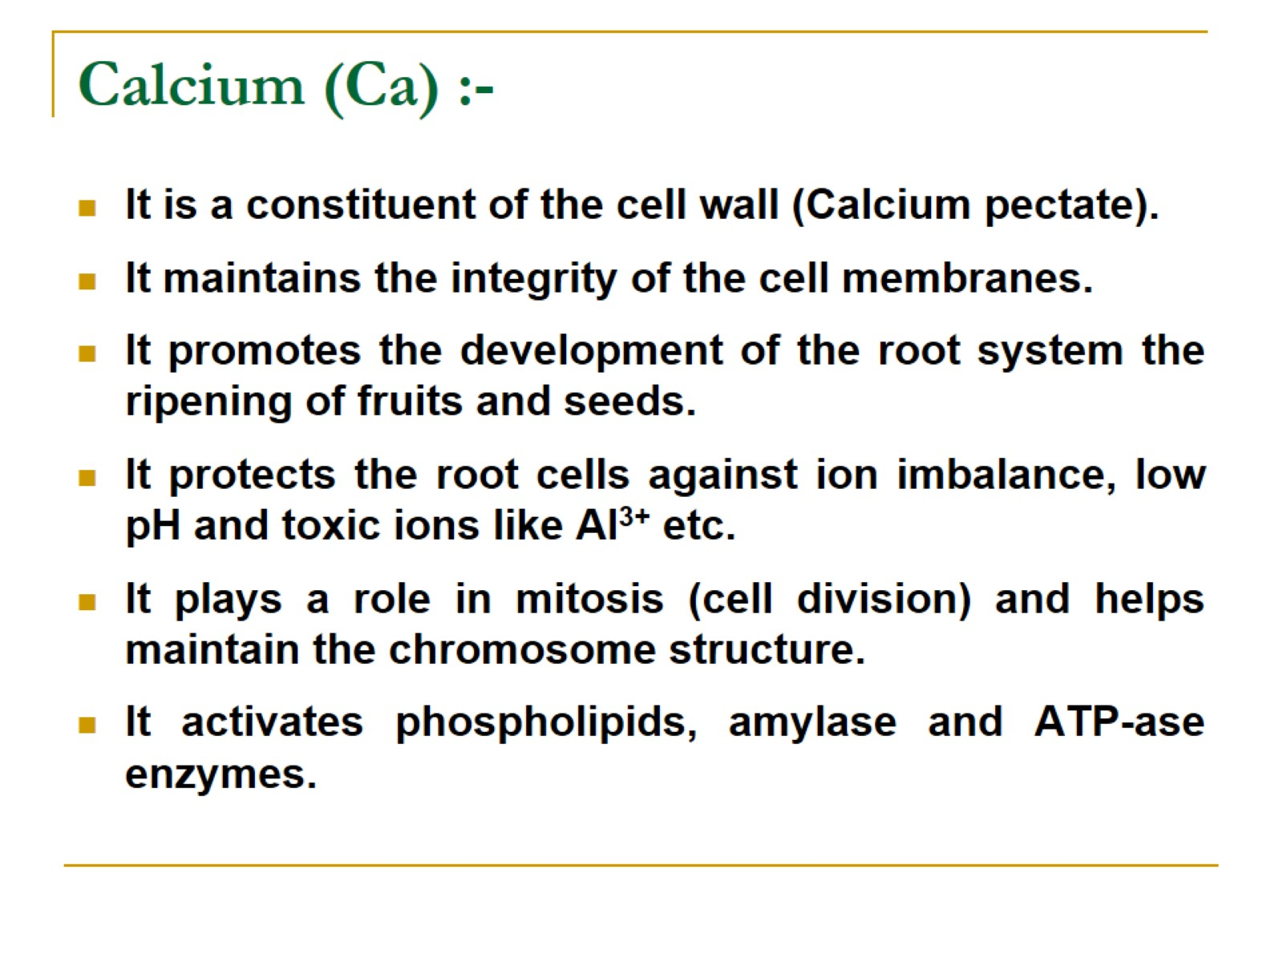
Calcium (Ca) :-

Slide 13
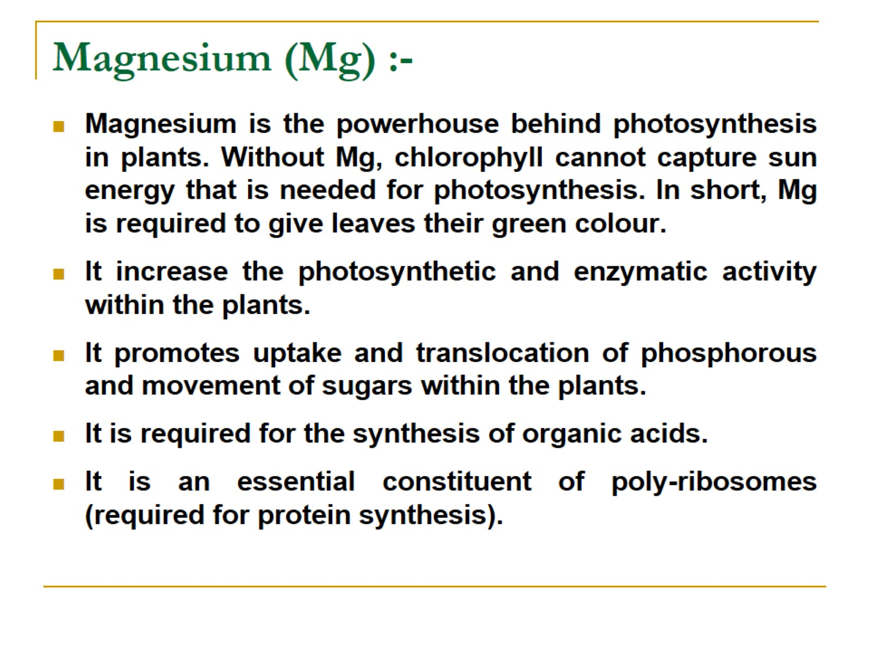
Magnesium (Mg) :-

Slide 14
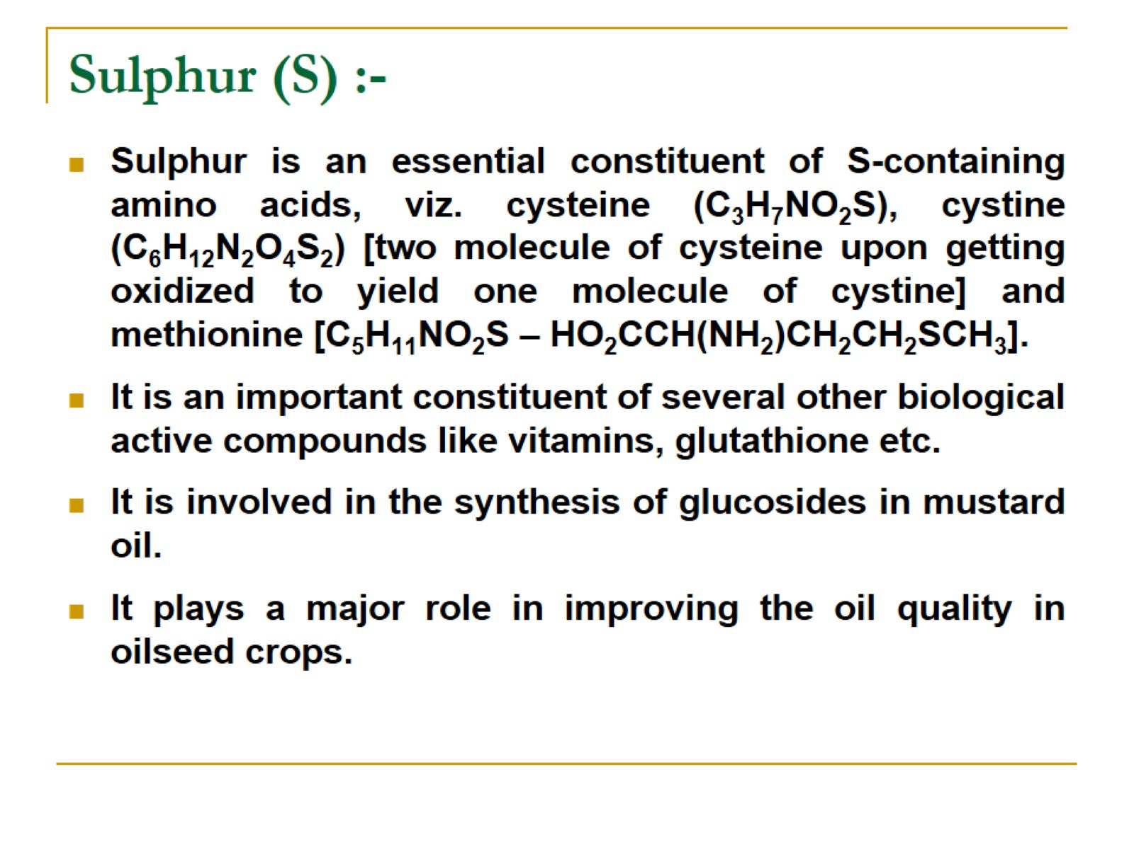
Sulphur (S) :-

Slide 15
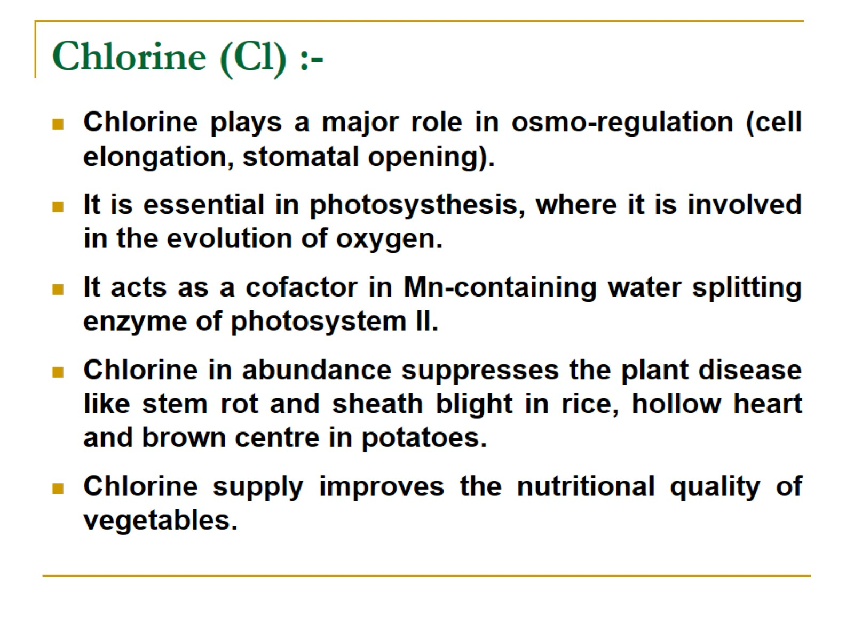
Chlorine (Cl) :-

Slide 16
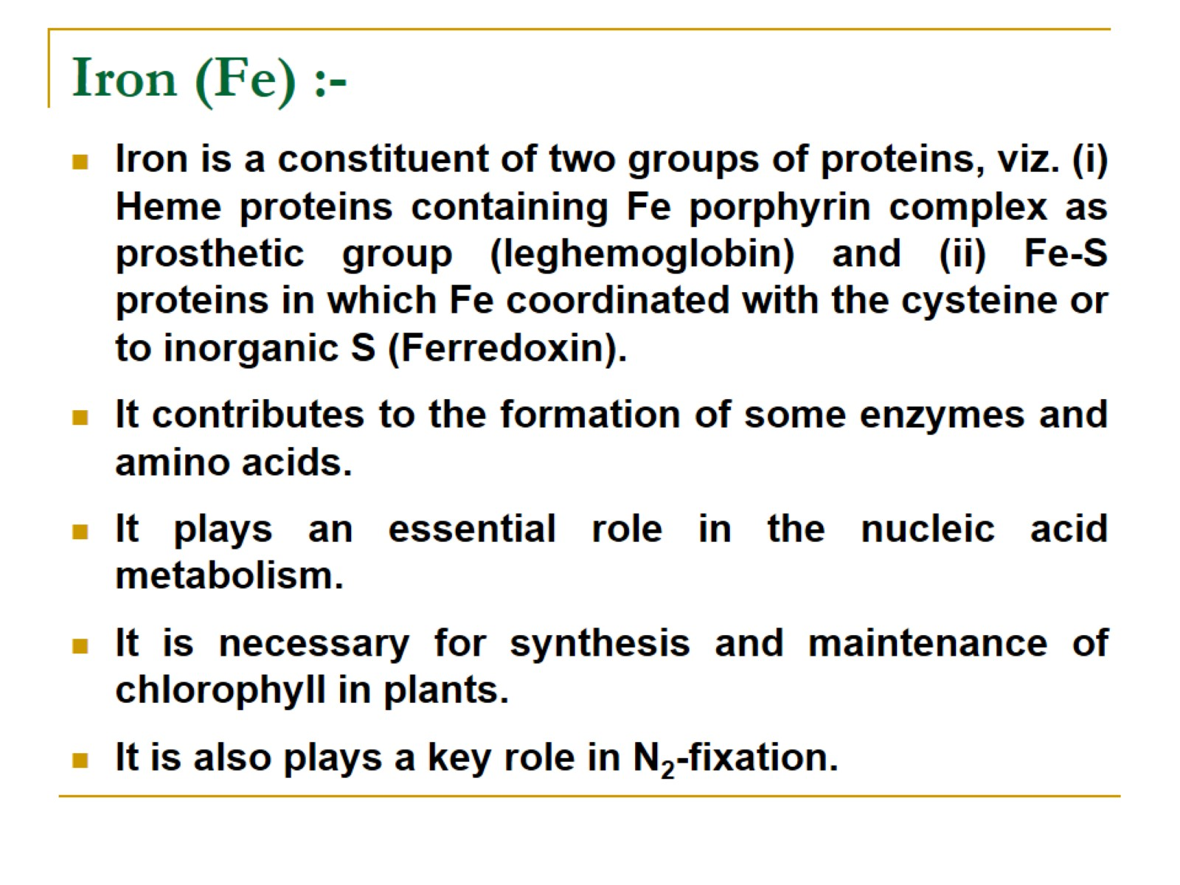
Iron (Fe) :-

Slide 17
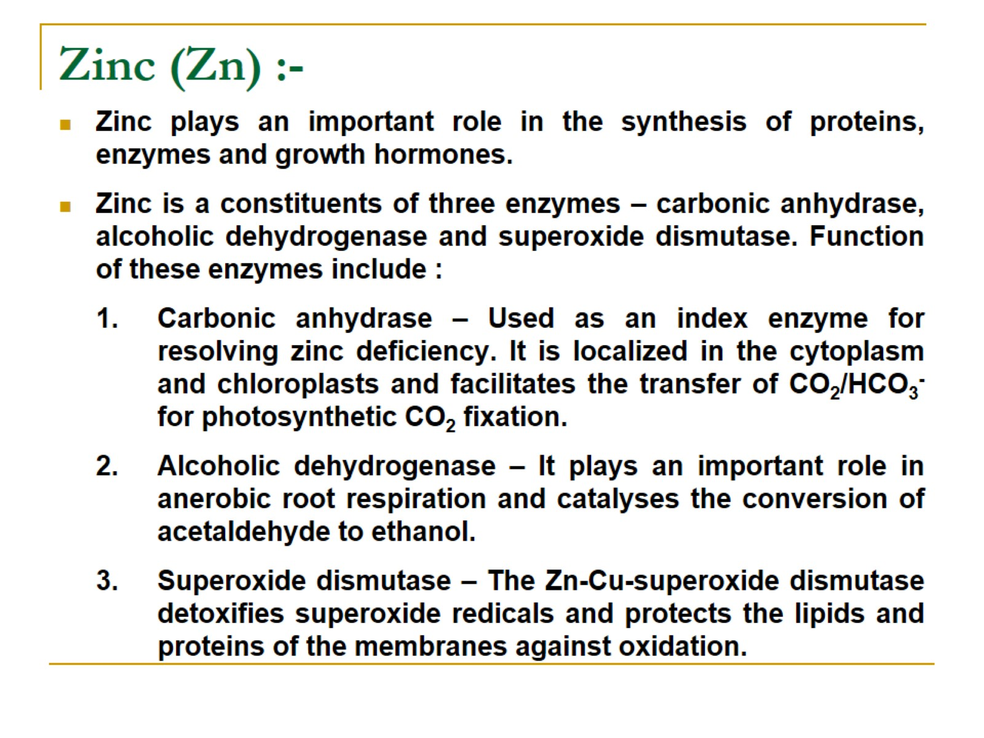
Zinc (Zn) :-

Slide 18
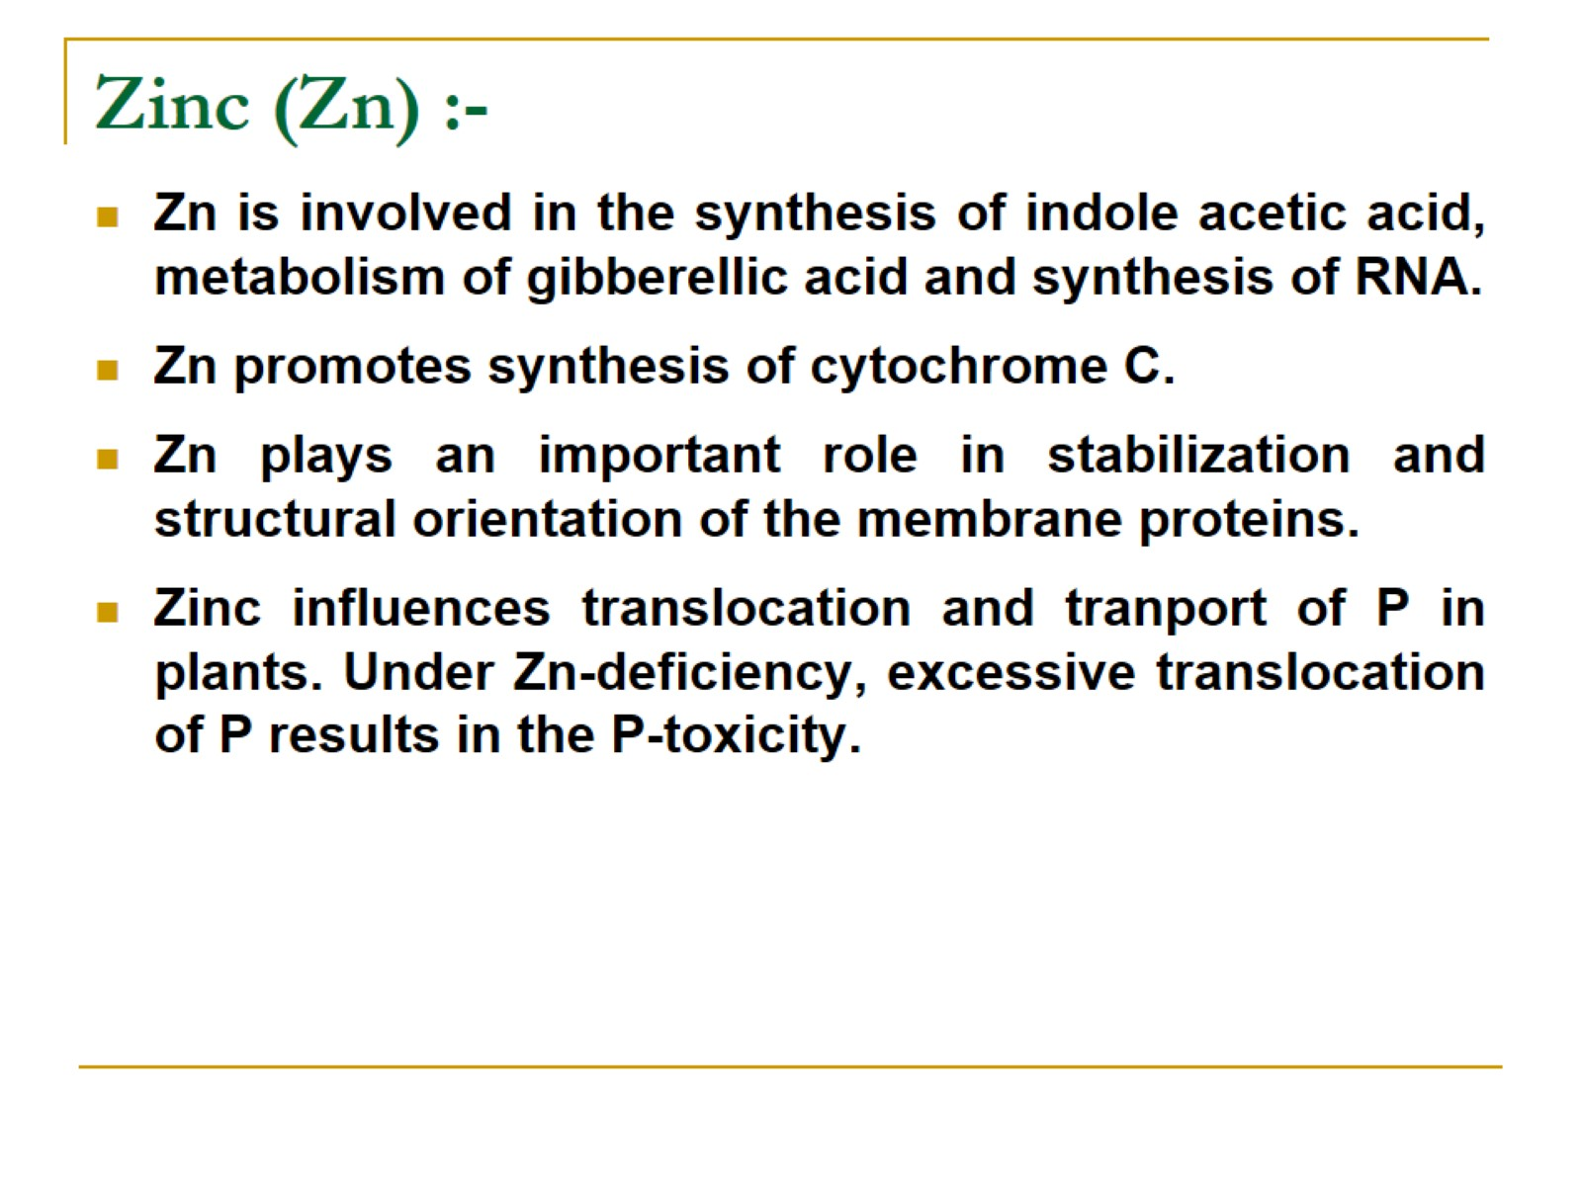
Zinc (Zn) :-

Slide 19
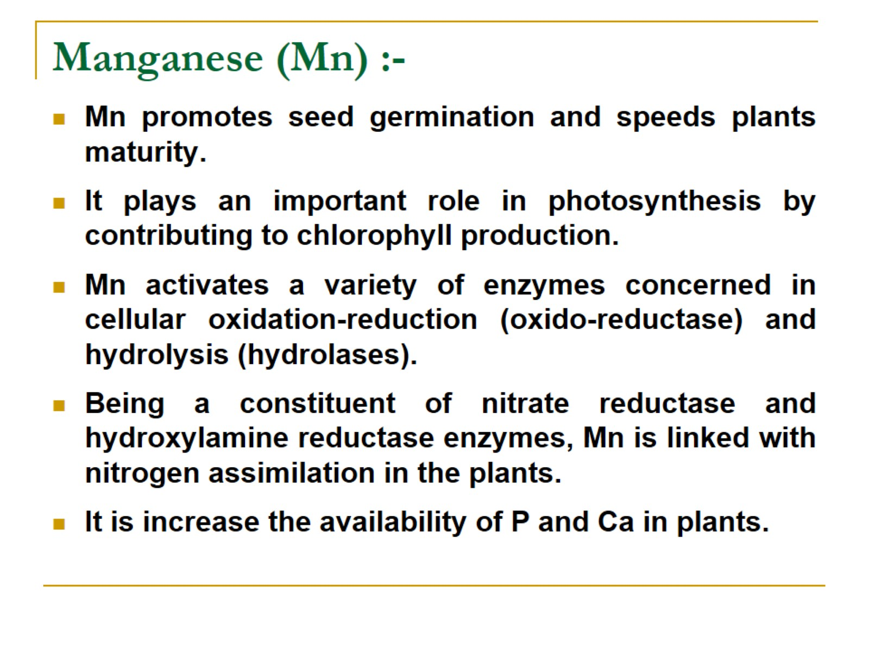
Manganese (Mn) :-

Slide 20
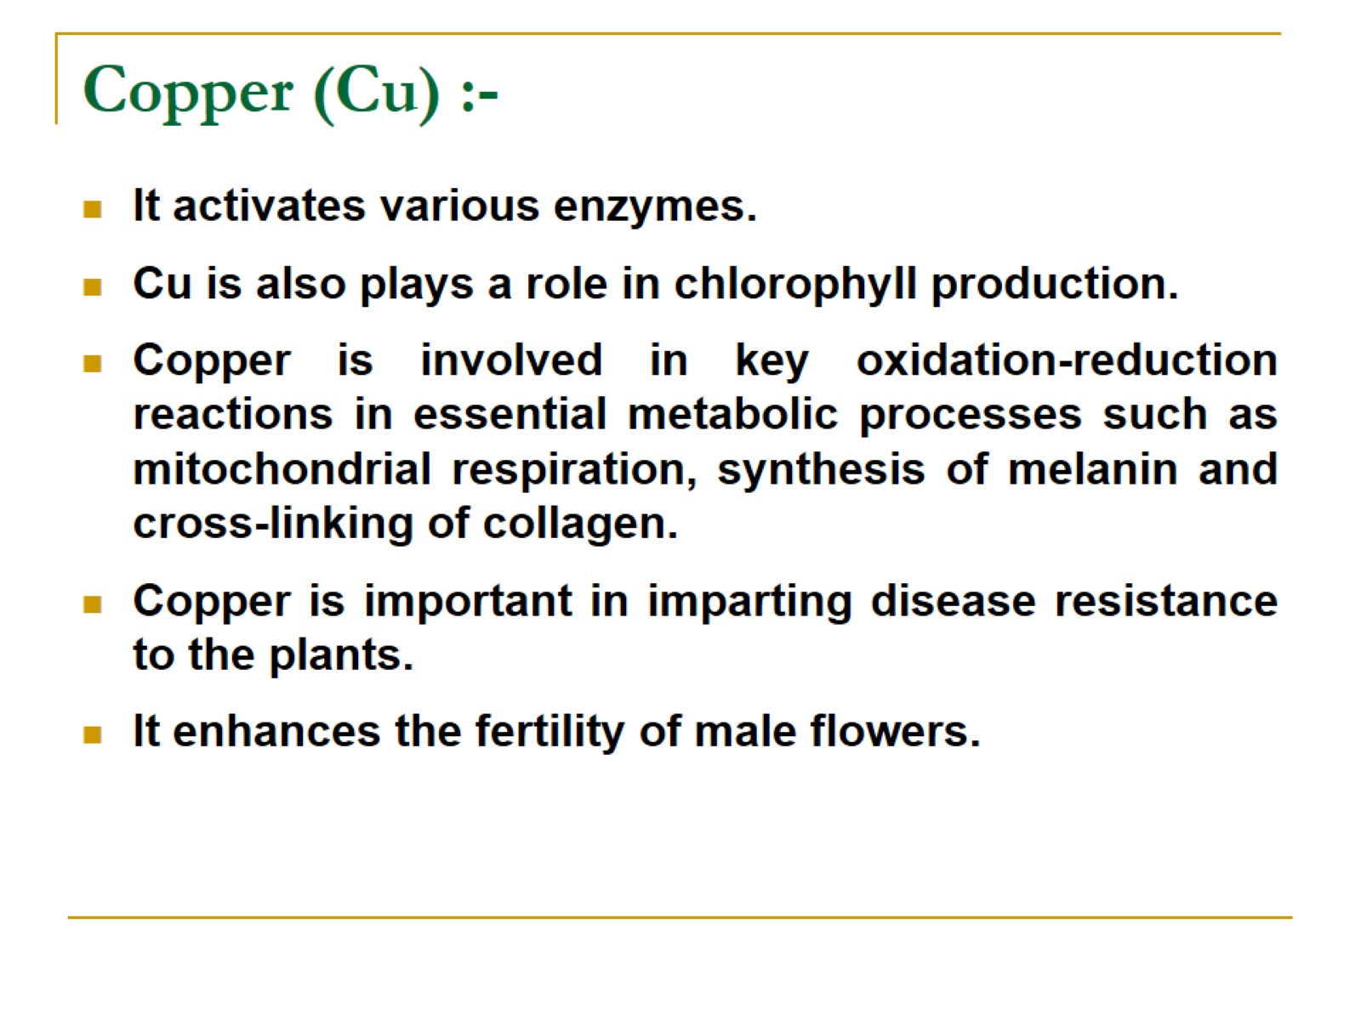
Copper (Cu) :-

Slide 21
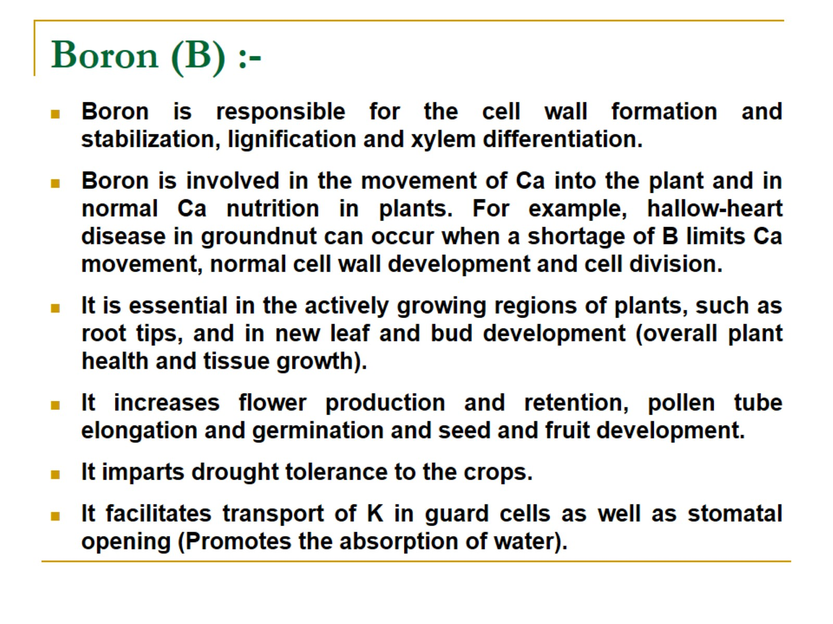
Boron (B) :-

Slide 22
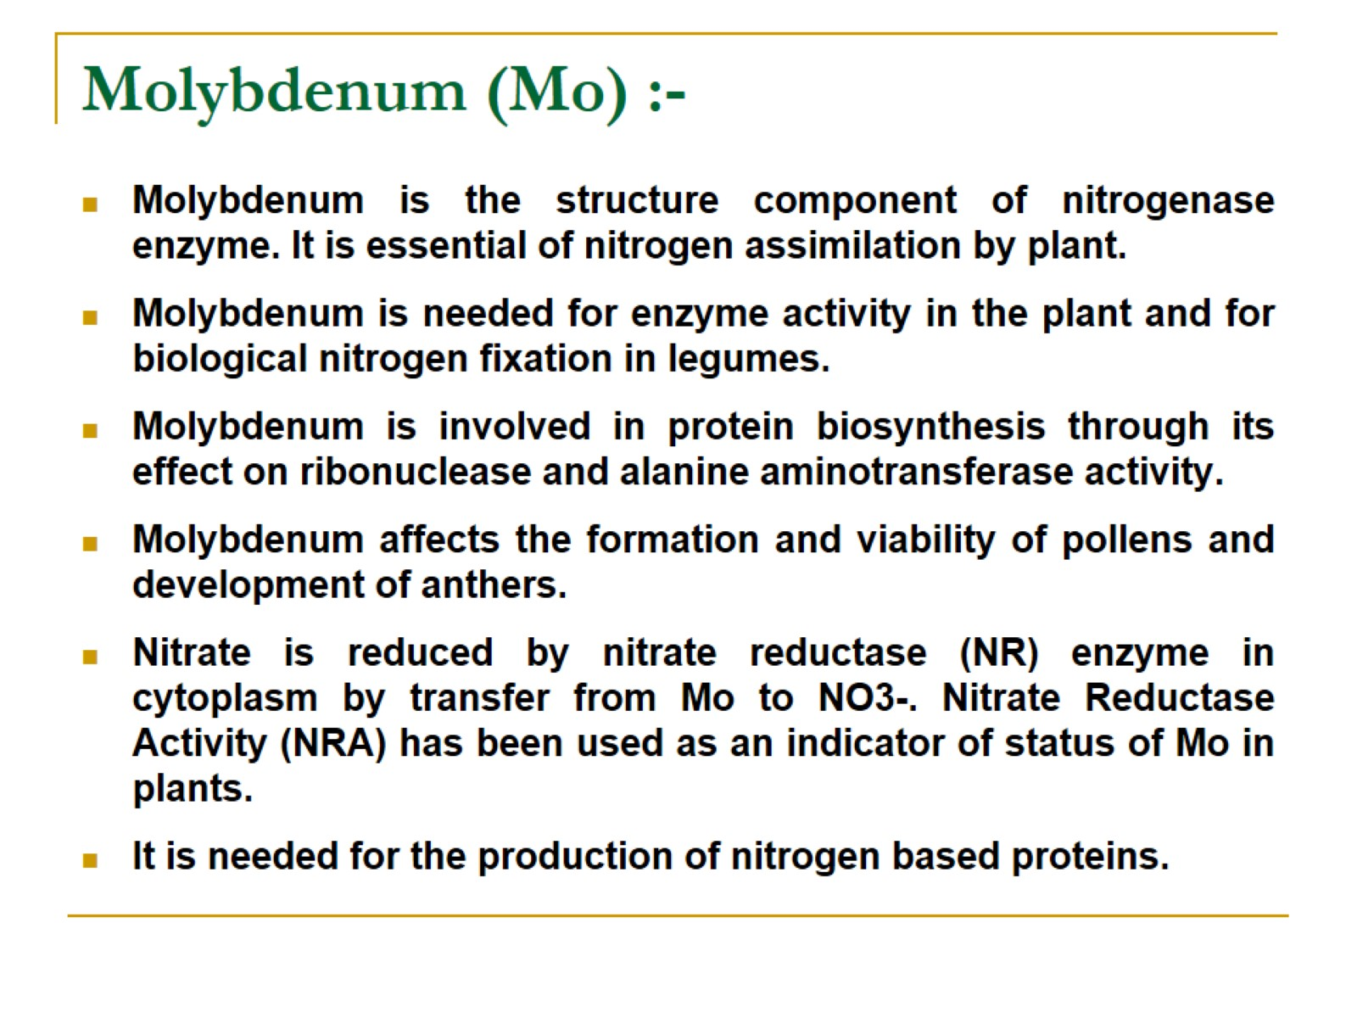
Molybdenum (Mo) :-

Slide 23
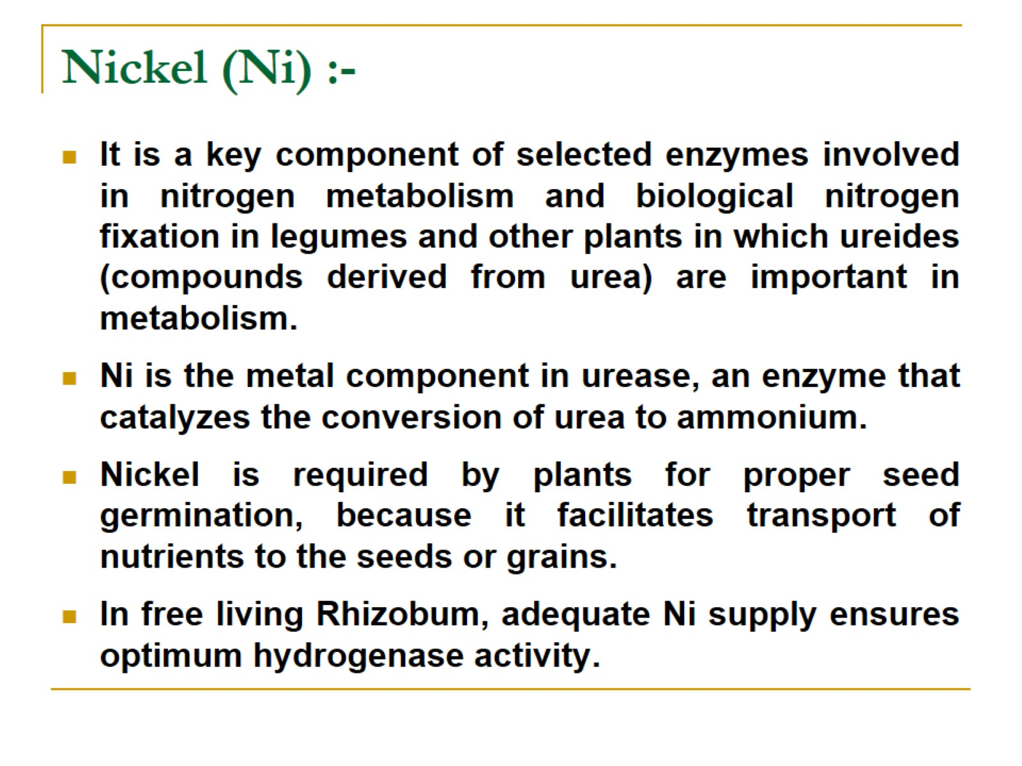
Nickel (Ni) :-

Slide 24

Thanks

