Slide 1
Fundamentals of Agronomy
Dr. Atul Shrivastava
Assistant Professor (Agronomy)

Slide 2
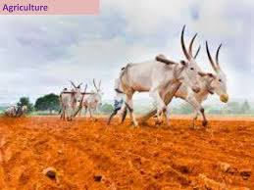

Slide 3
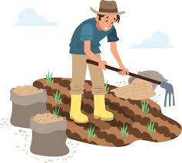

Slide 4
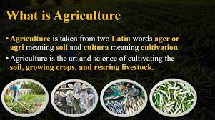

Slide 5
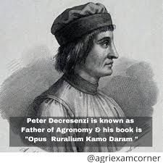

Slide 6
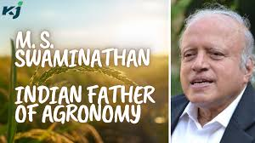

Slide 7
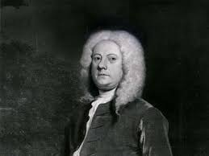
Jethrotull : Father of Tillage & Weeds

Slide 8
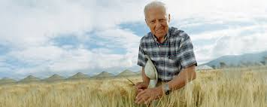
Dr Norman Borlaugh: Father of Green Revolution

Slide 9
Agronomy - Definition
The term Agronomy is derived from two Greek words ‘Agros’ meaning ‘Field’ and ‘Nomos’ meaning ‘Manage’.
“Agronomy is a branch of applied science deals with the principles and practices of soil, water and crop management”.
Norman (1980) defined agronomy as “The science of manipulating the crop environmental complex with dual aims of improving agricultural productivity and gaining a degree of understanding of the process involved”.
The recent definition of agronomy “is the successful, sustainable, profitable, nutritionally secured, efficient crop production with least or no environmental degradation”.

Slide 10
Relation of Agronomy to other sciences
Agronomy is a synthesis of several disciplines like
Soil science,
Crop physiology,
Plant ecology,
Biochemistry
Economics.
Plant Breeding & Genetics
Plant Enotomology & Pathology
Farm Machinery
Soil & Water Engineering
  Soil physical, chemical and biological properties have to be understood thoroughly to effect modification of soil environment.
  Similarly, it is necessary to understand the physiology of crops to meet their requirements. Advances in economic analysis helped in production of crops economically.

Slide 11
Objectives of Agronomy
Agronomist aims to obtain maximum production at minimum cost.
He exploits the knowledge developed by basic and applied science for higher crop production.
Whatever may be the research findings of other scientists, Agronomist has to test their suitability in the field and accept them finally and also judge the reactions of farming community.
He is a key person with working knowledge of all agricultural disciplines and coordinator of different subject matter specialists.

Slide 12
Scopes of Agronomy
1.Agronomy is a dynamic discipline with the advancement of knowledge and better understanding of plant and environment, agricultural practices are modified and new practices developed for high productivity,
for example availability of chemical fertilizer has necessitated the generation of knowledge on the method, quantity and time of application of fertilizers. Similarly, availability of herbicides for the control of weeds has led to development of knowledge about selectivity, time and method of application of herbicides.
To overcome the problems, different management practices are developed.
2.Population pressure is increasing but area under cultivation is static, therefore more number of crops has to be grown on the same piece of land to increase the yield. As a result, intensive cropping has come into practice.

Slide 13
Scopes of Agronomy
3.New technology has to be developed to overcome the effect of moisture stress under dryland conditions.
As new varieties of crops with high yield potential become available package of practices have to be developed to exploit their full potential.
4.Restoration of soil fertility, preparation of good seed bed, use of proper seed rates, correct dates of sowing for each improved variety, proper conservation and management of soil moisture and proper control of weeds are agronomic practices to make our limited land and water resources more productive.

Slide 14
Principles to Fundamentals of Agronomy
1.Planning, programming and executing measures for maximum utilization of land, labour, capital, sunshine, rainwater, temperature, humidity, transport and marketing facilities.
2.Choice of crop varieties adaptable to the particular agro-climate, land situation, soil fertility, season and method of cultivation and befitting to the cropping system.
3.Proper field management by tillage, preparing field channels and bunds for irrigation and drainage, checking soil erosion, leveling and adopting other suitable land improvement practices.
4.Adoption of multiple cropping and also mixed or intercropping to ensure harvest even under adverse environmental conditions.
5.Timely application of proper and balanced nutrients to the crop or crops in sequence and improvement of soil fertility and productivity. Correction of ill-effects of soil reactions and conditions and increasing soil organic matter through the application of green manure, farm yard manure, organic wastes, bio-fertilizers and profitable recycling or organic wastes.
6.Choice of quality seed or seed material and maintenance of requisite plant density per unit area with healthy and uniform seedlings.
7.Proper water management with respect to crop, soil and environment through conservation and utilization of soil moisture as well as by water that is available in excess. Efficient use of this water for life-saving or protective irrigation, scheduling irrigation at critical stages of crop growth and also growing crops in non-traditional seasons or belts with irrigation or rain or residual moisture.
8.Adoption of adequate, need-based, timely and exacting plant protection measures against weeds, insect-pests, pathogens, as well as climatic hazards and correction of deficiencies and disorders.
9.Adoption of suitable and exacting management practices including intercultural operations to get maximum benefit from dearer and difficult to get, low-monetary and non-monetary inputs. Adequate input supply should not be a substitute for deficiencies in management practices.
10.Adoption of suitable method and time of harvesting of crop to reduce field-damage and to release land for succeeding crop(s) and efficient utilization of residual moisture, plant nutrients and other management practices. Adoption of suitable post-harvest technologies.

Slide 15
Principles to Fundamentals of Agronomy
5.Timely application of proper and balanced nutrients to the crop or crops in sequence and improvement of soil fertility and productivity. Correction of ill-effects of soil reactions and conditions and increasing soil organic matter through the application of green manure, farm yard manure, organic wastes, bio-fertilizers and profitable recycling or organic wastes.
6.Choice of quality seed or seed material and maintenance of requisite plant density per unit area with healthy and uniform seedlings.
7.Proper water management with respect to crop, soil and environment through conservation and utilization of soil moisture as well as by water that is available in excess. Efficient use of this water for life-saving or protective irrigation, scheduling irrigation at critical stages of crop growth and also growing crops in non-traditional seasons or belts with irrigation or rain or residual moisture.
8.Adoption of adequate, need-based, timely and exacting plant protection measures against weeds, insect-pests, pathogens, as well as climatic hazards and correction of deficiencies and disorders.
9.Adoption of suitable and exacting management practices including intercultural operations to get maximum benefit from dearer and difficult to get, low-monetary and non-monetary inputs. Adequate input supply should not be a substitute for deficiencies in management practices.
10.Adoption of suitable method and time of harvesting of crop to reduce field-damage and to release land for succeeding crop(s) and efficient utilization of residual moisture, plant nutrients and other management practices. Adoption of suitable post-harvest technologies.

Slide 16
Principles to Fundamentals of Agronomy
8.Adoption of adequate, need-based, timely and exacting plant protection measures against weeds, insect-pests, pathogens, as well as climatic hazards and correction of deficiencies and disorders.
9.Adoption of suitable and exacting management practices including intercultural operations to get maximum benefit from dearer and difficult to get, low-monetary and non-monetary inputs. Adequate input supply should not be a substitute for deficiencies in management practices.
10.Adoption of suitable method and time of harvesting of crop to reduce field-damage and to release land for succeeding crop(s) and efficient utilization of residual moisture, plant nutrients and other management practices. Adoption of suitable post-harvest technologies.

Slide 17
Role of Agronomist
Agronomist exploits the knowledge of the basic and applied sciences to maximize crop production at minimum cost. Agronomists are concerned with deriving efficient technology of crop production activities like
a.Land Preparation: Developing efficient and economic field preparation methods depending on crop, season and resource availability. Developing machineries in co-ordination with Agricultural Engineers.
b.Selection of crops: Involved in selecting suitable crop and variety in accordance with the season, soil and farmers preference.
c.Sowing / Planting: Develop efficient method of sowing / planting and standardized spacing / plant geometry to maintain optimum plant population and in turn better yield.
d.Nutrient management: Identify various nutrients required by the crop taking crop demand and soil fertility in to consideration. He is also responsible for deriving optimum time and method of application of these nutrients.
e.Weed management: Agronomist is responsible for selecting better weed management practices viz., mechanical / physical or cultural / agronomic or biological or chemical or integration of two or more methods.
f.Irrigation management: Selection of proper irrigation method, time and quantity of application based on crop water need and its availability.
g.Crop planning / cropping system: Identifying the crop sequence, inter / mixed cropping for efficient utilization of available resources to maximize farm income.
h.Harvesting and Processing: Responsible for deriving efficient method and time of harvesting & processing.

Slide 18
Role of Agronomist
e.Weed management: Agronomist is responsible for selecting better weed management practices viz., mechanical / physical or cultural / agronomic or biological or chemical or integration of two or more methods.
f.Irrigation management: Selection of proper irrigation method, time and quantity of application based on crop water need and its availability.
g.Crop planning / cropping system: Identifying the crop sequence, inter / mixed cropping for efficient utilization of available resources to maximize farm income.
h.Harvesting and Processing: Responsible for deriving efficient method and time of harvesting & processing.

Slide 19
Agronomy -Art, Science and Business of crop Production
1. Agriculture as an art
Learning by doing and gaining experience. Art is concerned with skill and experience. It is inherited by seeing parents or elders through experience.
Agriculture tells us how to perform the operation like sowing, weeding etc in a skillful manner.
Agriculture primarily requires physical skill. Physical skill is inherited by doing physical work with perfect execution.
E.g. opening a straight furrow, levelling the field, sowing seed, application of manures and fertilizers etc.
Art of agriculture requires secondarily mental skill (Decision making).
Eg. Selection of crops for a particular area, Deciding the time of operation, timing of production to get better returns, choosing of low cost / no cost inputs etc.

Slide 20
Agronomy -Art, Science and Business of crop Production
2. Agriculture as a Science
Science is systematic study of happenings of anything. Scientific principles were used in agriculture for increasing production and quality of crops.
Several scientific advances have been made in all branches of agriculture which are systematized to increase crop production and achieve self sufficiency.
Eg. Plant breeding and Bio-technology - Developed many varieties suiting to various soils, climate and consumer tastes.
Agronomy- Developed improved crop production practices like management of soils, fertilizers.

Slide 21
Agronomy -Art, Science and Business of crop Production
3. Agriculture as a Business
Agriculture in developed countries is a business driven process.
The farmers in these countries cultivate the crops to earn higher income with less investment and agriculture is practiced on a business line and land is considered as workshop or factory to generate returns.
Mechanization and commercialization have been introduced in these countries to get maximum profit.
Whereas, in developing and under developed countries, agriculture is considered as a way of life and practicing on a subsistence level.
Traditional farming is handed over from father to son without any effort to increase production. Hence, Agriculture is considered as a business.

Slide 22
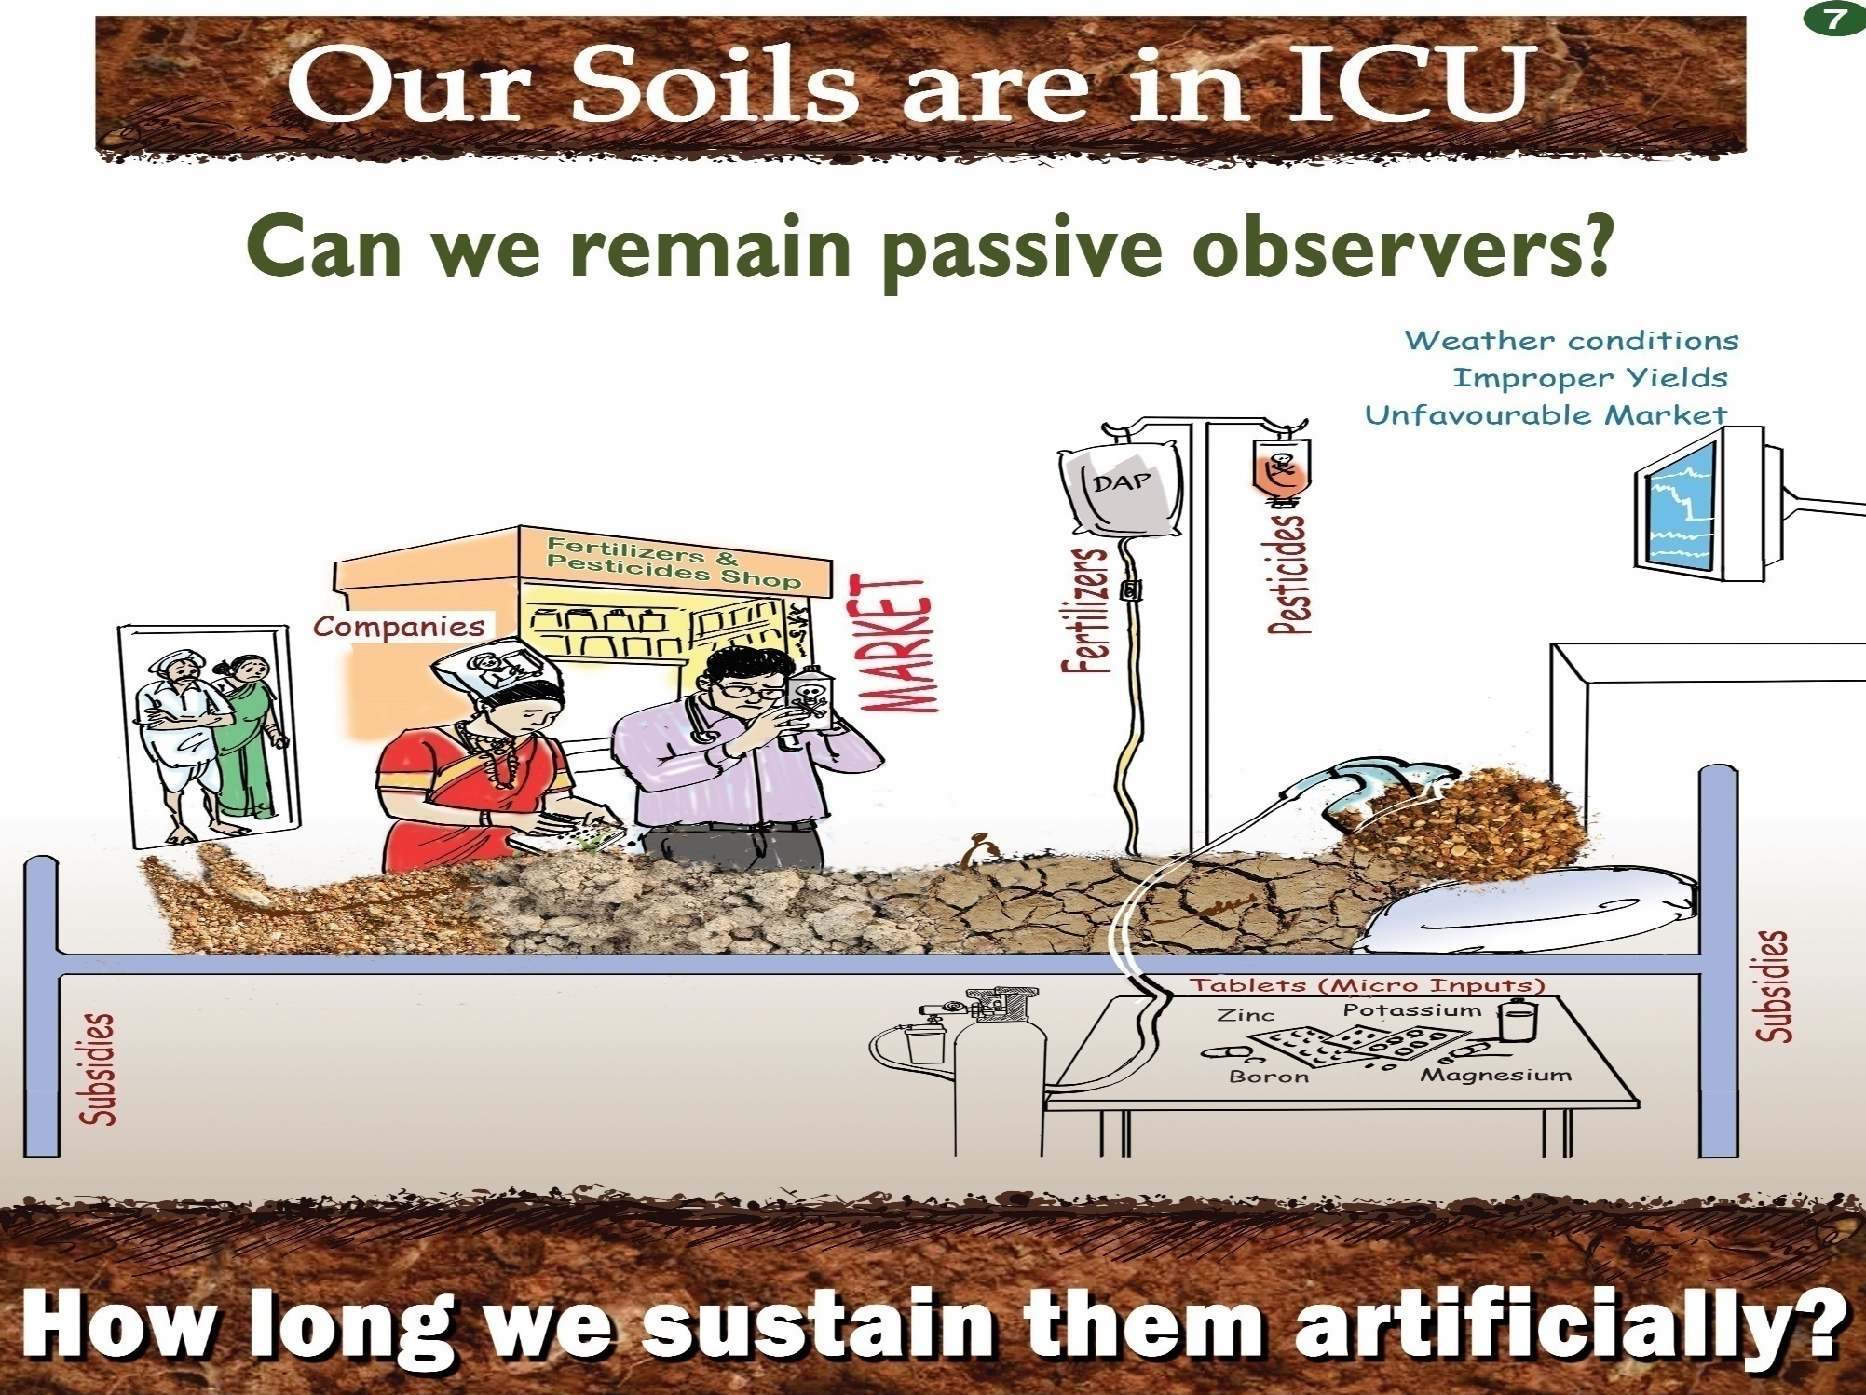
Restore soil health and fertility and soil’s biological life

