Slide 1

 | Plant Pathology
 | Plant Pathology is derived from Greek words- pathos (suffering) + Logos (study) Study of the suffering plant Two phases - Science- understanding of the disease i.e. how do pathogens invade, how do plants defend themselves, what causes symptoms etc. Art- application of the science to the field problems i.e. Diagnosis and Control. Defnition Plant pathology or phytopathology is the branch of agricultural, science which deals with the cause, etiology, resulting in losses and management methods of plant diseases.
READ THINK LEARN
Dr. Sanjeev Kumar

Slide 2
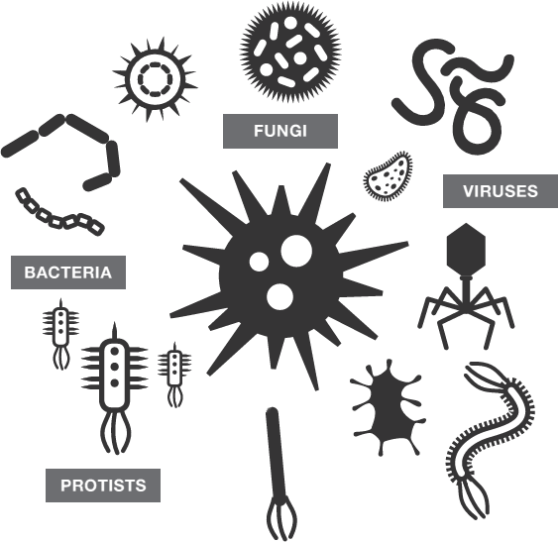
 | Study of plant pathology includes
 | 1. Microbiology: Study of Microorganisms 2. Bacteriology: Study of Bacteria 3. Virology: Study of Viruses 4. Mycology: Study of Fungi 5. Nematology: Study of Nematode 6. Protozology: Study of Protozoa 7. Phycology: Study of Algae.
READ THINK LEARN
Dr. Sanjeev Kumar

Slide 3
 | Major objectives
 | To study biotic, mesobiotic and abiotic causes of diseases or disorders. To study the mechanisms of disease development by pathogens. To study the plant (host)-pathogen interaction in relation to environment. To develop methods of management of plant diseases.
READ THINK LEARN
Dr. Sanjeev Kumar

Slide 4
 | Scope of Plant Pathology
 | Survey of crop fields to find out prevalence of diseases and their incidence. Recording new diseases of economic importance if any, with their identification and extent of incidence. Assessment of losses caused by different diseases of economic importance. Study of etiology, symptoms, predisposing factors and recurrence of such diseases. Find out suitable and economic methods of management of economically important plant diseases. Assisting in breeding of disease resistant varieties. To train the extension workers and subject matter specialists in order to bridge the gap between pathologists and farmers for better crop production.
READ THINK LEARN
Dr. Sanjeev Kumar

Slide 5
 | Importance of Plant Pathology in Agriculture
 | Advanced the knowledge to protect the crop from losses due to diseases. Most of the diseases with known disease cycle can now be avoided by the modification of cultural practices. With the knowledge of mode of disease spread, many diseases of economic importance can now be managed . Crop improvement and varietal resistance have been achieved against many diseases through the joint effort of breeder and plant pathologist. Contributed in disease free certified seed production Made possible to restrict the spread of plant diseases from one place to other and one country to other through suitable measures and quarantine legislation. Various prophylactic measures like seed treatment, soil treatment and crop rotations are adopted for successful management of diseases.
READ THINK LEARN
Dr. Sanjeev Kumar

Slide 6
 | Plant Pathology
READ THINK LEARN
Dr. Sanjeev Kumar

