Slide 1

 | Reproduction in Fungi
 | Reproduction: Formation of a progeny by either sexual or asexual means. Spore is an unit of reproductions. Asexual Reproduction: Production of identical individuals without the union of the sex organs. Methods of Asexual Reproduction: 1. By fragmentation of soma or cell sap or hyphae 2. Budding 3. Binary fission 4. Production of spores Sexual Reproduction: Union of two compatible nuclei. Methods of Sexual Reproduction: a. Planogamtic Copulation b. Gametangial Contact c. Gametangial Copulation d. Spermatization e. Somatogamy f. Heterokaryasis g. Dikaryotization.
READ THINK LEARN
Dr. Sanjeev Kumar

Slide 2
 | Methods of Asexual Reproduction
 | Fragmentation Breaking off of parts of the mycelium through external forces. Such pieces of mycelium can start a new individual Arthrospores or oidia. Cell gragment ted by formation of new septa. New cell function as spore Chlamydospores: Cell surrounded by thick walls before separation Budding small outgrowth from a parent cell called blastospores. eventually breaks off and forms a new individual Binary fission Simple splitting of a cell into two daughter cells by constriction Production of spores Spore produced may be conidia or Sporangiospores Basipetal oldest at the top and youngest at the bottom. Acropetal oldest at the bottom and youngest at the top.
READ THINK LEARN
Dr. Sanjeev Kumar

Slide 3
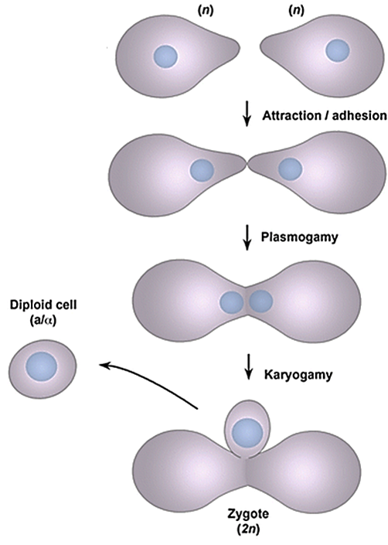
 | Methods of Sexual Reproduction
 | Process consists of three distinct phases. Plasmogamy: Union of two protoplasts Karyogamy: Actual fusion of two haploid nuclei Meiosis: Reduces the number of chromosomes to haploid.
READ THINK LEARN
Dr. Sanjeev Kumar

Slide 4
 | Methods of Sexual Reproduction
 | Planogamtic Copulation fusion of two naked gametes one or both of which are motile. Motile gametes are called planogametes b. Gametangial Contact Two gametangia of opposite sex come in contact, one or more gamete nuclei migrate from the male to the female Zygote formed is called Oospore. e.g. Oomycetes , Ascomycetes. c. Gametangial Copulation Entire protoplast is transferred into the female gametangia a involes the fusion of two protoplast in a common cell. Common in class Trichomycetes and zygomycetes. d. Spermatization Involves formation of small spores or seed like structures or spematia. Spermatia acts as male gamete carried out by wind, insects to the retentive hypha ( Female gametangium). A pore developed at the plant of contact and the contents of the spermatia passes into receptive hypha which serves as a female organ. e.g. Pycniospores and Receptive hypha in rusts. e. Somatogamy No gametes are involved. Vegetative hypha itself acts as a male and female gamete and bring about sexual reproduction. e. g. Smut Fungi.
READ THINK LEARN
Dr. Sanjeev Kumar

Slide 5
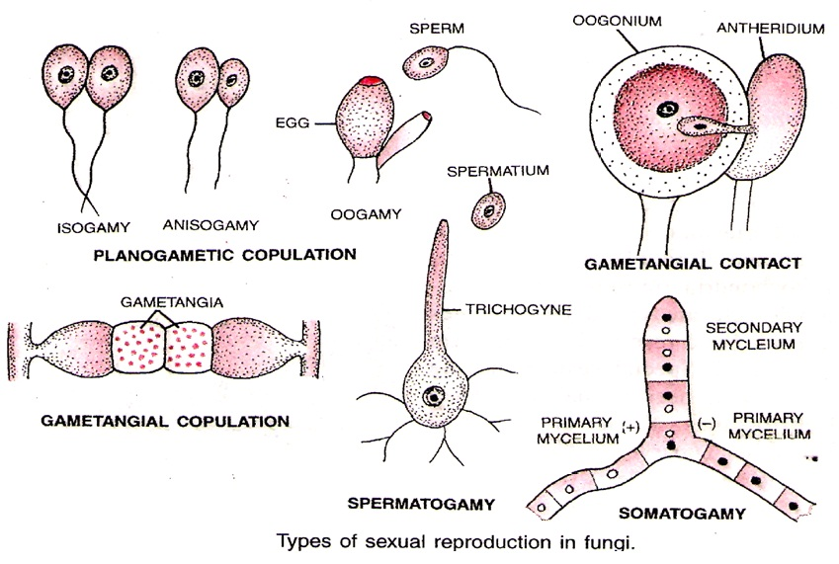
 | Sexual Reproduction in Fungi
READ THINK LEARN
Dr. Sanjeev Kumar

Slide 6
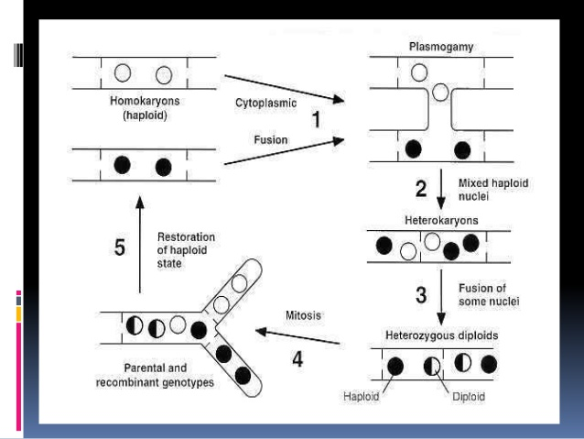
 | Heterokaryosis
 | Existence of genetically different kinds of nuclei in in cytoplasm continuity with one another Discovered by Hansen &Smith (1932) in Botrytis cinerea Play a major role in variability &sexuality in fungi
READ THINK LEARN
Dr. Sanjeev Kumar

Slide 7
 | Establishment of Heterokaryosis
 | Presence of haploid nuclei of dissimilar genotypes in the same cytoplasm is prerequisite for recombination. This is achieved by HETEROKARYOSIS which brought about by Mutation Anastomosis (Between hypha of different origin) This step is equal to cytokinesis of sexual reproduction
READ THINK LEARN
Dr. Sanjeev Kumar

Slide 8
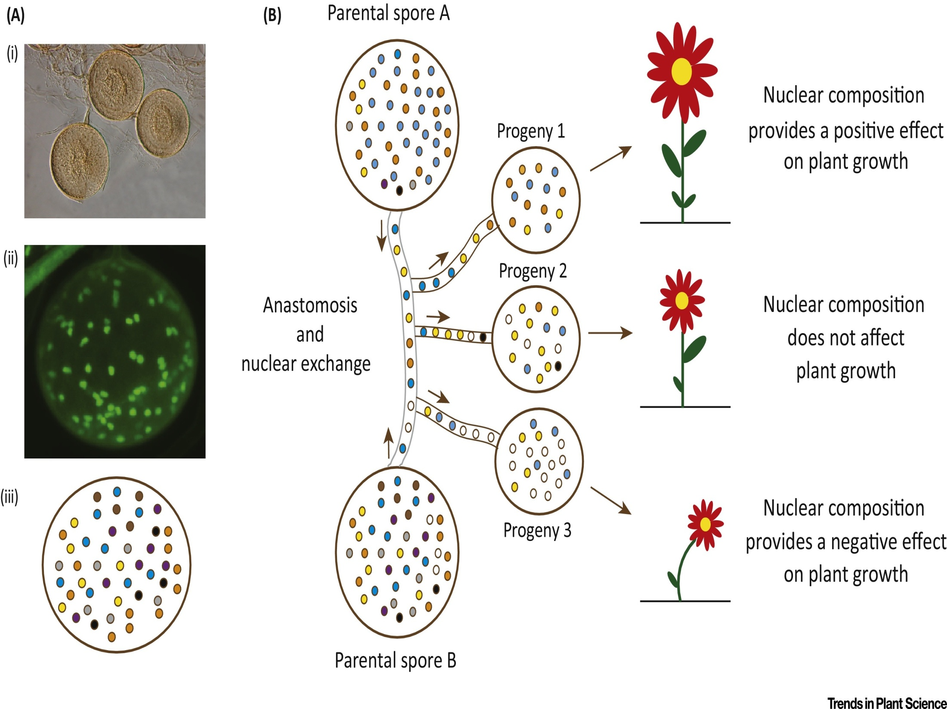

Slide 9
 | Parasexuality Special type of Sexual reproduction
 | Also known as ‘SOMATIC RECOMBINATION’ A cycle in which PLASMOGAMY, KARYOGAMY AND MEIOSIS (HAPLOIDIZATION) take place, but not a specified points in the thallus or the life cycle. Generally parasexual cycle occur in those fungi in which true sexual cycle does not exist. Parasexual cycle worked out in details in Aspergillus nidulans, Aspergillus niger & Penicillium chrysogenum Stages in Parasexual Cycle 1. Formation of heterokaryotic mycelium 2. Nuclear fusion and multiplication of the diploid nuclei 3. Mitotic crossing over during the division of the diploid cells. 4. Sorting out of the diploid strains. 5. Haplodization.
READ THINK LEARN
Dr. Sanjeev Kumar

Slide 10
 | PARASEXUAL RECOMBINATION
READ THINK LEARN
Dr. Sanjeev Kumar

