Slide 1

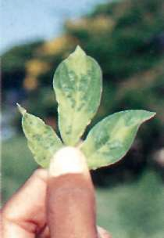
 | Plant Disease
 | Disease (literally dis-ease) implies lack of ‘comfort ’Deviation from normal functioning.’ Defnition Disease is any morphological or physiological abnormality in a plant or any of its parts caused by continuous irritation and results in economic losses to human beings. All these definitions indicate that disease; Is not a pathogen but it is caused by a pathogen. It is not symptom but results in symptoms. It is not a condition as the condition results from disease and is not synonymous with it. It is not an injury. Cannot be infectious, it is actually the pathogen which is infectious. Results from continuous irritation. Malfunctioning process and this result in some suffering and therefore disease is a pathological process
READ THINK LEARN
Dr. Sanjeev Kumar

Slide 2
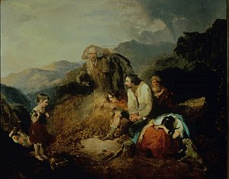
 | Importance of Plant Diseases
 | The major importance of plant diseases are Limit the kinds of plants and industries in the area. Reduce the quality and quantity of plant produce. May make plants poisonous to humans and animals May cause financial losses. Cost of controlling plant diseases is also a direct loss to diseases. Classical examples
READ THINK LEARN
Dr. Sanjeev Kumar
Sl.No | Major disease outbreaks | Location/ Country | Period | Impacts
1 | Late blight of potato | Ireland | 1845-46 | Irish famine
2 | Brown spot of rice | Asia (India) | 1943 | Bengal famine
3 | Coffee rust | Srilanka | 1870s-1880s | Destroyed all coffee in South east Asia

Slide 3
 | Plant Pathology
READ THINK LEARN
Dr. Sanjeev Kumar

