Slide 1
Fundamentals of Soil Science
3(2+1)
Presented by
Dr. Kiran Patel
Department of Soil Science and Agricultural Chemistry
College of Agriculture (JNKVV)
Jabalpur

Slide 2
Introduction of Soil Science
The word Soil is derived from Latin word Solum, means ground or floor.
Father of Soil Science and Founder of modern Pedology :
V.V. Dokuchaev (Vasily Vasilievich Dokuchaev)
Father of Indian Soil Science : Leather

Slide 3
Concept of Soil Science
Pedology : Greek word Pedon, means soil or earth
The study of genesis, survey, classification and geological distribution of soils.
Edaphology : Greek word Edaphos, means soil or ground
The study of soil in relation to growth, nutrition and yield of crops.
OR
Study of soil from stand point of higher plants.

Slide 4
Land and Soil
Land : Two dimensional- Geographical area and Landscape.
Land is broadly defined as the physical environment consisting of relief, soil, hydrology, climate and vegetation insofar as they determine the land use.
Soil : Three dimensional- Length, Breadth and Depth

Slide 5
Definition of Soil Science
1. V.V. Dokuchaev (1900): Soil is a natural body composed of mineral and organic constituents, having a definite genesis and a distinct nature of its own.
2. Buckman and Brady (1969) : Soil is a dynamic natural body on the surface of the earth in which plants grow, composed of mineral and organic materials and living forms.
3. Jenny (1941): Soil is a naturally occurring body that has been evolved owing to combined Influence of climate and organism, acting on parent material, as conditioned by relief over a period of time.

Slide 6
Definition of Soil Science
4. Hilgard (1892): Soil is more or less a loose and friable material in which plants, by means of their roots, finds a foothold for nourishment as well as for other conditions of growth.
5. Joffe and Marbut (1936): Soil is a natural body developed by natural force acting on natural material.
6. Ruffin (1968): Soil is a mixture of earth's uppermost mantle of weathered rock and organic matter. The deeper parts of this mantle (the regolith) were not
considered soil.

Slide 7
Branches of Soil Science
1. Soil Pedology
2. Soil Physics
3. Soil Chemistry
4. Soil Fertility
5. Soil Microbiology
6. Soil Conservation

Slide 8
Soil Pedology
The study of genesis, survey, classification and geological distribution of soils.
Earth's Crust, Rocks and Minerals, Weathering, Soil forming factors (Pedogenic factors), Soil forming processes (Pedogenic processes), Soil profile, Parent material, Pedon and Polypedon, Epipedons and Endopedons, Soil moisture regimes and Temperature regimes, Soil taxonomy categories, Soil Orders and Soils of India, Soil Survey- Kinds of soil surveys, Land capability classification, and Land suitability orders etc…
Soil profile, Epipedons and Endopedons, Soil moisture regimes and Temperature regimes, Soil taxonomy categories, Soil Orders and Soils of India, Soil Survey- Kinds of soil surveys, Land capability classification, and Land suitability orders etc…

Slide 9
2. Soil Physics
Soil physics is the fundamental subject of soil science which deals with the state and movement of matter and transformation of energy in the soil. The purpose of soil physics is to bring together the information on the physical properties of soils and their effects on crop production.
Soil Separates-Classification and characteristics
Soil Texture- Classes and determination
Soil structure- Classification and management
Soil crusting-Types
Relationship between different soil constituents- Particle density, Bulk density, Specific
volume, Porosity and Void ratio etc…

Slide 10
Viscosity
Dynamic properties of Soil
Soil consistency, Soil plasticity, Soil compaction, Soil strength, Soil colour, Soil air
Thermal properties of soil
Soil temperature-Importance and measurement
Soil water- Molecular structure, properties, Classification, Measurement,
Soil water potential-Concepts, components and measurements
Hysteresis-Causes

Slide 11
3. Soil Chemistry
It is the study of the chemical characteristics of the soil. Soil chemistry is affected by mineral composition, organic matter and environmental factors.
Soil colloids- Classification
Clay mineral- Structure, Identification of Clay minerals
Amorphous soil constituents
Source of negative charges on soil colloids
Zero point charge
Zeta potential-Factors
Diffuse double layer theory- Factors
Ion exchange in soil-CEC, AEC, theory
Base saturation, Schofield’s Ratio Law, Donnan membrane equilibrium etc…

Slide 12
4. Soil Fertility
The ability of soil to supply plant nutrients and water in adequate amounts and suitable proportions is called soil fertility.
Soil acidity, Soil pH, Soil pH determination, Sources of soil acidity, Kinds of Acidity, Lime potential, Liming of Acid Soils, Reaction of Lime in soil, Lime requirement, Principles of Liming Reactions, Determination of Lime requirement, Liming materials, Neutralizing value and effectiveness, Liming factor, Over liming, Acid sulphate soils, Potential acid sulphate soils.
Buffering capacity and its Importance, Soil reaction in nutrient availability, Soil salinity and Alkalinity, Distribution of salt affected soils, sources of Soluble salts, Classification of Salt-affected soils and its reclamation and management, Gypsum requirement.
Quality of irrigation water, Mineral nutrition of plants, Nutrient classification, Functions and Deficiency symptoms of nutrients, Growth Laws, Nutrient movement in plant root.
Manure and Fertilizers- Classification, Composition, method; Fertilizer control Order, Chemistry of Potassium and Phosphorus Fixation in soil, Concept of Potassium fixation,

Slide 13
5. Soil Microbiology
It is the study of microorganisms in soil, their functions and how the affected soil properties.
Soil Biodiversity, Cyanobacteria, Phototrophs, Chemotrophs, Heterotrophs, Lithotrophs, Obligate aerobes, Obligate anaerobes, Facultative Anaerobes, Microphiles, Halophiles, Osmophiles, Xerophiles, Enzyme Activities, Biogas production, Bacteria, Actinomycetes, Fungi, Algae, Lichens, Protozoa, Viruses, Nitrogen fixing microbes, Mineralization etc

Slide 14
6. Soil Conservation
Soil conservation is the prevention of loss of the topmost layer of the soil from erosion or prevention of reduce fertility caused by over usage, acidification, salinization or other chemical soil contamination.
Physical methods-Contour ploughing, Terrace farming, wind breaks
Chemical methods-FYM, compost, biochar, lime, gypsum
Biological methods-Cover crops, crop rotation

Slide 15
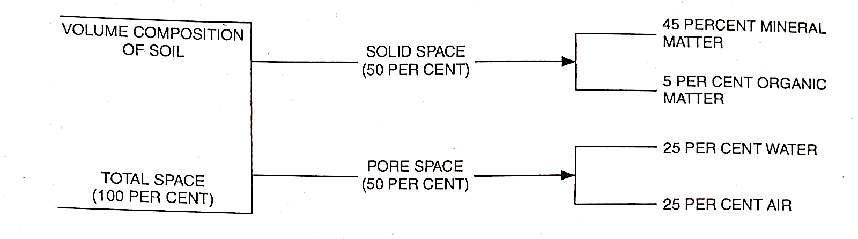
Soil Components
Soils consists of four major components
Mineral matter
Organic matter
Water
Air
Volume composition of Soil

Slide 16
Rocks
A naturally occurring hard mass of mineral matter formed after the solidification of molten magma comprising of two or more rock forming minerals e.g. Granite, Basalt and gneiss. (The rocks are generally composed of two or more minerals)
But some may be monomineralic e.g. olivine and dunite
Monomineralic rocks: Rock that are composed of only one mineral.
Majority of rocks are composed of several different minerals and absolutely pure
monomineralic rocks do not exist in nature anyway. But some of them are reasonably
pure to be called monomineralic.
Dunite is composed of almost pure forsterite

Slide 17
Note: Petrology: The branch of science which study about the rocks
Petrography: Description of rocks
Petrogenesis: Deal with origin of rocks
Classification of Rocks:
1. Igneous Rocks
2. Sedimentary Rocks
3. Metamorphic Rocks

Slide 18
1. Igneous Rocks
These are first formed in the earth crust due to the solidification of molten magma.
Based on the mode of formation, they are further classified as intrusive and
extrusive rocks.
(a) Intrusive rocks or plutonic rocks
These rocks are produced due to solidification of magma below the surface of the earth.
Example: Granite, Gabbro, Diorite and Syenite
(b) Extrusive rocks or volcanic rocks
These rocks are formed due to the consolidation of magma on the surface of the
earth. The magma, when it flows on the Earth surface is called LAVA.
Example: Basalt, Andesite and Rhyolite

Slide 19
Vesicular Rocks – Molten magma cools on the surface. Steam of water is entrapped into rocks and forms vesicles.
Based on the silica content, rocks are also classified as
1. Acid Rocks : > 65% SiO₂ (Granite and Rhyolite)
2. Intermediate : 56% - 65% SiO₂
Sub acid rocks 60 to 65% SiO₂ (Syenite and Trachyte)
Sub basic rocks 56 to 60% SiO₂ (Andesite and Diorite)
3. Basic Rocks : 40 to 55% SiO₂ (Basalt and Gabbro)

Slide 20
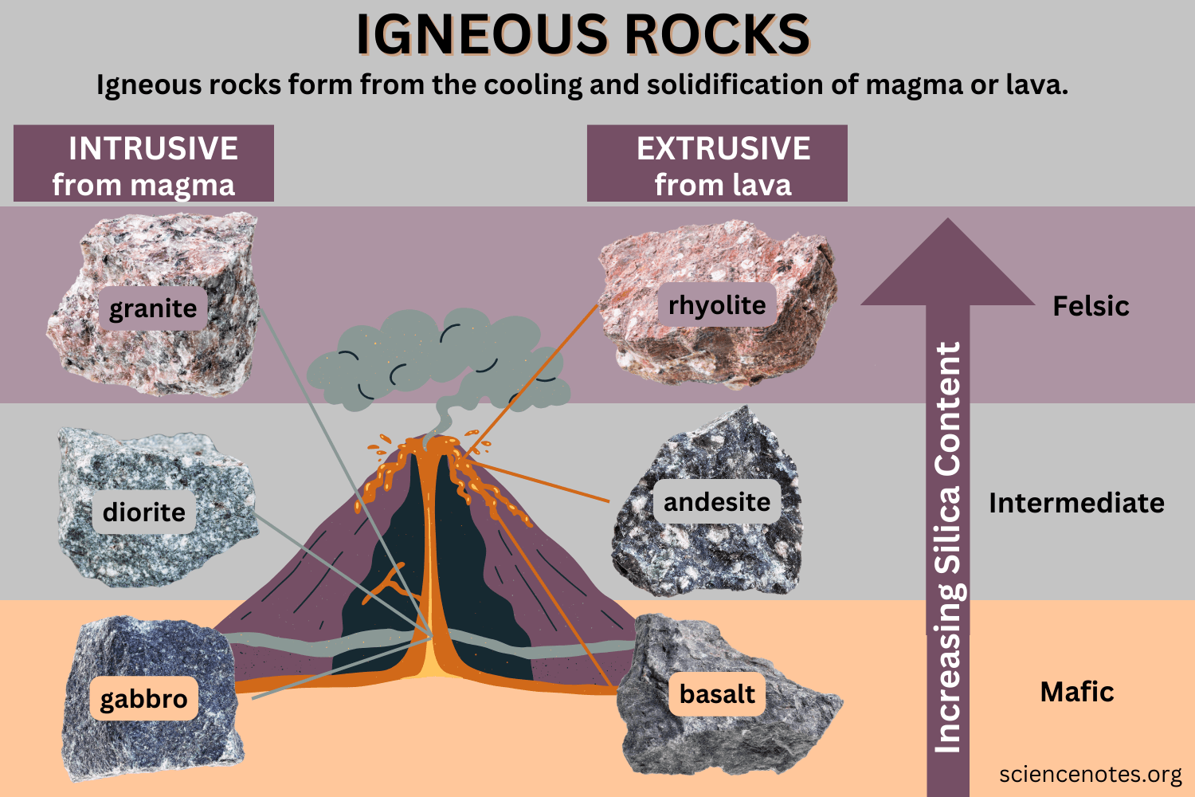
Types and Examples of Igneous Rocks

Slide 21
2. Sedimentary Rocks
2. Sedimentary Rocks:
Formed from sediments showing different stages of formation
(a) Weathering: Physical, chemical, and biological weathering of primary rocks give rise
to quartz, secondary minerals and soluble substances (Ca, Mg, Fe and
salts).
(b) Transportation: Transportation of weathered material by water, wind, glaciers and runoff.
(c) Deposition or sedimentation: Transported sediments settled to form graded bedding.
(d) Diagenesis: Transformation of unconsolidated sediments to hard rock with compaction
and cementing process.

Slide 22
Based on the origin, the sedimentary rocks are classified as
1. Residual : Laterite
2. Transported
a. Deposited as solids in suspension : Sandstone, shale
b. Deposited by chemical precipitation : Limestone, ironstone
c. Deposited through agency of organic matter: Peat, Phosphatic deposits
Based on the grain size, sedimentary rocks are classified as
1. Rocks with boulder pebbles sized minerals (Rudaceous) : Conglomerate
2. Rocks with sand size particles (Arenaceous) : Sandstone
3. Rocks with silt size particles (silt rocks) : Siltstone
4. Rocks with clay size particles (Argillaceous) : Shale

Slide 23
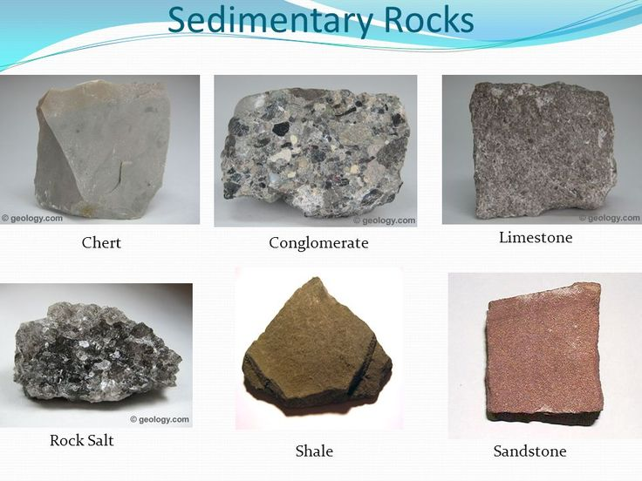
Examples of Sedimentary Rocks

Slide 24
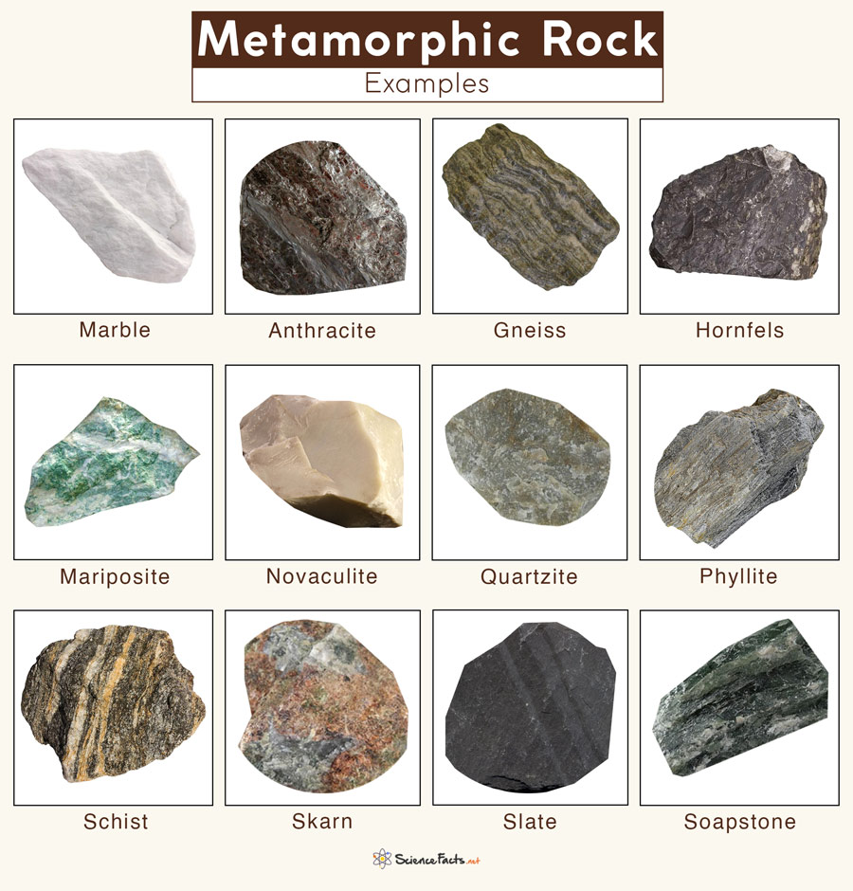
3. Metamorphic Rocks
Metamorphic rock is a rock that has been changed from its original form due to high heat, pressure, or both. The word "metamorphic" comes from Greek words meaning "change of shape".

Slide 25
The changes due to water is called hydro metamorphosis and due to
pressure is called dynamo metamorphosis
Sand stone : Quartizite
Shale : Slate/mica, schist
Lime stone : Marble
Granite : granite gneiss
Dolerite : Hornblende gneiss

Slide 26
Minerals
The minerals may be defined as naturally occurring, homogeneous element or inorganic compound having definite chemical composition. (Minerals are naturally occurring solids with a definite chemical composition and crystal structure. “Solid substances composed of atoms having an orderly and regular arrangement”)
Classification of Minerals
Primary minerals: The original component of rock is known as primary mineral. e.g. : feldspar, mica etc.
Secondary minerals: Minerals that are formed from changes in primary minerals are called secondary minerals. e.g. : clay minerals

Slide 27
3. Essential minerals: Those minerals that are chief constituents of rocks are called
essential minerals. e.g.: Feldspars, Pyroxenes, Micas etc.
4. Accessory minerals: Those which are present in small quantities, whose presence or
absence will not alter the properties of rocks are called accessory
minerals. e.g.: Tourmaline, Magnetite etc.
I

Slide 28
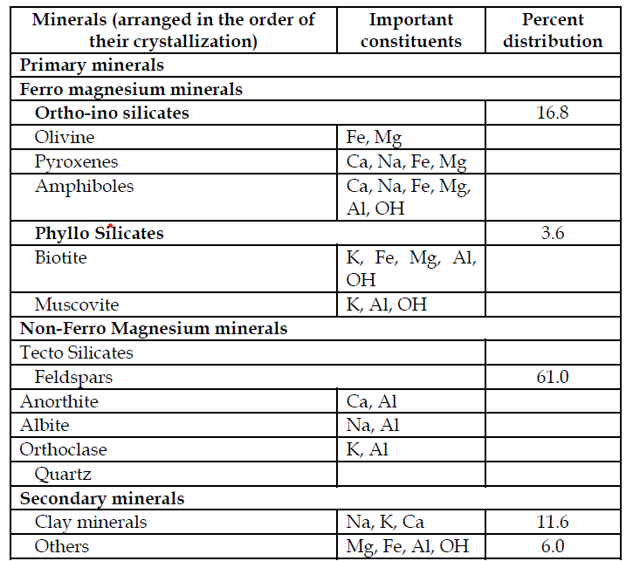
Classification and Examples of Minerals

Slide 29
Ferro magnesium minerals
Pyroxenes and amphiboles:
The pyroxenes and amphiboles are two groups of ferromagnesian minerals (heavy group) the structure of which consists of long chains of linked silica tetrahedral.
The pyroxenes consist of a single chain (2 oxygen shared in each tetrahedron) whereas amphiboles consist of a double chains (alternately 2 and 3 oxygen atoms shared successive tetrahedral).
These chain silicates are sometimes referred to inosilicates.

Slide 30
MOHS SCALE OF HARDNESS
Mineral Hardness Mineral Hardness
Talc 1 Feldspar 6
Gypsum 2 Quartz 7
Calcite 3 Topaz 8
Fluorite 4 Corundum 9
Apatite 5 Diamond 10

Slide 31
Clay Minerals
Clay minerals in soils are formed from primary minerals due to weathering processes.
These clay minerals are of size <0.002 mm and are considered to be the most reactive part of soil. Important soil properties like nutrient and water holding capacity are controlled by clay minerals.
These minerals are layered silicates consisting of silica
tetrahedron and aluminium octahedron.
1) 1:1 clay mineral = 1 silicon tetrahedron + 1 aluminium octahedron (Kaolinite)
2) 2: 1 non-expanding clay mineral i. Black mica (Biotite)
ii. White mica (Muscovite)
iii. Weathered mica (illite)
3) 2: 1 expanding clay mineral i.Partially expanding (Vermiculite)
ii.Fullyexpanding (Montmorillonite)
4) 2: 2 clay mineral (chlorite)

Slide 32
Weathering
It is the physical disintegration and chemical decomposition of rocks and minerals resulting in the formation of parent material.
OR
It is basically a combination of transformation and synthesis or the process of disintegration and decomposition of rocks and minerals which are brought by physical, chemical and biological weathering, leading to formation of parent material.

Slide 33
Classification of Weathering
A. Physical Weathering : A mechanical process, causing disintegration of consolidated massive rocks into smaller pieces under favourable climatic conditions through various agents viz. Temperature, water, ice, and wind. Role of different agents in Physical Weathering described as under:
Temperature - Due to monomineralic and polymineralic nature of rocks, a differential expansion and contraction of minerals occurs owing to diurnal temperature changes resulting in peeling off the surface layers from rocks (breakdown into small fragments). This phenomenon is called "Exfoliation" or onion type of weathering. Examples include exfoliation in basalt and granite. Cold temperature causes freezing of entrapped water inside the rock which expands 9% in volume and exerts a pressure of about 1465 tonnes/m² (t m² ) resulting in breakdown of rocks.
Water - Most pronounced and widespread weathering agent and which carries huge boulders which break into smaller fragments due to continuous flowing in water with friction and/or abrasion.
Ice - Moving ice or glaciers cause great deal of cutting and crushing of the bedrocks. On moving, glaciers exert a tremendous pressure on rock over which these pass.
Wind - The rounded rock (Mushroom rock) remnants in the Aravalis are caused by the wind erosion. Action of wind as weathering agent could be prominently seen in Thar desert of Rajasthan.

Slide 34
B. Chemical Weathering - Chemical weathering is decomposition process which takes place primarily at the junction of lithosphere and atmosphere is called "weathering front". It leads to alteration or disappearance of some minerals and formation of new (secondary) minerals. This weathering dominant in tropical climate (Temperature and Rainfall both are high) than arid climate. The rate of chemical weathering increases with increasing amounts of dissolved CO₂ and other minerals in water. The presence of organic and inorganic acids also accelerates the chemical weathering. The chemical weathering has great role in conversion of primary minerals (feldspars, mica and amphiboles) into secondary minerals (kaolinite, montmorillonite and vermiculite).
1. Solution : Water is a universal solvent due to its highest dielectric constant and its solubility action is enhanced with dissolved CO₂, organic, inorganic acids and salts in it. Decomposition of rocks depends on composition and solubility action of water. For example, halite (Rock salt or NaCl) readily soluble in water and where as the solubility of some silicate minerals like quartz is very low. In arid regions, soluble minerals remain in rocks as such where as in semi-arid and humid regions, these are completely washed away.
H₂O + CO₂ → H₂CO₃ (Carbonic acid)

Slide 35
2. Hydration - It is the chemical combination of water molecules with a mineral to form a new mineral. Hydration occurs primarily on the surface and edges of mineral grains. The adsorbed water provides a bridge for the hydronium ions (H₃O⁺) or hydrogen ions (H) to attack the structure. This process commonly occurs in secondary minerals like Aluminium oxide, Fe oxides and Gypsum.
1. CaSO₄ + ½ H₂O → CaSO₄. 0.5 H₂O
(Anhydrate) (Hemihydrate)
2. CaSO₄ + 2 H₂O → CaSO₄ . 2 H₂O
(Gypsum)
3. Olivine + H₂O → Serpentine
4. 2 Fe₂O₃ + 3 H₂O→ 2 Fe₂O₃. 3 H₂O
(Haematite) (Limonite)

Slide 36
3. Hydrolysis - It is the most important chemical weathering process among all. It is a type of double decomposition process, in which CO₂, minerals and organic acids rich water get easily dissociated into H ⁺ and OH ⁻ ions which chemically combine with a mineral and form a new mineral. Hydrolysis reactions may be considered as forerunner for clay formation (secondary minerals).
H₂O → H⁺ + OH ⁻
KAlSi₃O₈ + H₂O → HAlSi₃O₈ + KOH
(Orthclase) (Clay minerals)

Slide 37
4. Oxidation-It is the combination of oxygen dissolved in water or from atmospheric air with exposed rocks or minerals and occur mostly after hydrolysis. Oxidation can be occurring where oxygen supply is high and biological oxygen demand (BOD) is low. Rocks contain pyroxenes, Hornblende, Biotite, glauconite and chlorite are susceptible to oxidation and minerals contain Mn⁺² and sulphur S⁻² ions also susceptible to oxidation.
4 FeO + O₂ → 2 Fe₂O₃
(Iron oxide) (Haematite)
4 Fe₃O₄ + O₂ → 6 Fe₂O₃
(Magnetite) (Haematite)
5. Reduction-The process of removal of oxygen and addition of electron is called reduction. It is exact opposite of oxidation and can occur where oxygen supply is very low and biological oxygen demand (BOD) is high. It is the conversion of higher valent metals to the lower valent states (Ex: Fe ⁺³ to Fe ⁺²)
2 Fe₂O₃ → Fe O + O₂
6 Fe₂O₃ → 4 Fe₃O₄ + O₂

Slide 38
6. Carbonation - It is the combination of carbon dioxide with any base. When water reacts with CO, it gives carbonic acid (H₂CO,), which is a very important agent of chemical weathering of rocks and minerals. The solubility of calcium bicarbonate (CaHCO₃) is considerably higher than that of calcite (CaCO₃).
H₂O + CO₂ → H₂CO₃
(Carbonic acid)
CaCO₃+ H₂CO₃ → Ca(HCO₃ )₂
(Insoluble) (Soluble)

Slide 39
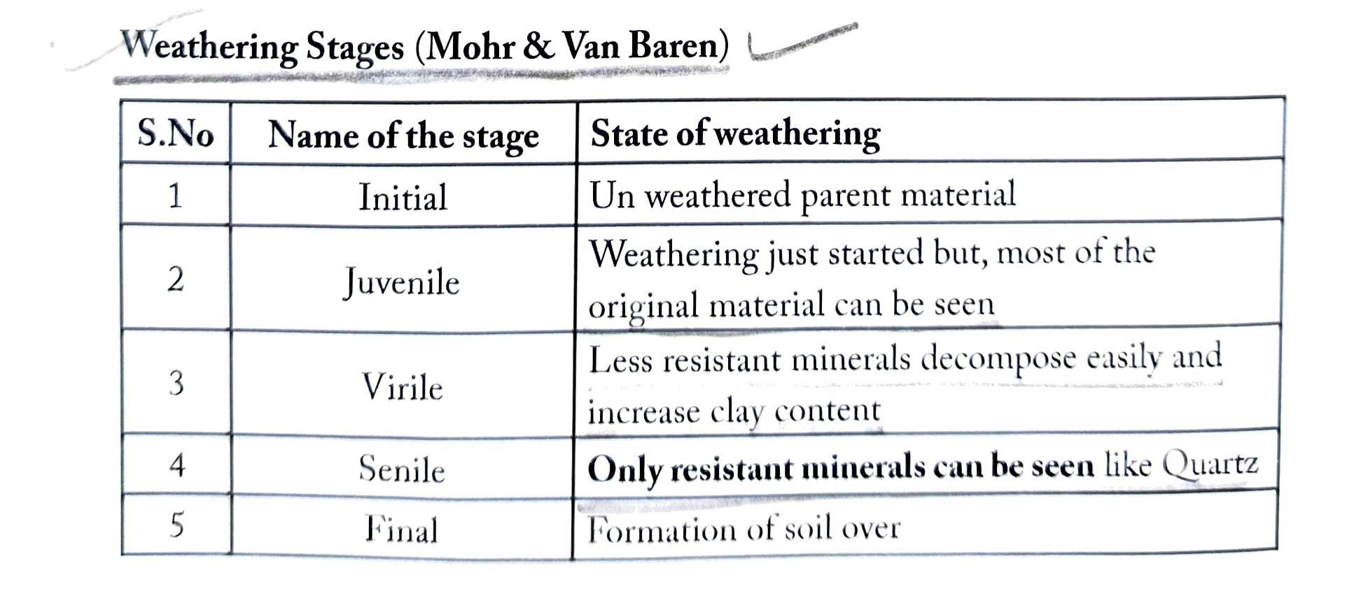
Weathering Stages

Slide 40
Soil Forming Factors (Pedogenic Factors)
Dokuchaev (1889) was the first to show that soil forms a definite pattern on the landscape and establish that they develop distinct horizons under the influence of parent material, climate and organism which put as S = f (p, cl, o).
Later on Jenny (1941) added two more factors i.e. relief and time.
These are further classified into two groups ie. active and passive soil forming factors by J.S. Joffe (1949).

Slide 41
It may be represented by following equation
S = f (cl, b, r, p, t) given by Jenny (1941)
Where, S Any soil property
f = Function of or dependent on
cl = Climate
b = Biosphere (flora and fauna)
[NOTE: Climate and Biosphere both are active soil forming factors]
r = Relief or topography, p = Parent material
t = Time or age
[NOTE: Relief, parent material and time are passive soil forming factors]
[Joffe divided soil forming factors into active and passive factors]

Slide 42
1. Climate (Precipitation and Temperature) Climate is the most influential factor în soil development, Rainfall is a more significant climatic element to determine the nature of soil.
Arid climate-Formation of saline soils
Cool humid climate-Podzols
Warm bumid climate-Laterite soils
Temperature is second important factor of climate as it influences the chemical reactions involved in soil formation. According to wan't Hoff law "with every 10°C rise in temperature, the speed of chemical reaction increases by a factor of two or three. This process applies to weathering of minerals which release soluble components and thus help in soil development.

Slide 43
2. Biosphere (Flora and Fauna) - Vegetation is an active factor of soil formation which contains soil solid that is organic matter. It is the source of food for soil organisms and is one of the most important indicator for soil health. Macro-organisms such as rodents, moles, snails, earthworms, termites, millipeds, centipeds etc., owing to their burrowing habit, cause mixing of soil material. By doing so they retard the differentiation of soil horizons and as a consequence retard the process of soil development. Microorganisms such as bacteria, fungi, actinomycetes, protozoa and nematodes inhabit in large numbers in soil and play an important role in the decomposition of organic matter and indirectly it also helps in decomposition of mineral matters through production of organic acids. Rapid decomposition of mineral and organic matter leads to formation of soil.

Slide 44
3. Relief or Topography : It denotes configuration of land surface describes in terms of elevation or slope. Generally low land soils are darker in colour, higher in pH, EC, clay and organic matter content. Soil formation is very poor on steep slopes due to erosion and the gently-sloping flat land is ideal for soil development. Due to higher rate of percolation and leaching of soil constituents on flat lands, horizon differentiation is rapid and depth of soil is more compare to the upland and low land positions. In low land depressions, water is available but percolation is very poor due to deposition of clay and organic matter.

Slide 45
4. Parent Material - Jenny (1941) defined parent material as "the initial stage of soil system" at the time of zero of soil formation" or it may be defined as a loose unconsolidated mass of mineral matter formed upon the weathering of rocks which serves as the raw material for soil formation. The initial stage of soil formation and soil properties are governed by the nature of parent material but with the time the influence of parent material on soil properties gradually diminishes. (ARS mains 2017)
NOTE: If the soils are developed mainly under the influence of parent material such type of soils are called "Endodynamomorphic soils" (calcimorphic and bydromorphic soils) while if the soils are formed mainly due to climate such type of soils are called "Ectodynamomorphic soils" (Podzol and Laterite soils).

Slide 46
5. Time : Soil formation is natural process which requires thousands of years to develop a mature pedon. The period of time devoted by the nature from the stage of parent material to the stage of soil formation is considered as "pedologic time". Rate of soil development (aging) varies among the soils. The warm humid climate, flat to gently sloping topography, sandy parent materials are favourable for soil formation, whereas, cold and arid climate, clayey parent material, steep slope, flood plains and activities of burrowing animals retard the pace of soil profile development.

Slide 47
Pedological Process (Soil Forming Processes)
The pedogenic processes are extremely complex and dynamic, involving many chemical and biological reactions and different processes or combination of processes operate under the influence of soil forming factors, The basic processes involved in operation of soil forming processes are (According to simonson) (SRF 2015)
Addition or gain of water, mineral and organic matter in the soil
Losses of the above materials from the soil
Transformation of mineral and organic materials with in the soil
Transfer of translocation of energy and matter (mineral or organic)

Slide 48
Classification of Pedological Process
Pedogenic processes broadly classified into two groups
Fundamental Pedogenic Process
Humification
(b) Eluviation (Emigration)
(c) Illuviation (Immigration)
2. Specific Pedogenic Process
Zonal Soil Forming Processes
(i) Calcification
(ii) Decalcification
(iii) Podzolization (Acid hydrolysis)
(iv) Laterization (Alkali hydrolysis)
(b) Intrazonal Soil Forming Process
(v) Gleization
(vi) Salinization
(vii) Alkalization
(viii) Pedoturbation

Slide 49
1. Fundamental Pedogenic Process
(a) Humification :
It is the process of transformation of raw organic matter into humus. When raw organic materials added in soil, their decomposition by various organisms produces simple organic acids. Further bacterial polymerization of these organic acids produces a dark brown colloidal substance resistant to microbial attack is called humus. The whole process may be about a decade to complete.

Slide 50
(b) Eluviation (Emigration) :
Process of removal (wash out) of soil constituents in suspension or solution by the percolating water from the upper to lower layers, resulting textural differences which leads to horizon differentiation or development of soil. This process occurs in E-horizon or A₂ horizon of soil profile. Order of mobility of inorganic soil constituents expressed relative to Cl>SO₄>Ca>Na>Mg>K>SiO₂>FeO₃>Al₂O₃ (ARS & NET 2017).

Slide 51
(c) Illuviation (Immigration) :
Process of deposition of simpler soil constituents removed from upper layer (Eluvial zone) in to the lower layer (Zone of accumulation) is termed as Illuviation. This process occurs in B-horizon of soil profile (especially Bt).

Slide 52
2. Specific Pedogenic Process : These specific pedogenic processes can be categorised into two groups
Zonal Soil Forming Processes: The soil forming processes that are occurring under the prevailing conditions of climate and biosphere (active factors). These attain equilibrium with their environment in due to course of time.
(i) Calcification : Process of precipitation and accumulation of calcium carbonate (CaCO₃) in some part of soil profile is called calcification. This process occurs in arid and semi arid climates.
H₂O + CO₂→ H₂CO₃
(Carbonic acid)
CaCO₃ + H₂CO₃ → Ca(HCO₃)₂
Insoluble Calcium bicarbonate (Soluble)
temp ↑
Ca(HCO₃)₂ → CaCO₃ + H₂O + CO₂
CO₂↓

Slide 53
(ii) Decalcification- It is the reverse of calcification, which means process of removal of CaCO₃ or Ca ions from the soil by leaching. This process occurs in the humid climates.
temp↓
CaCO₃ +H₂O + CO₂→ Ca (HCO₃)₂
CO₂ ↑
(iii) Podzolization (Acid hydrolysis) - The term podzol is derived from Russian word-Pod means under, Zola means ash like. Podzolization is the process of accumulation of silica and removal sesquioxides (Fe and Al oxides). It is also called "acid hydrolysis".
Climate Cold → humid
Vegetation → Coniferous (acidic nature and narrow leaf)
Parent material→ Sandy (siliceous)
Dominant organism→ Fungi

Slide 54
(iv) Laterization (Alkali hydrolysis) : The term laterite derived from Latin word later means brick or tile. It is the process of accumulation of sesquioxides and removal of silica.
Climate → Warm-humid
Vegetation → Broad leaf tropical vegetation (basic nature)
Parent material → Basic parent materials that contain high Fe (Ferromagnesian minerals)
Dominant organism → Bacteria

Slide 55
b) Intrazonal Soil Forming Process: These pedogenic processes are more influenced by certain local conditions such as relief or parent material than climate and vegetation. Ex: Hydromorphic, halomorphic and Calcimorphic soils
(v) Gleization : Glei (Russian word) refers to blue, grey, green clay. This process results in the development of a gley horizon (g) in some part of profile due to poor drainage condition, impervious soil parent material, lack of aeration etc. Hydromorphic soils will be developed due to Gleization process.

Slide 56
(vi) Salinization: The process of accumulation of salts such as SO₄⁻² and Cl⁻(sulphates and chlorides) of Ca, and Mg in soil in the form of a salic horizon (z) leading to formation of saline soil. These soils are formed under arid and semi arid climate where evaporation losses are more than precipitation. Area having more brackish ground water, depression lands and poor drainage condition also leads to the formation of saline soils. If ground water table is under capillary fringe, upward movement of capillary water followed by evaporation results in accumulation of salts at soil surface or in root zones.

Slide 57
vii. Alkalization : The process of accumulation of sodium ions on exchange complex of the clay, resulting in the formation of alkali soils (sodic/solonetz). These soils are also called black alkali soils and contain mostly CO, and HCO, of Na and less amounts of Cl and SO, of Ca and Mg.)
viii. Pedoturbation : Process of mixing of soil materials not by the Illuviation.
1) Faunal Pedoturbation - Mixing of soil by animals
2) Floral Pedoturbation - Mixing of soil by plants
3) Argillo Pedoturbation - Mixing of soil by churning process caused
by swell shrinking of clays

Slide 58
Soil Profile
A vertical section of soil which is showing all its horizons is called soil profile. Horizon is defined as a layer approximately parallel to the surface of soil. Soil profile is vertical section of soil up to a depth of 1.5 to 2.0 meters in deep soils. In the case of shallow soils, the vertical cut is made up to bedrock or up to water table in the case of waterlogged soils. Width of profile ranges from 1 metre to several meters.
Soil horizons are two types
1) Genetic Horizons
2) Diagnostic Horizons
Genetic horizons are again broadly classified into three categories
a) Master Horizons
b) Transitional Horizons and Combination Horizons
c) Subordinate distinction within master horizons

Slide 59
Soil Profile
a) Master Horizons - The capital letters are used to represent the master horizons. Earlier there were only six (6) master horizons (O, A, E, B, C and R), later on Soil Survey Staff added three more (L, M and W) horizons. A brief description of master horizons as under-
1. O Horizon (Organic horizon): A layer dominated by organic material. O - horizon present in forest land and absent in grass lands.
2. A-Horizon (Top most mineral horizon) - Mineral horizon that has formed at the surface or below an O-horizon. This horizon shows accumulation of organic matter closely mixed with the mineral fractions and due to this A- horizon is darker in nature.
3. E-Horizon (Main feature of E horizon is the loss of silicate clay, iron and aluminium). E-horizon most commonly differentiated from an underlying B- horizon by a colour of high value or lower chroma, or both. This horizon is lighter in colour and has less organic matter than the A-horizon. This horizon also called as a horizon of eluviation.
4. B-Horizon Horizon that has formed below an A, E or O- horizon. This horizon shows one more soil characteristics like: accumulation of clay, humus, iron, aluminium, carbonates, gypsum, strong gleying, low chroma mortles and alterations associated with formation of granular, blocky or prismatic structure. This horizon can be generally considered as a layer of accumulation or Illuviation.

Slide 60
Soil Profile
5. C-Horizon (Parent material)- This horizon ideally represents the parent material from which the soil above is formed.
6. R-Layer - Strongly cemented to indurate bedrocks such as granite, basalt, quartzite, limestone and sandstone.
7. L-Horizon-It includes both organic and mineral limnic materials that are deposited in water by precipitation or through the action of algae and diatoms. This layer only found in Histosols.
8. M layer Root limiting subsoil layers. Example of the materials designated by M are geotextile liners, asphalt, concrete, rubber and plastic.
9. W-Layer- It is water layer within or beneath the soil. The water layer is designated as Wf, if it is permanently frozen.

Slide 61
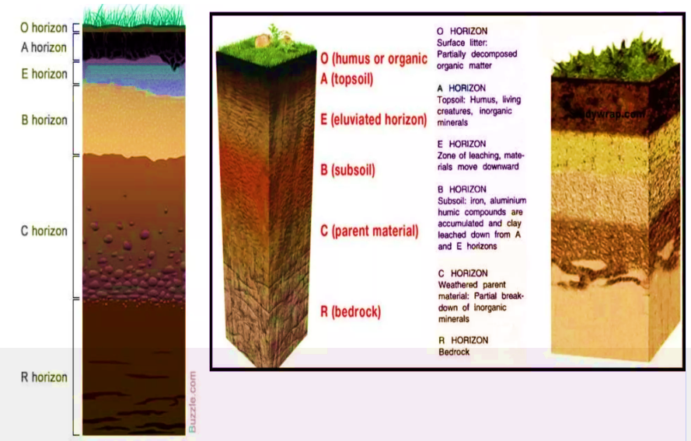
Soil Profile

Slide 62
Soil Profile
A+ B horizons = Solum
A+ B+ C horizons = Regolith
Notes:
B horizon of soil profile can't be cultivated by tillage.
Dark coloured horizon in soil profile is A horizon.

Slide 63
Soil Texture
The relative proportion of sand, silt and clay is called soil texture. It cannot be altered or changed. That is why it is basic or permanent property of soil. Soil particles of size less than 2 mm in diameter are included in the classification and these are considered as soil material normally used in soil analysis. Several systems exist for classification of soil particles but International Society of Soil Science (ISSS), renamed as the International Union of Soil Sciences (IUSS) and the United States Department of Agriculture (USDA) are widely in use.
Soil Textural Classes : The three broad and fundamental groups of soil textural classes namely sandy soils, loamy soils and clayey soils and one more medium textured soil namely silty soil described below.
1. Sandy Soils : The group includes soils having atleast 70% sand separates and 15% or less clay particles by weight. These soils are coarse in texture.

Slide 64
2. Loamy Soils - An ideal loamy soil may be defined as mixture of sand, silt and clay separates in about equal proportions. An ideal loamy soil feels gritty and cohesive. This is the ideal soil for crop production.
[NOTE: Loamy soil does not contain equal percentages of sand, silt and clay but which exhibit approximately equal properties of sand, silt and clay and from agriculture point of view, loam soil is most favourable as its capacity to retain water and nutrients is better than sandy while its drainage, aeration and tillage properties are more favourable than clayey soils]
3. Clayey Soils Clayey- soils must contain 35% of clay separate and in most cases not less than 40% of clay separate. These soils are fine in texture. As these soils contain high amount of clay, their specific surface and cation exchange capacity are very high and because of these, their capacity for adsorption of water and nutrients is high. It is difficult to till these soils.

Slide 65
4. Silty Soils - This group includes soils which have atleast 80% of silt and 12% or less clay.
Heavy and Light soils-Sometimes fine textured soils (e.g., clayey soils) are termed as heavy soils and coarse textured soils (e.g., sandy soils) are termed as light soils. Heavy and light soils do not reflect the weight of the soils. As relatively more power is needed to plough fine textured soil e.g., clayey soils because they become plastic and sticky when wet, hard and coherent when dry and difficult to cultivate, they are called heavy soils. As relatively, less power is needed to plough coarse textured soils i.e., sandy soils because they are loose and easy to cultivate, they are called light soils. Clayey soils have more total pore space and less bulk density than those of sandy soils. So clayey soils are actually lighter in weight than sandy soils i.e., the weight of clayey soils is less than that of equal volume of sandy soils.

Slide 66
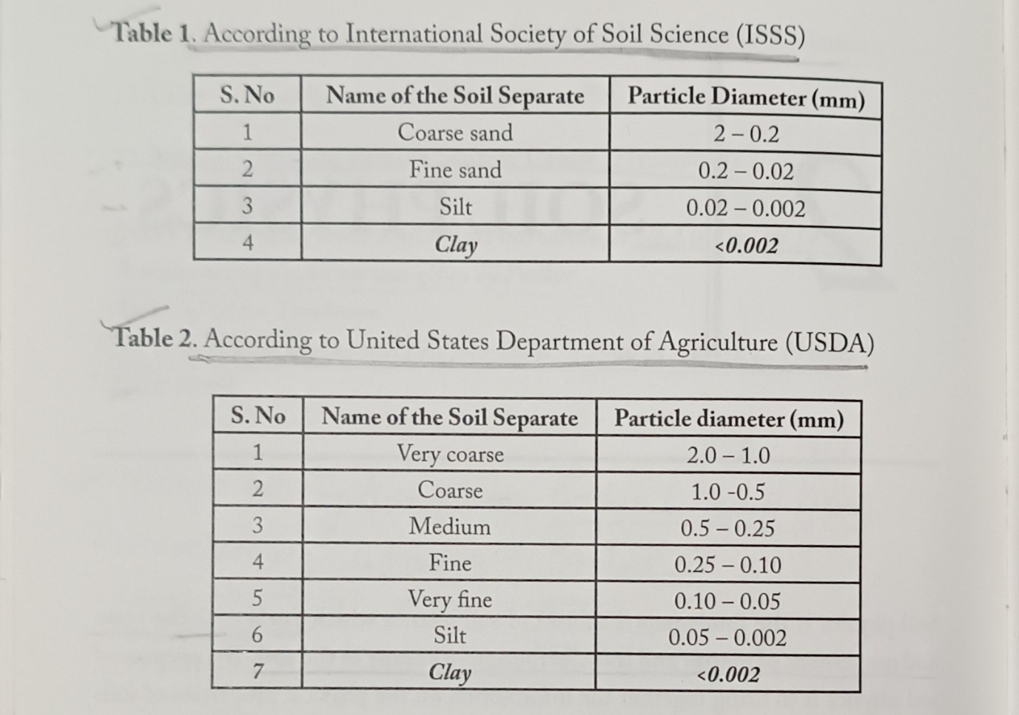

Slide 67
Importance OF Soil Texture
It is one of the most important physical properties because it affects almost every other soil characteristic. The major importance of soil texture is given below:
1. Water-Holding Capacity
Fine-textured (clay) soils hold more water due to small pores.
Coarse-textured (sandy) soils hold less water and drain quickly.
Loamy soils have balanced water retention, ideal for crop growth.
2. Water Movement (Infiltration & Percolation)
Sandy soils: fast infiltration and high percolation.
Clay soils: slow infiltration, prone to waterlogging.
Texture helps determine irrigation needs and scheduling.

Slide 68
3. Soil Aeration
Sandy soils provide good aeration.
Clay soils have poor aeration because of compact particles.
Adequate aeration is essential for root respiration and microbial activity.
4. Soil Fertility and Nutrient Retention
Clay soils have high cation exchange capacity (CEC) → hold more nutrients.
Sandy soils have low CEC → nutrients easily leach.
Texture affects fertilizer requirement and efficiency.

Slide 69
5. Root Penetration and Plant Growth
Loose sandy soils allow easy root penetration.
Clay soils can become hard, restricting root growth.
Loam soils are ideal for most crops.
6. Soil Structure Development
Clay helps form stable aggregates.
Sandy soils lack cohesion and form weak structure.
Good structure improves tilth and reduces erosion.

Slide 70
7. Soil Temperature
Sandy soils warm up quickly → good for early sowing.
Clay soils warm slowly due to higher moisture.
8. Erosion Susceptibility
Sandy soils: high risk of wind erosion.
Silty soils: high risk of water erosion.
Clay soils: less erodible but can disperse under heavy rain.

Slide 71
9. Suitability for Crops
Different textures support different crops:
Sandy soils: Groundnut, watermelon, cotton.
Clay soils: Rice, wheat, jute.
Loamy soils: Suitable for most crops.
10. Tillage and Cultivation
Sandy soils are easy to till.
Clay soils are hard when dry and sticky when wet.
Texture helps determine the best time and method for land preparation.

Slide 72
11. Microbial Activity
Aerated sandy soils favour aerobic microbes.
Wet clay soils promote anaerobic conditions.
Microbial activity affects nutrient cycling.

Slide 73
Soil structure
Soil structure may be defined as the arrangement of primary soil particles such as sand, silt and clay in to a stable aggregate. In the broad sense Soil Structure denotes: a) the size, shape and arrangement of particles and aggregates; b) the size, shape and arrangement of the voids or spaces separating the particles and aggregates; and c) the combination of voids and aggregates in to various types of structures.

Slide 74
Important Terms
Peds – Natural aggregates which vary in their water stability.
Clod – It is used for a coherent mass of soil broken in to any shape by artificial means such
as by tillage.
Fragment - It is a broken ped.
Concretion – It is a coherent mass formed with in the soil by the precipitation of certain
chemicals dissolved in percolating waters.

Slide 75
Structure is studied in the field under natural conditions and it is described under three categories:
(i) Type : Shape and arrangement of peds
(ii) Class : Size of the peds
(iii) Grade : Distinctness and durability of peds

Slide 76
TYPES OF SOIL STRUCTURE
There are four principal forms of soil structure:
1. Plate-like (Platy and Laminar)
2. Prism-like (Prismatic and Columnar)
3. Block like (Angular Blocky and Sub Angular Blocky)
4. Spheroidal (Crumby and Granular)

Slide 77
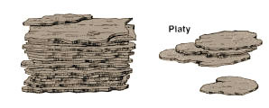
1: Plate-like:
The horizontal dimensions are much more developed than the vertical. When the units are thick, they are called platy, and when thin, laminar structure.

Slide 78
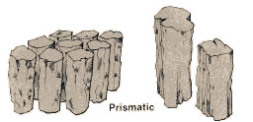
2: Prism-like:
The vertical axis is more developed than horizontal, giving a pillar-­like shape. When the top of such a ped is flat, the structure is termed as prismatic, and when rounded, columnar. They commonly occur in sub-soil horizons in arid and semi-arid regions.

Slide 79
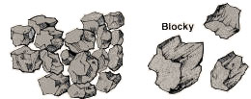
3: Block-like:
All these dimensions are about the same size and the peds are cube-­like with flat or rounded faces. When the faces are flat and the edges sharp angular, the structure is named as angular blocky. When the faces and edges are mainly rounded it is called sub angular blocky. These types usually are confined to the sub-soil and characteristics have much to do with soil drainage, aeration and root penetration.

Slide 80
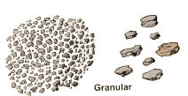
4: Spheroidal (Sphere-like):
All axes are developed equally with the same length.
These are two types
(i) Crumby : Granules are high porous
(ii) Granular: Granules are less porous
Note: Crumby structure is well suitable structure for agriculture

Slide 81
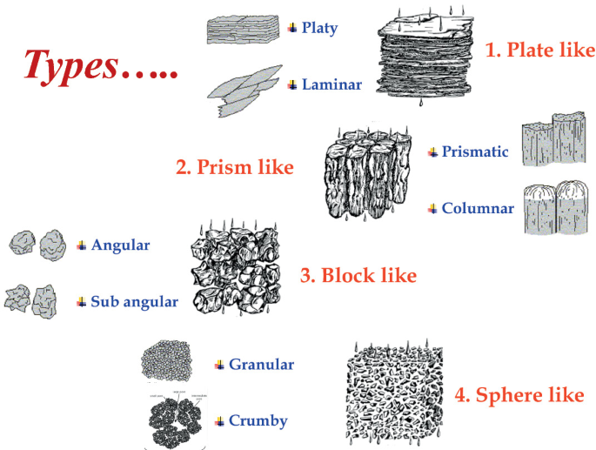

Slide 82
Importance of Soil Structure
Soil structure is crucial for almost every physical process in soil:
1. Water Movement and Retention
Good structure → good infiltration, drainage, and aeration
Poor structure → waterlogging or excessive runoff
2. Root Growth and Penetration
Well-aggregated soils allow easy root penetration
Compacted or platy structure restricts root development

Slide 83
3. Soil Aeration
Stable aggregates create pore spaces needed for oxygen
Important for root respiration and microbial activity
4. Soil Fertility
Good structure improves nutrient availability
Aggregates protect organic matter from decomposition
5. Microbial Activity
Ideal structure provides habitat and oxygen for microbes
Enhances nutrient cycling and soil health

Slide 84
6. Resistance to Soil Erosion
Stable aggregates resist detachment
Poor structure increases erosion by wind and water
7. Tillage and Cultivation
Good structure improves soil tilth
Poor structure increases cost of ploughing
8. Crop Productivity
Soil structure influences water, nutrients, air, and root growth → increases
yield

Slide 85
Factors Affecting Soil Structure
1. Soil Texture
Clay promotes aggregation; sand limits it.
2. Organic Matter
Acts as a binding agent → improves crumb structure.
Humus increases aggregate stability.
3. Soil Organisms
Bacteria, fungi, roots, earthworms help form stable aggregates.

Slide 86
4. Climate
Rainfall, temperature, wetting-drying and freezing-thawing affect aggregation.
5. Cultivation Practices
Excessive tillage destroys aggregates.
Proper tillage improves structure.
6. Soil Moisture
Drying and wetting cycles promote natural aggregation.
Too much water can cause dispersion.

Slide 87
7. Soil pH and Cations
Calcium → promotes aggregation
Sodium → causes dispersion and columnar structure
8. Land Use and Vegetation
Forest soils have good structure
Overgrazing leads to compaction

Slide 88
Management of Soil Structure
1. Add Organic Matter
FYM (farmyard manure)
compost
green manure
crop residues
Improves soil binding and aggregate stability
2. Reduce Excessive Tillage
Avoid working soil when too wet
Use minimum or conservation tillage
Prevent aggregate breakdown

Slide 89
3. Revent Soil Compaction
Avoid heavy machinery on wet soils
Use controlled traffic farming
Promote deep-rooted crops
4. Improve Soil Drainage
Prevent waterlogging
Use drainage channels or pipes

Slide 90
5. Use Soil Amendments
Gypsum for sodic soils → improves aggregate formation
Lime in acidic soils → promotes flocculation
6. Maintain Proper Vegetation Cover
Cover crops
Grasses
Mulching
Reduces erosion and enhances biological activity

Slide 91
7. Encourage Biological Activity
Earthworms, microbes, and plant roots help natural aggregation
Avoid excessive chemical use that harms biota
8. Practice Crop Rotation
Deep-rooted crops help break compaction layers
Legumes add organic matter

Slide 92
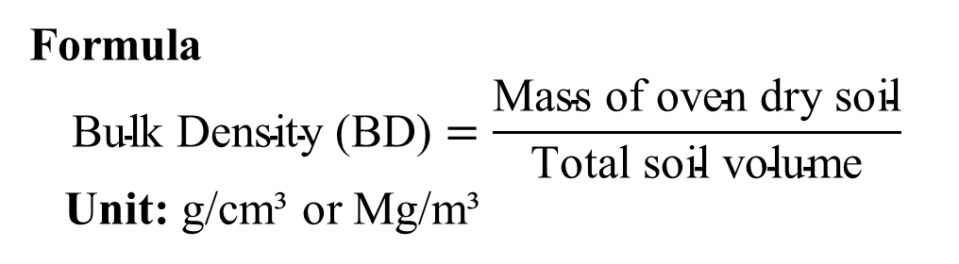
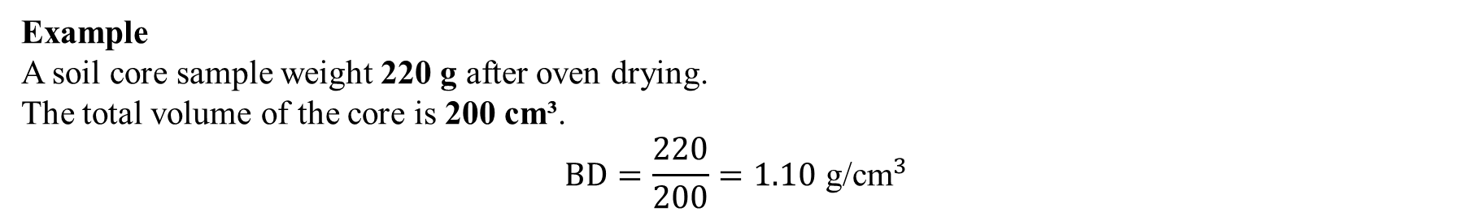
Bulk Density
Bulk Density is the mass of oven-dry soil per unit total volume, including both solids and pore spaces. It indicates soil compaction and affects root growth, aeration and water movement.
Formula
$$\text{Bulk} \text{Density}\text{ (}\text{BD}\text{)}=\frac{\text{Mass} \text{of} \text{oven} \text{dry} \text{soil}}{\text{Total} \text{soil} \text{volume}}$$
Unit: g/cm³ or Mg/m³
Example
A soil core sample weight 220 g after oven drying.
The total volume of the core is 200 cm³.
$$BD=\frac{220}{200}=1.10 {\text{g}\text{/}\text{cm}}^{3}$$

Slide 93
Importance of Bulk Density in Crop Production-
High BD → compact soil → poor aeration, slow root growth
Low BD → loose soil → good aeration and infiltration
Determines root penetration capacity
Influences water retention and drainage
Helps identify soil degradation or compaction due to machinery
Essential for irrigation and tillage planning
Ideal BD values:
Sandy soils: 1.4–1.7 g/cm³
Clay soils: 1.1–1.4 g/cm³

Slide 94
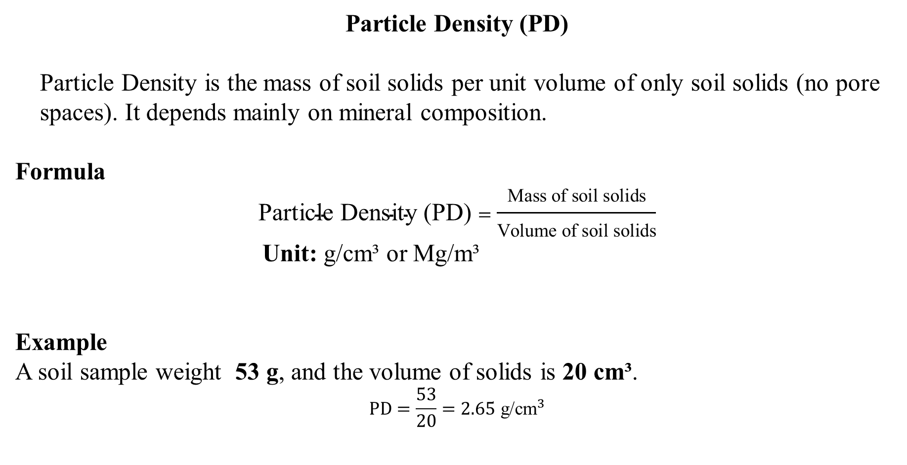
Particle Density (PD)
Particle Density is the mass of soil solids per unit volume of only soil solids (no pore
spaces). It depends mainly on mineral composition.
Formula
$$\text{Particle} \text{Density}\text{ (}\text{PD}\text{)}=\frac{\text{Mass} \text{of} \text{soil} \text{solids}}{\text{Volume} \text{of} \text{soil} \text{solids}}$$
Unit: g/cm³ or Mg/m³
Example
A soil sample weight 53 g, and the volume of solids is 20 cm³.
$$PD=\frac{53}{20}=2.65 {\text{g}\text{/}\text{cm}}^{3}$$

Slide 95
Importance of Particle Density in Crop Production
Needed to calculate soil porosity
Helps understand soil mineralogy (quartz, Fe-oxides, OM)
Helps estimate total pore space in soil
Important for soil physical studies

Slide 96

Porosity
Porosity is the percentage of total soil volume occupied by pore spaces (air + water).It
controls water storage, aeration, infiltration, and root health.
Formula
Example
Given:
BD = 1.3 g/cm³
PD = 2.65 g/cm³
$$\text{Porosity}=\left(\frac{2.65−1.3}{2.65}\right)×100$$
$$=\frac{1.35}{2.65}×100=50.9\%$$
Porosity (%)=(1−BD/PD​)×100

Slide 97
Importance of Porosity in Crop Production
Determines water-holding capacity
Controls aeration (O₂ supply to roots)
Influences microbial activity and nutrient cycling
Affects drainage and waterlogging
Important for seedling emergence
Helps assess compaction, tillage, and irrigation needs
Typical porosity:
Sandy soil: 35–45%
Clay soil: 45–60%

Slide 98
Soil Colour
DEFINITION
Soil colour refers to the visual appearance of soil as perceived by the human eye.
It is an important physical property that indicates organic matter content, drainage condition, soil mineralogy, degree of weathering, and aeration status.
Soil colour is scientifically measured using the Munsell Colour System (Hue, Value, Chroma).

Slide 99
IMPORTANCE OF SOIL COLOUR
Indicator of organic matter and soil fertility
Reflects drainage condition (red = good; grey = poor)
Helps in soil classification
Used for identifying soil horizons
Provides hints on aeration and waterlogging
Helps in land management decisions

Slide 100
COMPONENTS OF THE MUNSELL COLOUR CHART
The Munsell Colour System describes soil colour using three components:
1. Hue (H) – Dominant Wavelength / Basic Colour
Represents the main colour family of the soil.
Indicates the presence of different minerals (especially iron compounds).
Recorded as symbols like:
10R, 2.5YR, 5YR, 7.5YR, 10YR, 2.5Y, 5Y etc.
Examples:
10YR = yellowish-brown soils
5R = reddish soils
5Y = yellow soils

Slide 101
2. Value (V) – Lightness or Darkness
Indicates how light or dark the colour is.
Scale ranges from 0 (pure black) to 10 (pure white).
Affects the “brightness” of soil colour.
Example:
Value 2 = very dark
Value 8 = very light

Slide 102
3. Chroma (C) – Strength or Purity of Colour
Measures the intensity or saturation of the colour.
Scale starts from 0 (neutral grey) and increases outward.
Example:
Chroma 2 = dull subtle colour
Chroma 8 = strong bright colour

Slide 103
A soil colour written as:
10YR 5/4
Means:
Hue = 10YR
Value = 5
Chroma = 4

Slide 104
Soil Consistency
1. Definition
Soil consistency refers to the degree of cohesion and adhesion of soil particles and the resistance of soil to deformation or rupture under applied forces such as pressure, pulling, or manipulation.

Slide 105
Form of Soil Consistency
Hard or harsh consistency- Observed in dry soil
Soft and friable consistency- Observed in moist soil
Plastic consistency- Observed in wet soil
Sticky consistency- Observed in very wet soil
Viscous consistency- Observed in saturated soil

Slide 106
S. No. | Form of Soil Consistency | pF Value
1. | Hard or harsh consistency | >4.5
2. | Soft and friable consistency | 4.5-2.8
3. | Plastic consistency | 2.8-0.5
4. | Sticky consistency | 0.5-0
5. | Viscous consistency | 0

Slide 107
Importance of Soil Consistency
1. Determines Tillage Operations
Soil consistency indicates whether the soil is too hard, too soft, or workable for ploughing and
seedbed preparation.
Friable soil consistency is ideal for tillage.
Prevents excessive tillage, which can destroy soil structure.
2. Influences Root Penetration and Plant Growth
Hard or compact soil restricts root elongation and reduces nutrient uptake.
Soft or friable soils promote better root expansion and aeration.

Slide 108
3. Affects Water Movement & Retention
Sticky or plastic soils (high clay) hold more water but may have slow infiltration.
Loose and non-sticky soils drain quickly and reduce waterlogging risk.
4. Helps in Soil Classification and Identification
Soil consistency is used in field soil surveys to classify soils into:
  Hard
  Soft/friable
  Plastic
  Sticky
  Cohesive
Important for mapping and understanding soil behavior.

Slide 109
5. Important for Construction & Engineering
Determines soil’s bearing capacity and stability for foundations, embankments, and roads.
Highly plastic and sticky soils shrink and swell, causing structural damage.
6. Assists in Irrigation and Drainage Planning
Sticky or plastic soils need controlled irrigation to avoid waterlogging.
Loose soils require frequent irrigation due to high infiltration.

Slide 110
7. Indicates Soil Moisture Status
Consistency changes with moisture:
  Wet soil → sticky or plastic
  Moist soil → friable
  Dry soil → hard or harsh
Helps farmers judge when to irrigate or allow soil to dry.
8. Supports Soil Conservation Practices
Hard or compact soils have higher runoff → soil erosion increases.
Friable soils allow better infiltration and reduce erosion losses.

Slide 111
9. Related to pF (moisture tension) Values
Soil consistency correlates with soil moisture tension:
pF 2.8-0.5: Wet soil → plastic
pF 4.5-2.8: Moist soil → friable
pF > 4.5: Dry soil → hard/harsh
This helps understand moisture levels and soil consistency together.
10. Useful for Seedling Emergence
Hard crust formation (in dry conditions) affects seed emergence.
Friable soils provide easy emergence and better germination.

Slide 112
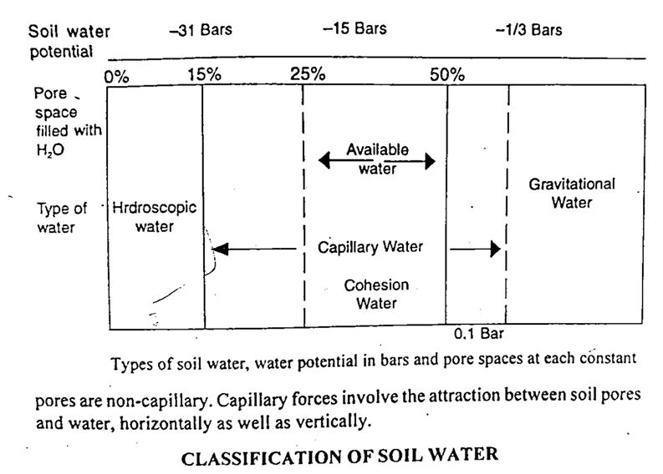
Soil Water

Slide 113
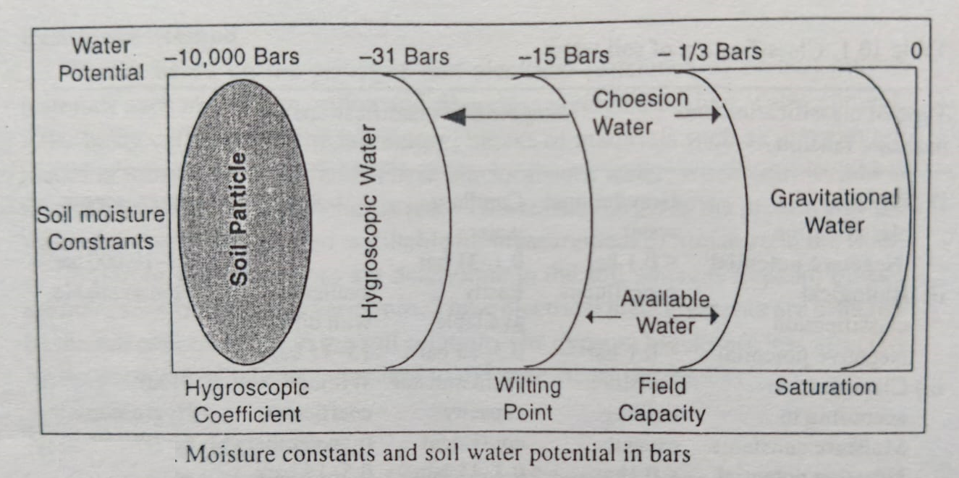

Slide 114
CLASSIFICATION OF SOIL WATER
Physical Classification
Gravitational water-
Water in excess in field capacity is termed as gravitational water .
That is held at a potential greater than -1/3 bar or -0.33 bar (Fine texture) or -1/10 bar or -0.1 bar (Coarse texture)
At saturation, will drain from larger pores within 24 to 48 hours in well drained soils.
This water is not held in the soil but drain under the influence of gravity.
This water is limited use to plants because it is present in the soil for a short time and it occupies the larger pores thereby reducing soil aeration.
The removal of gravitational water from the soil is usually requires for optimum plant growth.

Slide 115
(2) Capillary water- Capillary water is held in the micropores of soils (capillary pores). Capillary water may be defined as the water that is retained in the soil between the water potential of -1/3 bar or -1/10 (Field capacity) to -31 bar (Hygroscopic coefficient). Part of the capillary water, suction value is less than -15 bar (wilting coefficient) is used by plant.
(3) Hygroscopic water- Hygroscopic water is defined as the water that is held by the soil particles at a suction of more than -31 bar (Hygroscopic coefficient). It moves primarily in the vapour form. This water is held so tenaciously that plants are not able to absorb it and thereby unavailable to plants. Some micro-organisms can utilize such form of water.

Slide 116
B. Biological Classification
Super available water- The fraction of soil water held between 0 bar suction (saturated condition or maximum water holding capacity) and -0.1 or -0.33 bar suction (field capacity). This water is held in macropores and rapidly lost by drainage. Such type of water is unavailable to plants and rather presence of such water in the soil for a long period causes harmful effect for plant growth because of lack of air.
Available water- Available water is defined as that portion of water which is retained in the soil between field capacity (-1/3 bar) and the permanent wilting point or wilting coefficients (-15 bars). This water is easily usable by plants and therefore, it is called plant available water.
(iii) Un-available water- Unavailable water is defined as the water which is held at soil water potential
greater than -15 bar (wilting coefficient). It is unavailable to plants.

Slide 117
SOIL MOISTURE CONSTANTS
Oven dry: Oven dry weight is the basis for all soil moisture calculations. The equilibrium tension of the moisture at oven dryness is -10,000 atmospheres or bar (-10,000 bar of soil moisture potential). It is determined by placing the soil in an oven at 105°C until it loses no more water.
Air dry: Air dry weight is a somewhat variable term, mainly because the moisture in the air fluctuates. Moisture at air dryness is held with a force of -1,000 atmospheres or bar (-1,000 bar of soil-moisture potential). This water is not available to plants.
Hygroscopic co-efficient- The soil moisture tension at this point is equal to -31 bar (soil moisture potential -31 bar) and this water is not available to plants, but available to certain micro-organisms.

Slide 118
Wilting Coefficient- Sometimes it is also used as permanent wilting point. The wilting point is defined as that amount of water which is held with water potential less than -15 bar and it is held so strongly that plants are not able to absorb it for their needs. At this point of soil-moisture potential, the plants begin to wilt and at the very beginning of the wilting condition is sometimes recovered with the addition of water and it is then called temporarily wilting point, while such wilting condition of the plant is not recovered with the addition of water and then it is called permanent wilting point. Both the wilting points indicate low moisture availability to plants.
Field capacity- Field capacity is defined as the capacity of a soil to retain moisture against the downward pull of the force of gravity and moisture is held with soil water potential less than -1/3 bar. It is used to determine the amount of irrigation water needed and the amount of reserve soil water available to plants.

Slide 119
SOIL WATER POTENTIAL
Ability of water to move in soil
More water in soil = More water potential
Measure of the energy status of the soil water
Unit of measure are normally bar or atmosphere
Soil water potential are negative pressure(tension/suction)
Water flow from a higher (less negative) potential to a lower (more negative) potential

Slide 120
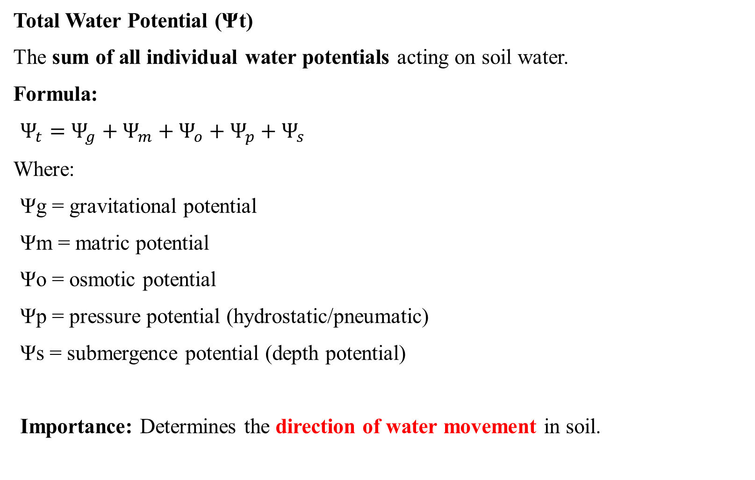
Total Water Potential (Ψt)
The sum of all individual water potentials acting on soil water.
Formula:
$Ψ_{t}=Ψ_{g}+Ψ_{m}+Ψ_{o}+Ψ_{p}+Ψ_{s}$
Where:
Ψg = gravitational potential
Ψm = matric potential
Ψo = osmotic potential
Ψp = pressure potential (hydrostatic/pneumatic)
Ψs = submergence potential (depth potential)
Importance: Determines the direction of water movement in soil.

Slide 121
1. Gravitational Potential (Ψg)
Potential energy due to gravity
Force of gravity pulling on the water
Positive
2. Matric Potential (Ψm)
Force placed on the water by the soil matrix
The value of matric potential decrease with increase in water content
Negative
Saturated soil (Ψm) = 0
Unsaturated soil (Ψm) = -ve

Slide 122
3. Osmotic Potential (Ψo) or Solute potential
Special case of salty soils
Due to the difference in salt concentration across a semi permeable membrane, such
as a plant root
Negative
Increase in concentration decrease
In pure water Ψo = 0
4. Pressure Potential (Ψp)
In saturated soil, the Pressure Potential is always +ve
Unsaturated soil, the Pressure Potential is always zero

Slide 123
5. Submergence Potential (Ψs)
the energy exerted by the depth of water over the soil, and it increases with
increasing water height
It is positive in value
Found in flooded soils, paddy fields, and submerged conditions

Slide 124
pF
pF is a logarithmic measure of soil water suction (tension).
pF = log₁₀(h)
where h is the soil water suction (negative pressure or tension) in centimeters (cm) of water column.
Higher pF → water held more tightly → plants cannot absorb easily

Slide 125
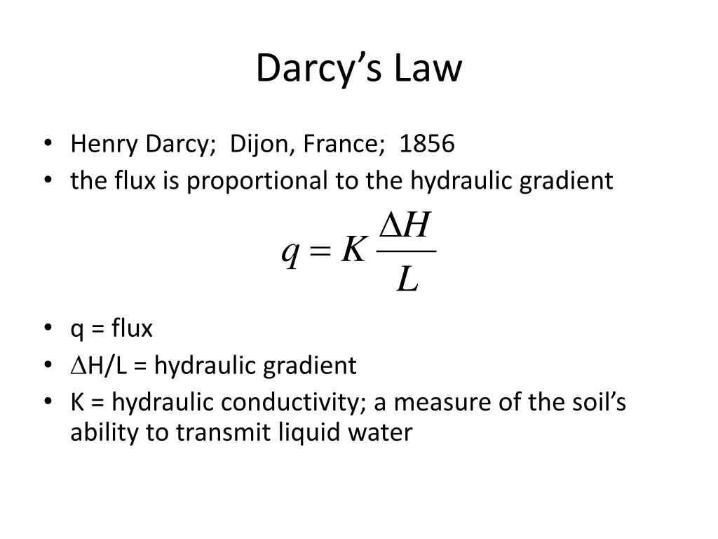
Darcy’s Law
Hydraulic Head (H): Hydraulic head is the total energy of water at a point in soil

Slide 126
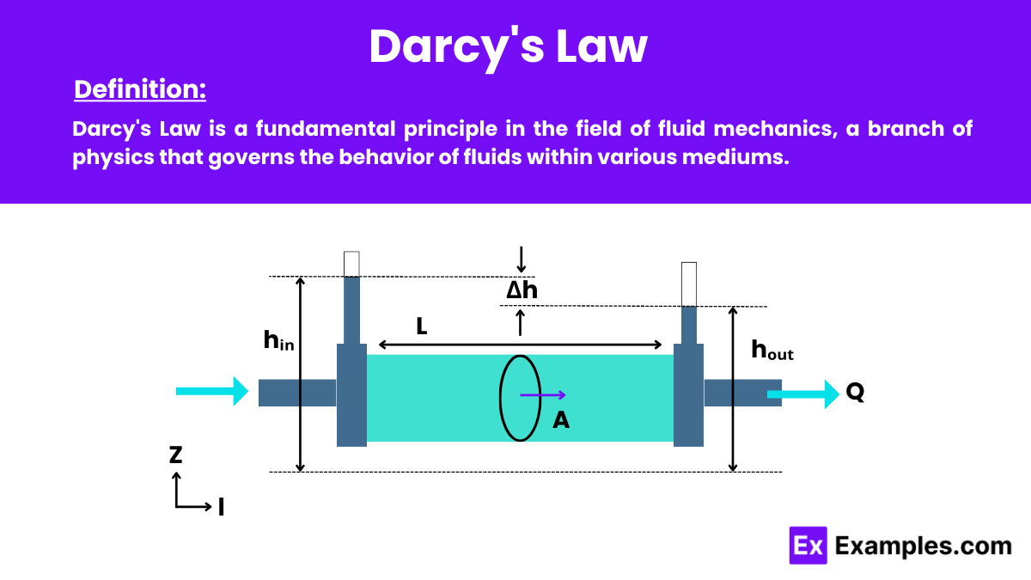

Slide 127
Factors Affecting Soil Water in Agriculture
1. Soil Texture Proportion of sand, silt, and clay controls pore size.
Sandy soils → large pores, low water-holding capacity, rapid drainage.
Clayey soils → small pores, high water-holding capacity but slow drainage.
2. Soil Structure
The arrangement of soil particles into aggregates.
Granular & crumb structures hold water well.
Platy or massive structures restrict infiltration and water movement.
3. Soil Organic Matter (SOM)
Acts like a sponge; improves water retention.
Increases porosity and improves soil aggregation.
4. Soil Depth
Deeper soils store more water; shallow soils have limited storage capacity.
5. Soil Density & Compaction
High bulk density reduces pore space → lower infiltration and storage.
Compacted soils limit root water uptake.

Slide 128
6. Infiltration Rate
Affected by surface conditions, crusting, slope, texture.
Higher infiltration means more water enters the soil instead of running off.
7. Evaporation and Temperature
High temperature increases evaporation losses from soil surface.
Mulching and cover crops reduce moisture loss.
8. Vegetation & Rooting Pattern
Dense vegetation increases water uptake.
Deep-rooted crops (e.g., sugarcane, alfalfa) can use deeper soil water.
9. Rainfall Characteristics
Amount, intensity, duration, and distribution of rainfall affect soil moisture availability.
10. Tillage Practices
Excessive tillage breaks soil aggregates, reduces organic matter → poor water retention.
Conservation tillage improves infiltration and reduces evaporation.

Slide 129
Importance of Soil Water in Agriculture
1. Essential for Plant Growth
Required for photosynthesis, respiration, and metabolic activities.
2. Medium for Nutrient Transport
Water dissolves nutrients and transports them from soil to roots.
Facilitates mass flow, diffusion, and root interception.
3. Maintains Cell Turgor Pressure
Turgidity keeps the plant upright.
Prevents wilting and supports leaf expansion.
4. Regulates Soil Temperature
Moist soils have lower temperature fluctuations.
Protects roots against extreme heat.
5. Influences Seed Germination
Seeds need adequate moisture to initiate metabolic processes.
Dry soils delay or reduce germination rates.

Slide 130
6. Supports Microbial Activity
Microorganisms responsible for nutrient cycling (N, P, S) need moisture to survive.
Adequate soil water improves fertility.
7. Determines Irrigation Scheduling
Knowing soil water capacity helps plan irrigation frequency and quantity.
Prevents over- or under-irrigation.
8. Affects Soil Structure and Tilth
Optimal moisture facilitates tillage and root penetration.
Too much water = waterlogging
Too little = hard, compact dry soil
9. Influences Crop Yield
Soil water availability directly impacts photosynthesis and nutrient uptake.
Proper moisture management results in higher productivity.

Slide 131
Soil Temperature
SOURCES OF SOIL TEMPERATURE (HEAT SOURCES)
(a) Solar Radiation – Primary Source
Sunlight is the main source of soil heat.
(b) Atmospheric Temperature
Heat exchange occurs between air and soil through conduction and convection.
(c) Heat from Biological Activity
Decomposition of organic matter by microbes releases heat (important in compost pits).
(d) Heat from Rain and Irrigation Water
Warm water increases soil temperature; cold water reduces it.
(e) Geothermal Heat
Heat from Earth's interior, though very small, affects deep soil layers.

Slide 132
FLOW OF HEAT IN SOIL (HEAT TRANSFER PROCESSES)
(a) Conduction
Main method of heat transfer in soil.
Heat moves from warmer layer → cooler layer.
Depends on soil composition:
  High in sand (good conductor)
  Low in clay and organic matter (poor conductor)
(b) Convection
Movement of heat through soil water and air.
Occurs when warm water/air moves through pores.
(c) Radiation
Soil surface loses heat by long-wave radiation at night, causing cooling.

Slide 133
EFFECT OF SOIL TEMPERATURE ON PLANT GROWTH
1. Effect on Seed Germination
Each crop has an optimum temperature range for germination.
Low temperature → slow or delayed germination, poor emergence.
High temperature → rapid germination but may reduce seedling vigor.
Very high temperature can kill embryos or cause thermal dormancy.
Examples:
Wheat: 20–25°C
Maize: 25–30°C
Soybean: 20–30°C

Slide 134
2. Effect on Root Growth
Roots are highly sensitive to soil temperature.
Optimum temperature increases root elongation and branching.
Cold soil slows root growth → poor water and nutrient uptake.
Hot soil (>35°C) damages root tips and reduces root respiration.
3. Effect on Nutrient Availability
Soil temperature affects mineralization, nitrification, and microbial activity.
Low temperature reduces microbial activity → low nitrogen availability.
Warm temperature increases nutrient release.
Very high temperature decreases microbial population → reduced nutrient cycling.

Slide 135
4. Effect on Water Absorption
Cold soil reduces water absorption due to slower root metabolism.
Warm soil improves uptake until the temperature reaches harmful levels.
5. Effect on Physiology of Plants
Soil temperature affects:
  Root respiration
  Enzyme activities
  Hormone balance
  Rate of photosynthesis (indirectly through root function)
Cold soil → reduced leaf growth and photosynthesis
Hot soil → reduced root respiration, leaf wilting

Slide 136
6. Effect on Soil Biological Activity
Soil organisms like bacteria, fungi, earthworms grow better in warm temperatures.
Cold soil reduces decomposition and nutrient recycling.
Excessive heat kills beneficial microbes.

Slide 137
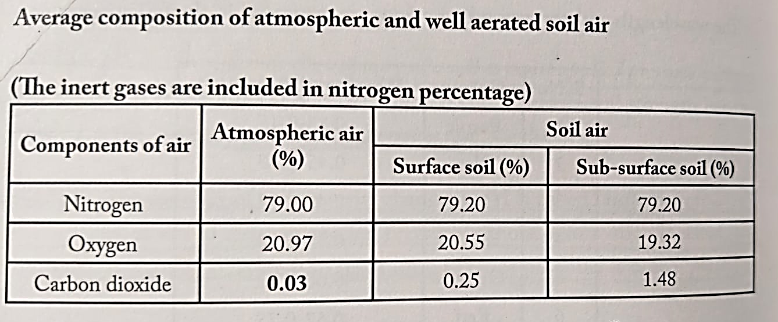
Soil Air

Slide 138
1. Mass Flow (Convective Flow)
Definition:
Movement of gases in soil along with the bulk movement of air or water due to a pressure difference.
Characteristics
Driven by pressure gradient.
Fast movement but minor contribution (10–15%) to total gas exchange.
Moves gases together (bulk flow), not individually.
Examples :
When wind blows over the soil surface → creates pressure difference → air moves
into soil pores.
During rainfall → water enters pores → pushes air outward (displacement).
Root respiration also changes pressure → causes air movement.

Slide 139
2. Diffusion
Definition:
Movement of gas molecules from an area of higher concentration (or partial pressure) to an area of lower concentration.
Characteristics
Major process (80–90% of soil gaseous exchange).
Moves each gas according to its own concentration gradient.
Slow in wet soils because water blocks pores.
Example
Roots and microbes consume O₂, decreasing its concentration → outside O₂ diffuses in.
Roots produce CO₂, increasing its concentration → CO₂ diffuses out.

Slide 140
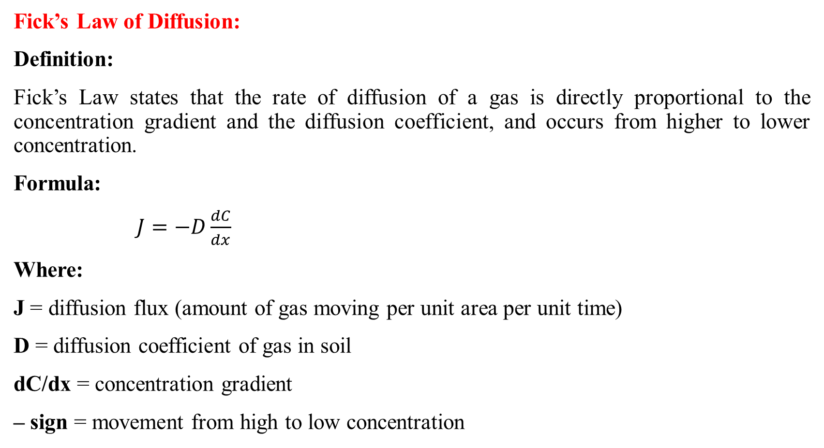
Fick’s Law of Diffusion:
Definition:
Fick’s Law states that the rate of diffusion of a gas is directly proportional to the concentration gradient and the diffusion coefficient, and occurs from higher to lower concentration.
Formula:
$J=−D\frac{dC}{dx}$
Where:
J = diffusion flux (amount of gas moving per unit area per unit time)
D = diffusion coefficient of gas in soil
dC/dx = concentration gradient
– sign = movement from high to low concentration

Slide 141
IMPORTANCE OF SOIL AIR IN PLANT GROWTH:
1. Provides oxygen for root respiration
Roots need oxygen (O₂) to respire.
Respiration releases energy for root growth, nutrient uptake, and water
absorption.
Lack of oxygen → root suffocation → stunted plant growth.
2. Helps in Water and Nutrient Absorption
Root respiration produces energy (ATP), which is required for:
  Active absorption of minerals (N, P, K, Ca, Mg).
  Water uptake through root cells.
Poor aeration → low energy → nutrient deficiency symptoms.

Slide 142
3. Supports Soil Microorganisms
Beneficial microbes (bacteria, fungi) also need oxygen.
Good aeration enhances:
  Nitrification
  Organic matter decomposition
  Humus formation
  Release of plant-available nutrients
4. Reduces Toxic Gas Accumulation
Well-aerated soils allow CO₂, methane, and other toxic gases to escape.
Poor aeration causes gas buildup → root toxicity and reduced growth.

Slide 143
5. Promotes Healthy Root Development
Roots grow deeper and spread better in aerated soil.
6. Improves Soil Structure
Aeration helps:
  Aggregation
  Porosity
  Balance between air and water
This results in better drainage and root penetration.

